Slide 1
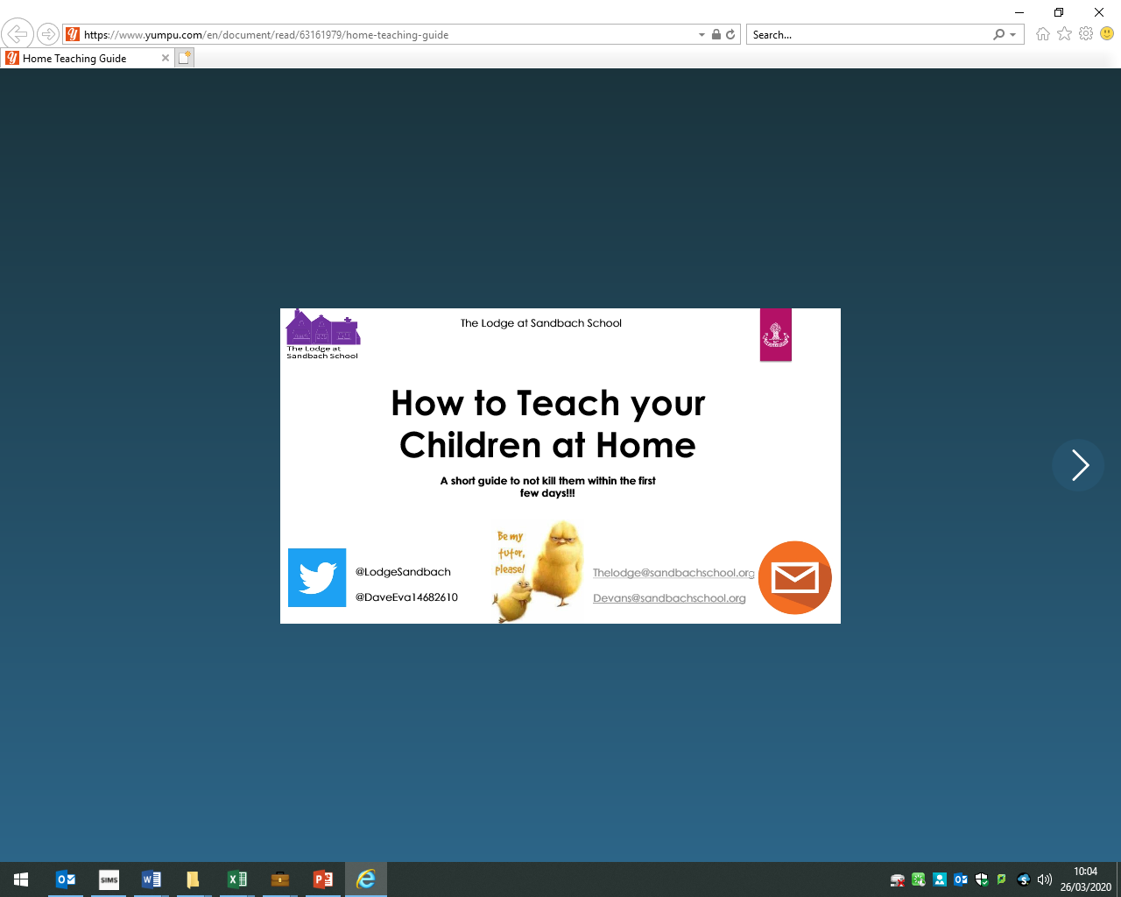

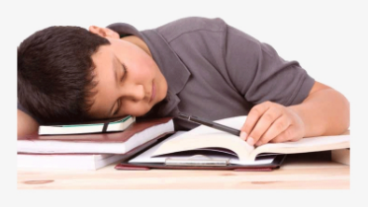
Poynton High School would like to thank Sandbach School for creating this resource
which we have adapted for our school community.
How to Teach your
Children at Home
A short guide to how not to kill them within the first few days!

Slide 2
How to make Home Learning as successful as possible.
The 4 ‘S’ to Home Learning
Structure
Sales
person
Support
Share & De-stress

Slide 3
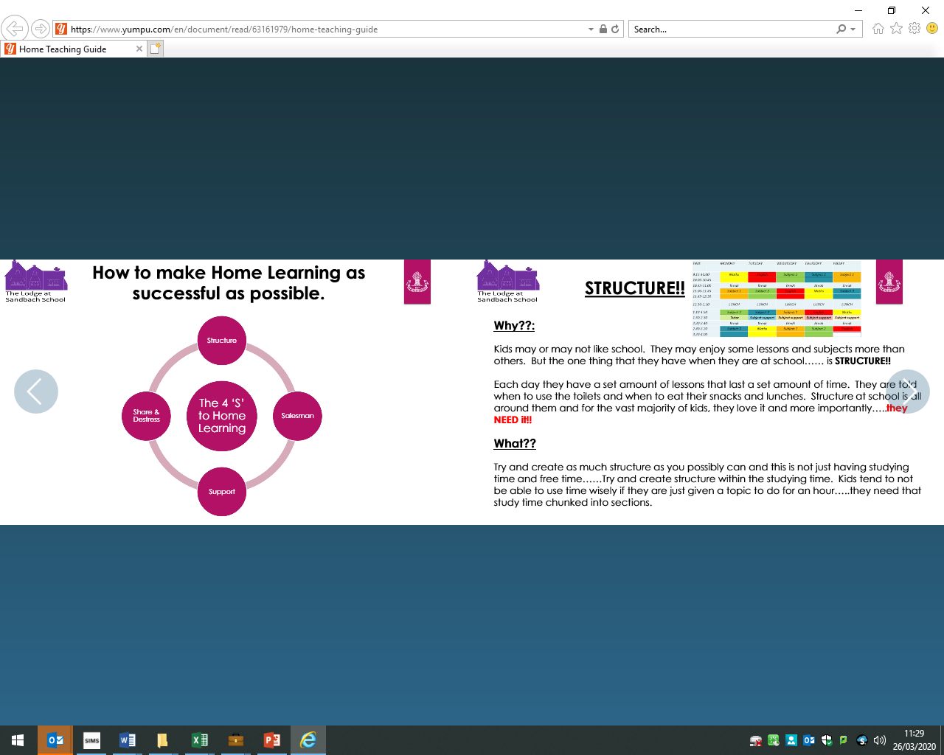
STRUCTURE!
Why?
Children may or may not like school. They may enjoy some lessons and subjects more than others. But the one that they have when they are at school is STRUCTURE.
Each day they have a set number of lessons that last a set amount of time. They are told when to take a break. Structure at school is all around them and for the vast majority of children they love it and more importantly they NEED IT.
What?
Try to create as much structure as you possibly can and this is not just setting studying and free time. Try to create structure within the studying time. Children tend to not be able to use time wisely if they are just given a topic to do for an hour. They need that study time chunked into sections.

Slide 4
How?
Timetable – Create this together with your child/children so they feel part of the process and therefore will be more likely to stick to it. They may want to follow their normal school timetable as a start.
Dress for work – This obviously doesn’t have to be a uniform but make sure they are not in their PJs. Get them to shower and dress as they would if they were going outside.
Chunking – Whatever the subject is, try to have at least 3 different tasks with timings to prevent boredom and ensure they remain focussed.
Timed breaks – Remember when they are at school they have time between lessons and time to go outside and run around. Include these in your daily routine.
Location – Create a learning space in the house so that they know that when they are in that space, they are there to learn. Not having a structured location to work in creates blurred lines and in turn results in a lack of work or respect for the system you have implemented. Ideally this would be at the dining or kitchen table rather than their bedroom.
Rules – Try to stick to the school’s policies, e.g., no phones, no eating, etc. when they are meant to be working. Distractions will lead to conflict between you. Have a designated space where electronic devices are kept during learning time but allow them for social times.

Slide 5
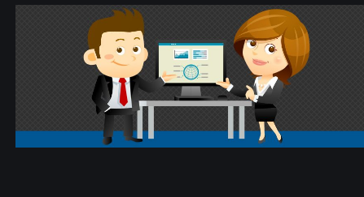
SALESPERSON
Why?
As teachers, one of the challenges we face every day is trying to engage children that may not like the topic or subject that we are teaching. It is our job to try and change that and make them enjoy that subject just as much as we do. In order to do this, we have to try and put on the act and SELL THE SUBJECT to them. Now it is over to you!
How?
Be enthusiastic – With each subject or topic. Make them feel like there is a reason for doing this work and not just because you have to.
Bigger picture – Where does learning this topic fit into life? What skills are they gaining from these tasks? Where does it fit into the bigger picture? Make sure you can answer them.
Spot them being good – If they are working quietly, make sure you praise them. Don’t just highlight when they are off task. Build confidence by praising every chance you get.

Slide 6
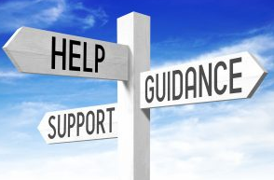
Support
Why?
Just because your child/ children are not in front of teachers at school, does not mean to say you cannot stay in contact with your child’s teachers.
WE ARE STILL HERE TO HELP. USE US!
How?
Work is being set on Doddle for students. If you have any questions about this, please contact the school.
Who to contact?
Contact school in the normal way through info@phs.cheshire.sch.uk or through the Year Teams.

Slide 7
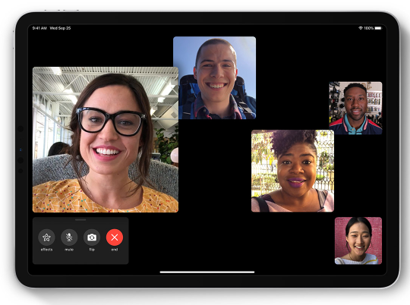
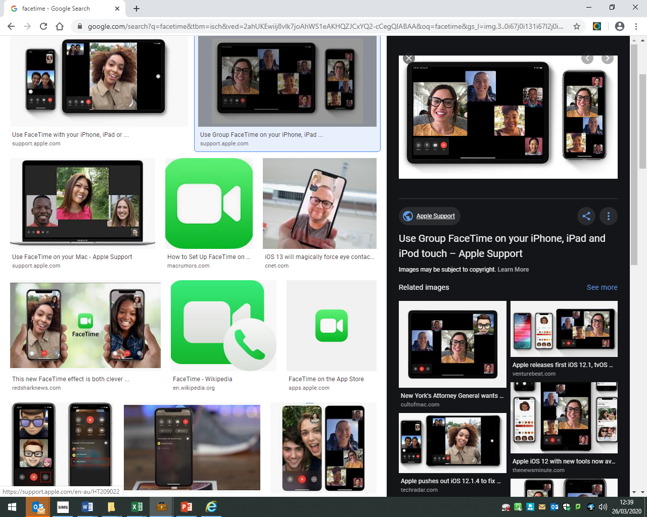
Share and De-stress
Why?
We are in completely uncharted territory. You will some great days and you will have some days where you are just banging your head against a wall! All you can do is to keep calm and to try and keep yourself sane. You are no good to anyone if you are stressed and snappy!
How?
Photos – Show your children photos of their friends working so that they know that it isn’t just them having to do school work.
Ideas – If something is working well for you, then tell your friends. Likewise, tell them what hasn’t worked.
Talk – Make sure you speak to people outside of your home about your stresses and frustrations. We know how stressful teaching can be and it is SO IMPORTANT that you get things off your chest for your own wellbeing.

Slide 8
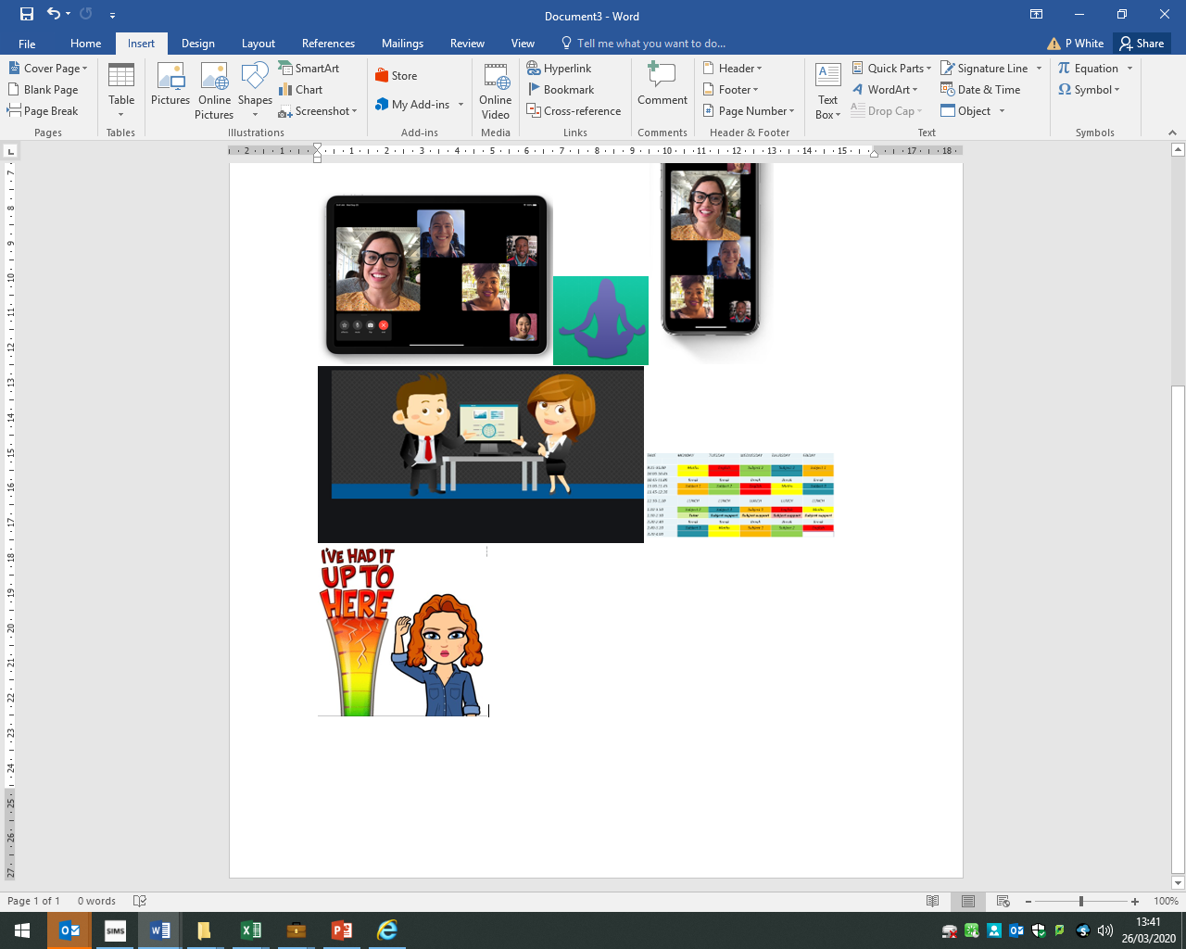
And Finally…
Don’t put pressure on yourselves
We are in completely uncharted territory. All we can do is to try our best; it won’t be perfect so don’t put unnecessary pressure on yourself to deliver a perfect curriculum with limited resources and restricted space.
Stick to your strengths
If you are a good cook, show your then how to cook a few meals. If you are good with numbers, make maths an area you spend more time on. Whatever you are good at, make them part of that and teach them skills you already have.
ENJOY SPENDING TIME WITH YOUR CHILDREN
We know how fast our children grow up. Soon they will be adults and living a completely separate life. This is a chance to really have some quality time so when we get through this difficult time, you can look back at some fond memories as well!

Slide 9
Good Luck
&
Stay In Touch

