Slide 1
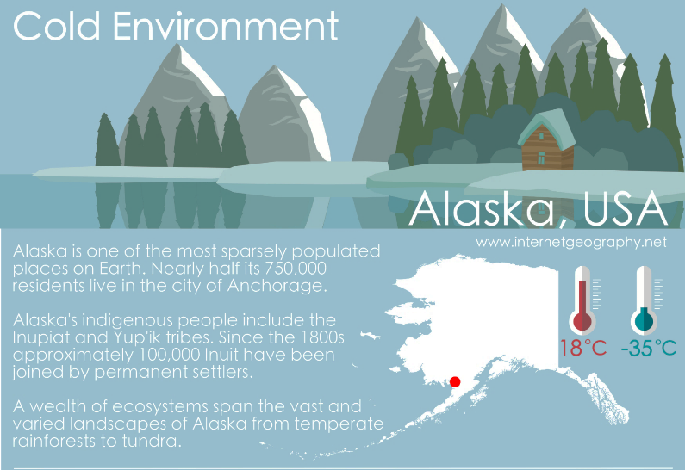
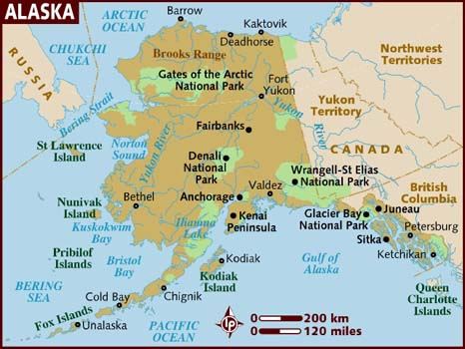
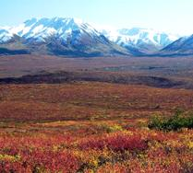
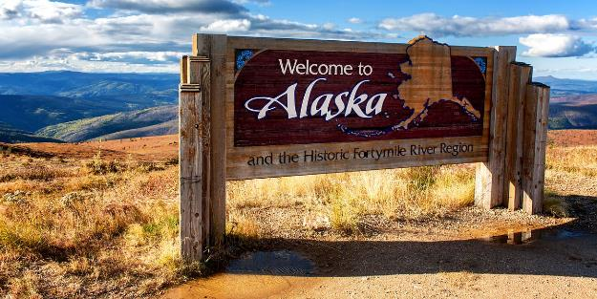
This is the link to the AQA A level specification in the glaciation topic that we do first in year 12..
Human impacts on cold environments
Concept of environmental fragility.
Human impacts on fragile cold environments over time and at a variety of scales.
Recent and prospective impact of climate change.
Management of cold environments at present and in alternative possible futures.
https://www.youtube.com/watch?v=ZvgPTipdvE8 Introducing Alaska – watch the 2.40 minute clip and write down 5 reasons that people might choose to visit or live in Alaska.

Slide 2
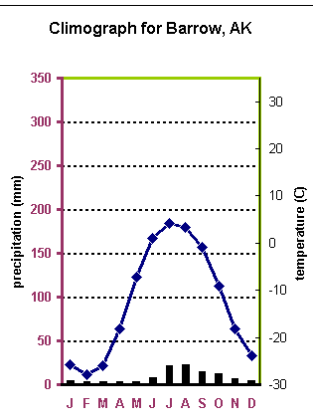
Graph interpretation:
What is the highest temperature Barrow achieves and in which month?
Why is there so little rainfall (clue temperature!)
What is the range in the temperature?
https://www.youtube.com/watch?v=MP1OAm7Pzps Watch the 9 minute clip and answer this question…. Why do people live in Barrow, Alaska?!

Slide 3
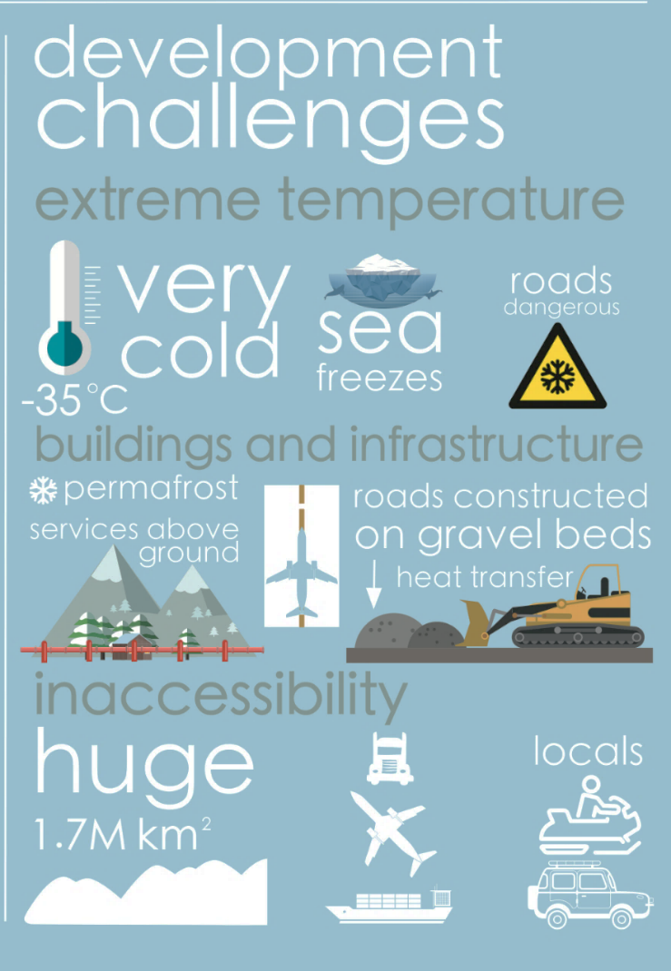
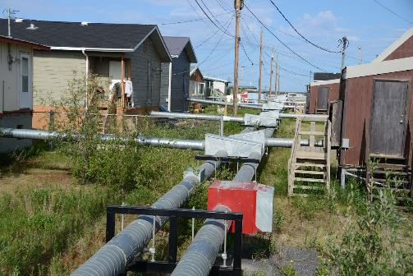
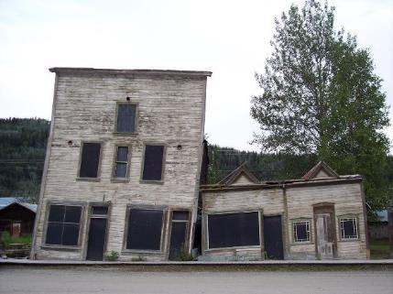
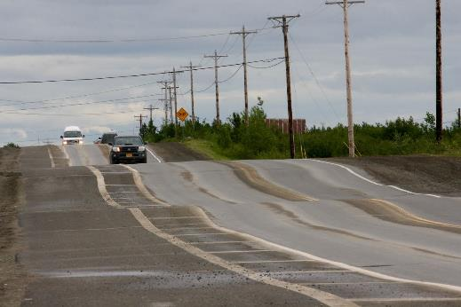
Look at the infographic here and think..
What challenges face the people that live in Alaska?
Permafrost is permanently frozen ground where soil temperatures have remained below 0 °C for at least 2 years.
It develops because of the cold temperatures but the surface layer does melt in the summer. This layer is known as the Active Layer.
This poses big challenges in the summer for developing the Tundra because this layer can be very mobile.
This moving soil layer can make buildings sink and subside, roads to crack and even make trees topple and fall.
Roads affected by melting permafrost.

Slide 4
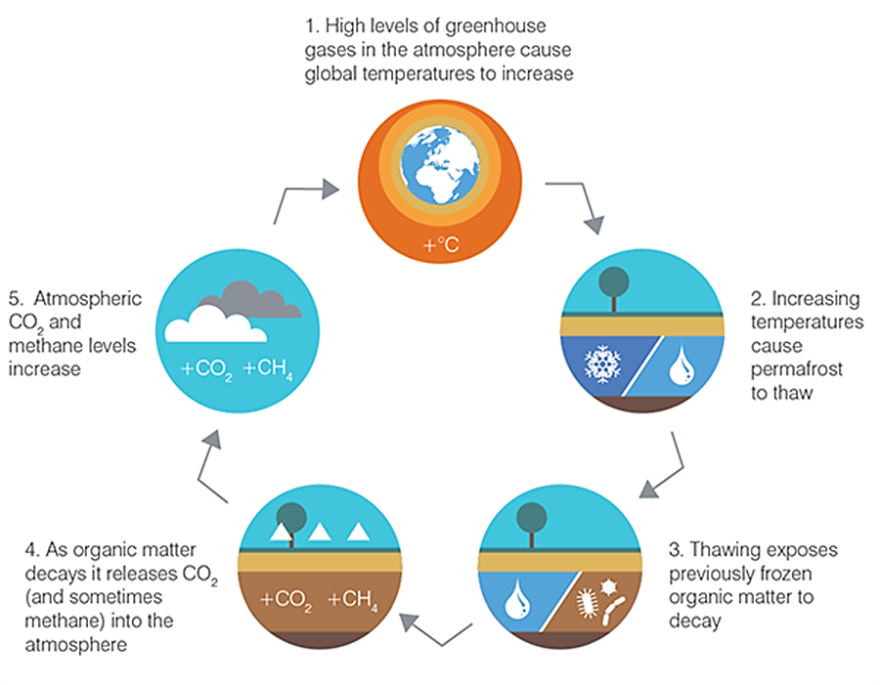
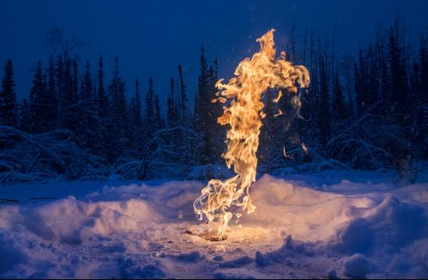
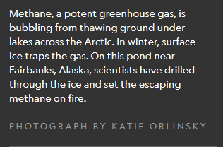
A positive feedback loop is where one action causes an impact that leads to something else increasing…
As permafrost thaws, this carbon is released to the atmosphere in the form of methane, a powerful greenhouse gas.
This process leads to more climate change and is an example of a positive feedback loop, which happens when warming causes changes that lead to even more warming.
https://video.nationalgeographic.com/video/news/00000156-d81b-dbd5-add6-dbfb22fd0000 Watch the clip : What else does Alaska have to worry about?
Look at the feedback loop above – why is the amount of CO2 in our atmosphere increasing?

Slide 5
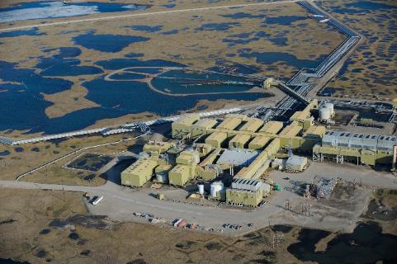
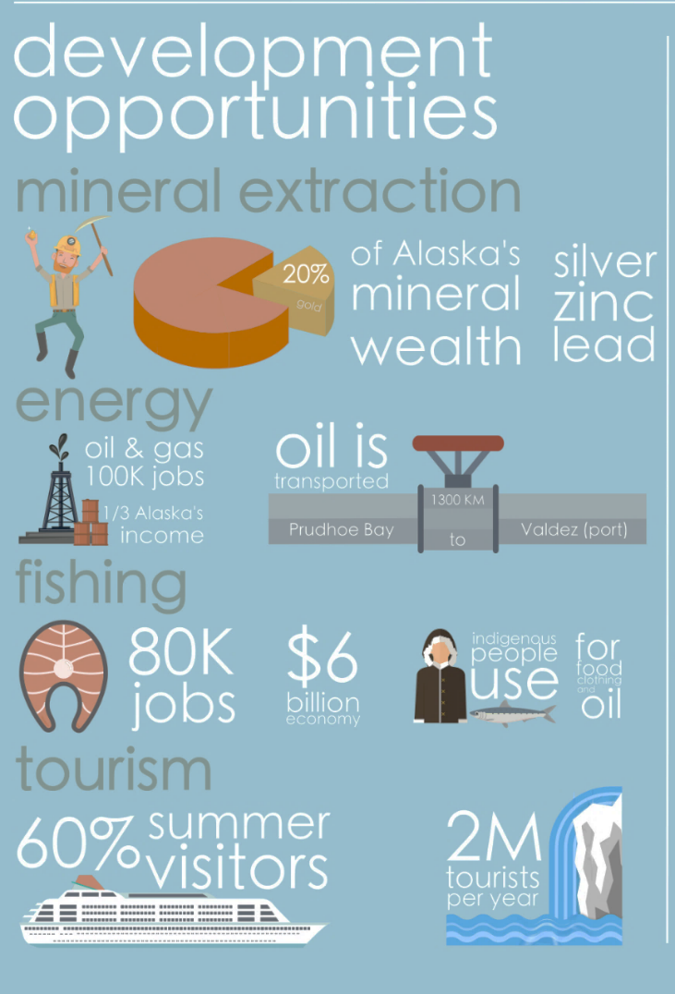
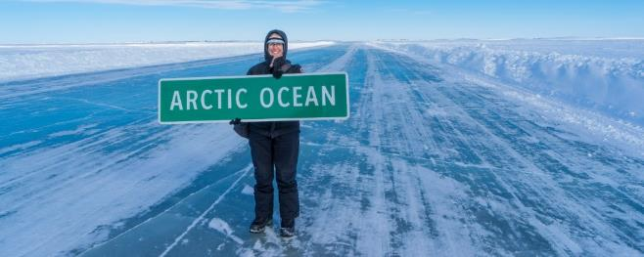
Look at the infographic here and think..
What opportunities are there for the people that live in Alaska?
Prudhoe Bay : Oil field.- nearest town is Deadhorse.
Population: 2,174 with several thousands of seasonal oil workers
https://www.youtube.com/watch?time_continue=7&v=VN68CNJhLTk&feature=emb_logo Ice road truckers

Slide 6
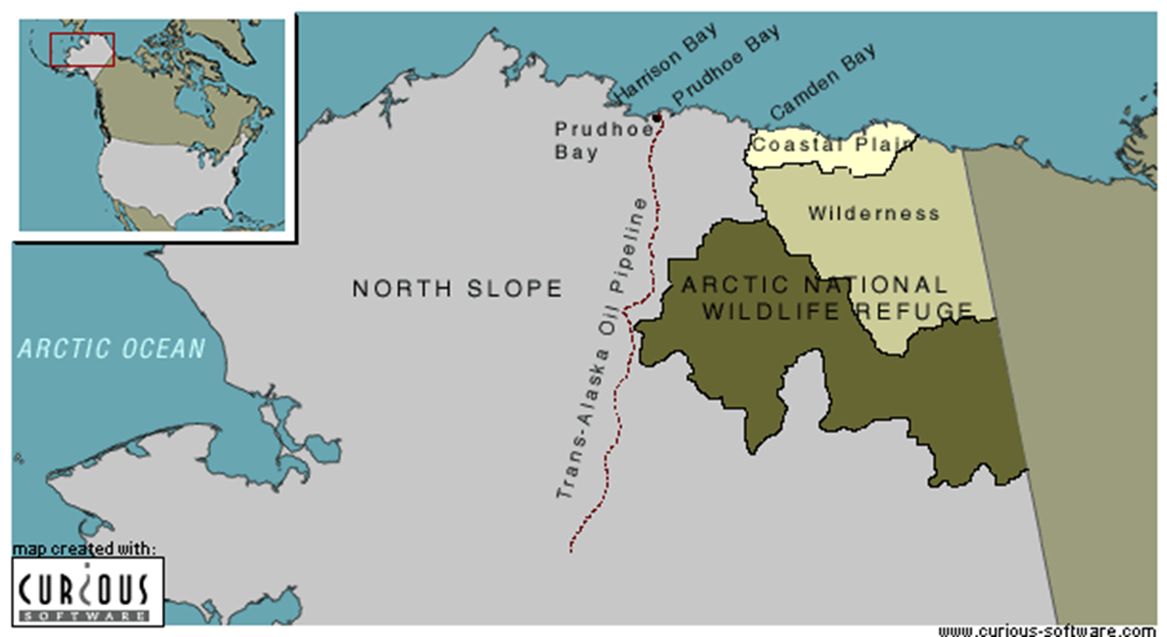
The Arctic National Wildlife Refuge (ANWR)
It is estimated that the Arctic region contains 25% of the world unexploited gas and oil reserves. The Arctic region lies within the Arctic circle (66.5 degree line of latitude) and consists of ice covered Arctic ocean surrounding the North Pole, as well as the Northern parts of 8 countries - Canada, Greenland, Alaska (USA), Iceland, Norway, Finland and Sweden.
A Case Study to explore how increasing energy insecurity is leading to the exploration of technically difficult and environmentally sensitive areas in search of new resources
ANWR is the most biological diverse Arctic region in the world and is located in the northern part of Alaska (USA). The area is a total of 19 million acres, with 37 species of land mammal, 8 marine mammals, 42 ﬁsh species and 200 migratory bird species.

Slide 7
What is a meant by the term ‘resource frontier’?
A resource frontier refers to an area on the periphery of a country or territory which is being opened up for resource extraction as older, more accessible resource locations become exhausted.
The fact that these frontiers have yet to be fully exploited means that they are often natural environments with little or no human development. As such there is frequently a potential conflict between the demand for mineral resource exploitation and the desire to maintain the natural environment. Also, the lack of prior human development is normally because of a harsh natural environment which has largely deterred settlement. This same harsh environment of deserts, mountains or tundra normally poses technological challenges to those exploring for natural resources, extracting them and moving them to market. While there may be resource frontiers on the margins of countries, resource frontiers can also exist in international territory. In such cases, the challenges are not only physical but also political.
Examples of resource frontiers posing environmental challenge include Alaska and the Arctic Circle. Exploration for on- and off-shore mineral resources in Alaska has often been the focus of political debate since Alaska became a US state in 1959. A ban on drilling in the Arctic National Wildlife Refuge (ANWR) was eventually signed into law in 1980. Most recently, in January 2015, President Barack Obama tried to extend the area where drilling for oil is prohibited but President Trump is arguing to lift restrictions.
The Arctic Circle is considered to have great potential for mineral resource extraction, especially for oil and gas, but the physical challenges of exploring for and extracting oil and gas in the icy conditions are some of the most challenging in the world.

Slide 8
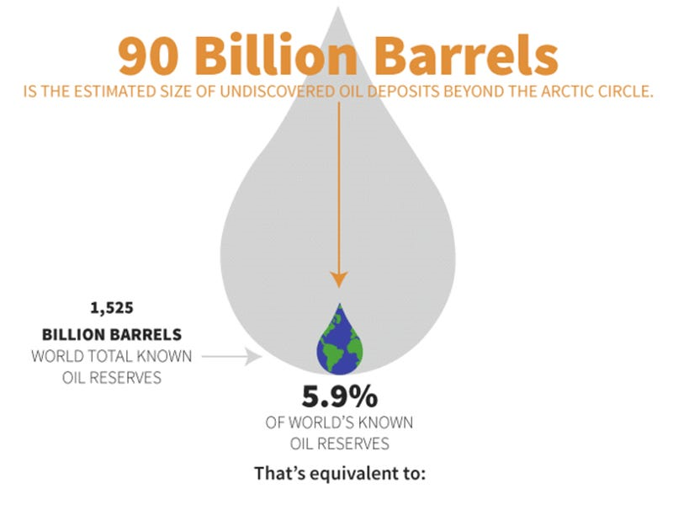
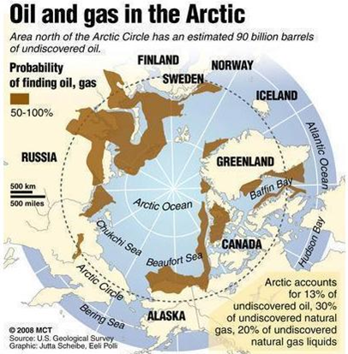
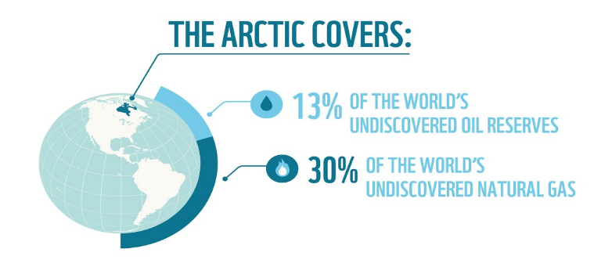
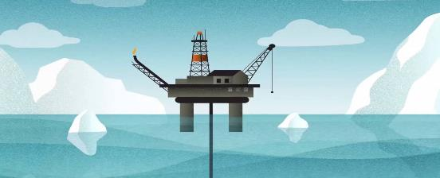
Look at the infographic here and think..
What opportunities are there for the people that live in the Arctic?

Slide 9
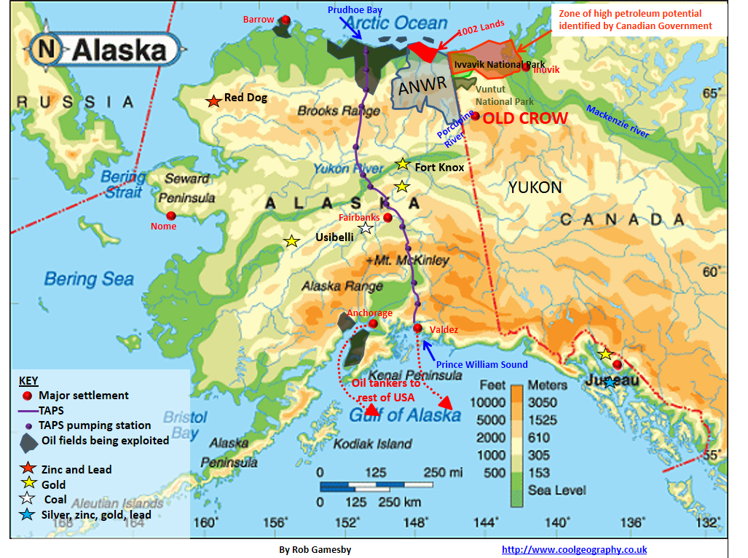
Development opportunities in Alaska and North West Canada
This area has been the focus of attention for many years because it is estimated that beneath the land there is 1 million additional barrels of oil that could be extracted for use each day. This would produce around 27 million gallons on petrol and diesel.
The extraction of this oil would increase the supply and therefore lower prices in the USA.

Slide 10
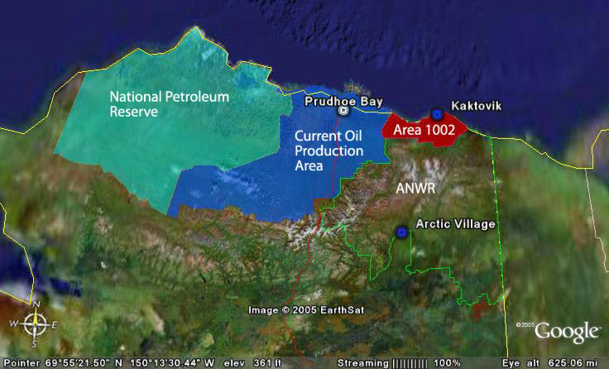
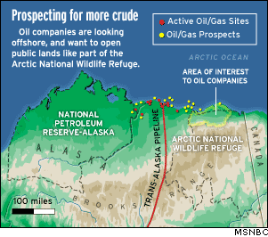
The productivity of the Prudhoe Bay oil field is in decline, and some of the reserves left are in places where it is dangerous and expensive to extract the oil, such as in the sea. Oil companies have identified areas where it is easier and cheaper to access the oil. One such place is in the Arctic National Wildlife Refuge (ANWR) It is thought that this area holds 10billion barrels of crude oil.
The 19 million acre Arctic National Wildlife Refuge (ANWR) lies in the northeast corner of Alaska. The entire refuge lies north of the Arctic Circle and 1,300 miles south of the North Pole.
The Coastal Plain area, comprising 1.5 million acres on the northern edge of ANWR, is bordered on the north by the Beaufort Sea, on the east by the U.S. Canadian border, and on the west by the Canning River. The Kaktovik Inupiat Corporation and Arctic Slope Regional Corporation (both Alaska Native corporations) own 94,000 acres in the Coastal Plain surrounding the village of Kaktovik.

Slide 11
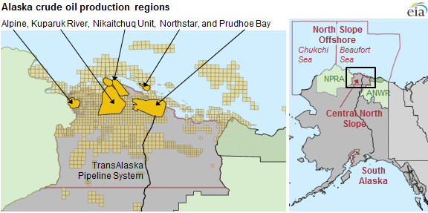
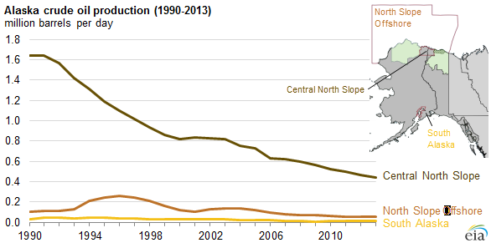
Graph interpretation:
Using the maps and graph, Describe how the pattern of crude oil production has changed from 1990-2013

Slide 12
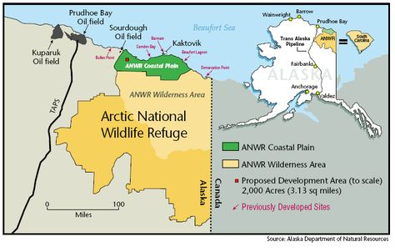
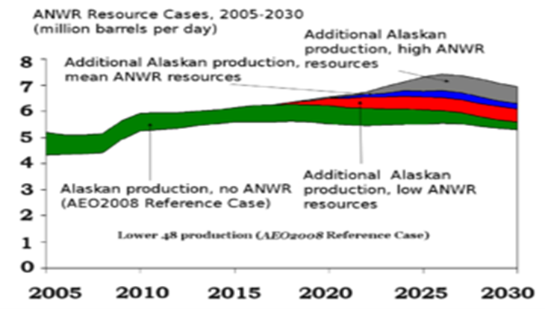
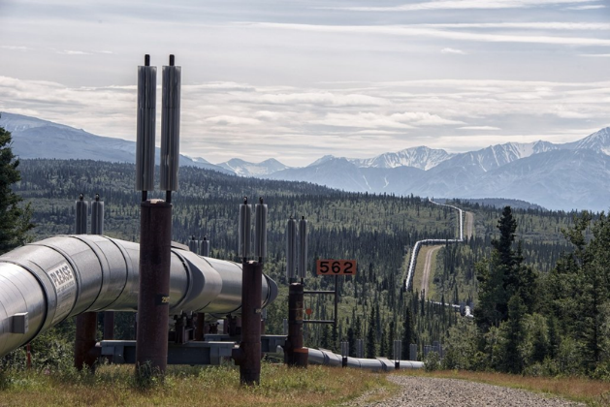
Graph interpretation:
Using the maps and graph, Explain why the ANWR coastal plain (area 1002) is a desirable area for oil exploitation.

Slide 13
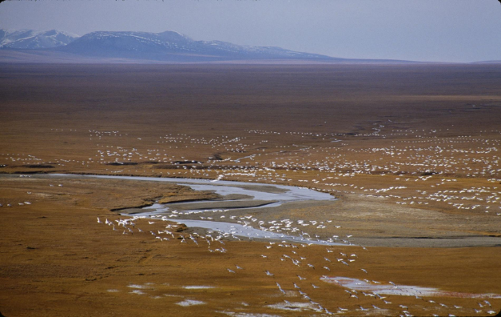
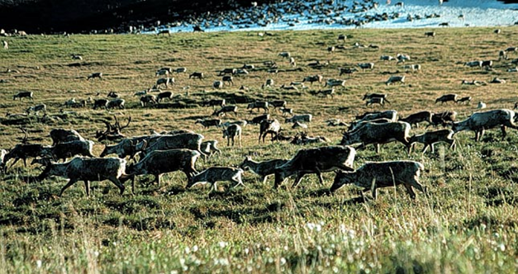
Protection of cold environments as wilderness areas
What is a wilderness area?
Wilderness areas are remote, unspoilt parts of the world including deserts, mountains and cold environments. Wilderness areas are typically fragile environments unspoilt by human development and remain natural.
Many of the world’s cold environments are considered as wilderness areas. This is due to their remoteness and hostile physical conditions. Cold environments considered cold environments include Antarctica as well as areas of Greenland, Alaska, Svalbard, Iceland and Siberia.
Why should wilderness areas be protected?
Cold environments need to be protected for a range of reasons, including:
Tundra and polar environments are fragile environments. Cold environments take a long time to develop and when damaged by humans, can take a significant amount of time to recover. A footprint on the tundra can last for several years. Therefore pollution, mining, energy exploitation and transportation can have a significant impact on cold environments.
Some cold environments are inhabited by indigenous people. Often, their culture depends on the preservation of the natural environment.
Cold environments are home to a range of species (biodiversity), many of which are unique to the environment.
There is a global moral responsibility to protect wilderness areas.
Scientists need to access unspoilt environments to conduct research into global processes. Valuable research into climate change has been conducted in Antarctica

Slide 14
Look at the article here and….
Describe in 500 words why ANWR is considered a ‘special place.’
What do you understand by the term ‘fragile environment’?
Why do you think people choose to live in such harsh physical environments?
Discuss how people have responded to the social, economic and environmental challenges of living in that cold environment.
Watch the clip:
Climate Change and Arctic Oil with Emma Thompson
https://www.youtube.com/watch?v=fFNqKA8VBGU
What is the impact of climate change on the Arctic?

Slide 15
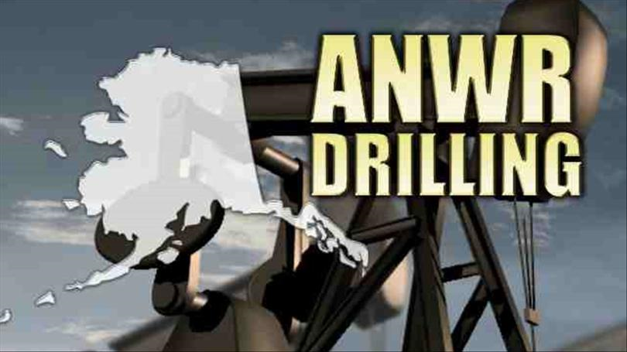
The Arctic National Wildlife Refuge
Protected … but
… there are oil reserves there …
And the Prudhoe Bay oilfield is nearly exhausted.

Slide 16
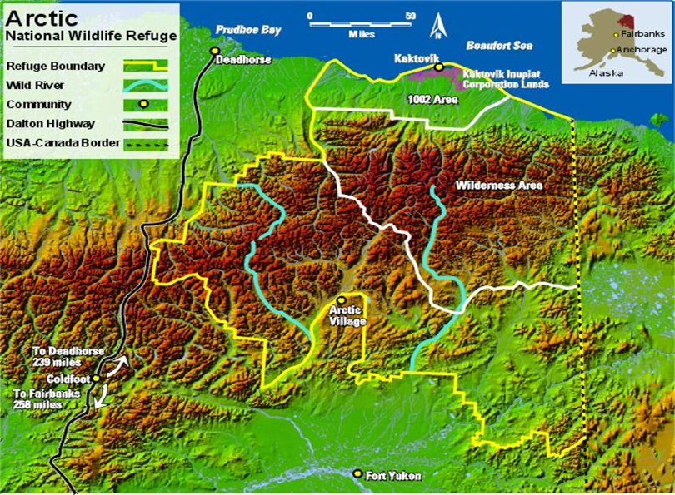
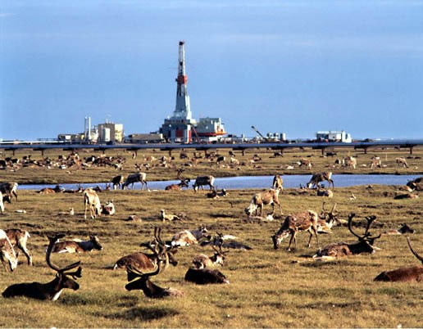
What is the debate all about?
The question of whether to drill for oil in the ANWR has been an ongoing political controversy in the United States since 1977. The controversy surrounds drilling for oil in a 1,500,000 acres (6,100 km2) subsection on the coastal plain, known as the "1002 area." Much of the debate over whether to drill in the 1002 area of ANWR rests on the amount of economically recoverable oil, as it relates to world oil markets, weighed against the potential harm oil exploration might have upon the natural wildlife
The Arctic National Wildlife Refuge (ANWR or Arctic Refuge) is a national wildlife refuge in northeastern Alaska, United States. It consists of 19,286,722 acres (78,050.59 km2) in the Alaska North Slope region. It is the largest National Wildlife Refuge in the country, slightly larger than the Yukon Delta National Wildlife Refuge.
Year-round residents of the boreal forest include moose, lynx, marten, wolverines, black and grizzly bears, and wolves.
Each year, thousands of waterfowl and other birds nest and reproduce in areas surrounding Prudhoe Bay and Kuparuk fields and a healthy and increasing caribou herd migrates through these areas to calve and seek respite from annoying pests.

Slide 17
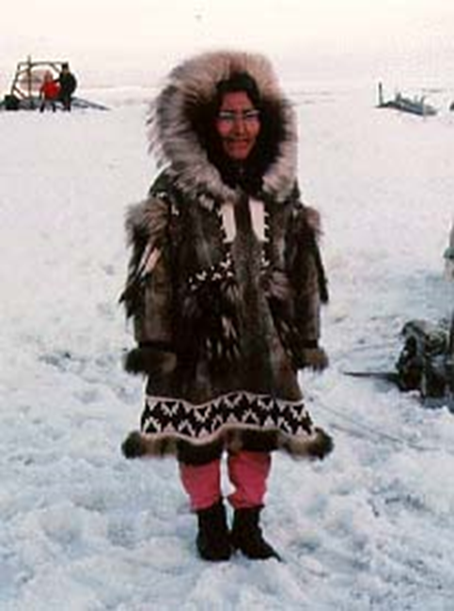
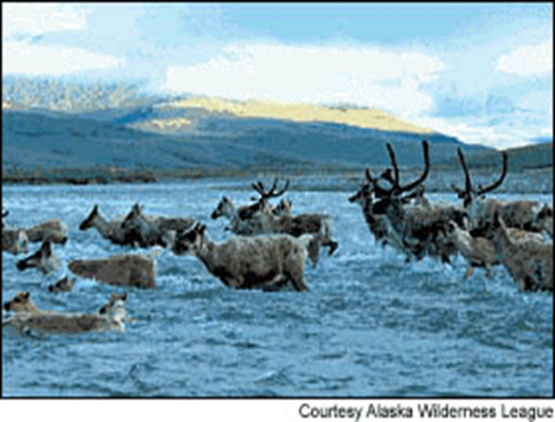
Research the migration of the Porcupine caribou. Make notes explaining what drives their migration and how the results of climate change might affect their migration patterns in the future.
Research the Vuntut Gwitchen community from the following websites:
Old Crow – Yukon
(www.Cambridge.org/links/gase6036)
Yukon community profiles
(www.Cambridge.org/links/gase6034 )
What about the indigenous people?
In January 2008 a proposal was put forward to open the lands up for petroleum exploration and development. This would badly affect the Vuntut Gwitchin, an indigenous group who live close to ANWR on the Canadian side of the border. The Vuntut Gwitchin have adapted to this harsh environment, they number 300 people in the settlement of Old Crow and some 7500 in total across the whole community. They are a traditional community, and originally they survived by hunting and gathering. They trap Muskrat for their furs in the off-season but their main activity is to hunt in sustainable numbers the porcupine Caribou herd, so called because they cross the Porcupine River at Old Crow. If oil development at ANWR goes ahead the Vuntut Gwitchin are very concerned that it will damage the Porcupine Caribou herd, and therefore ruin their way of life. To date, drilling has been prevented by the USA government.
Watch this Bruce Parry clip:
https://youtu.be/Enf-BexL_oI

Slide 18
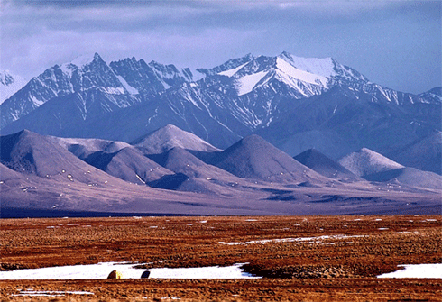

Look at some of the arguments for and against drilling: Outline the social, economic, environmental and political arguments arising for and against exploiting oil and gas in ANWR?
(Draw a large table like this..)
Arguments for drilling
The opportunities offered in Tundra areas create employment and increases local taxes and local government spending. This allows for the improvement of infrastructure and public services, improving the socio economic conditions of the area and allowing for even more development. This is known as the positive multiplier effect.
The increased oil and gas supply with decrease the dependency that the USA has on foreign imported oil and gas.
It will dramatically help the economy of Alaska by providing thousands of jobs
The revenue generated from the oil could lead to a drop in price, creating another economic boom

Slide 19
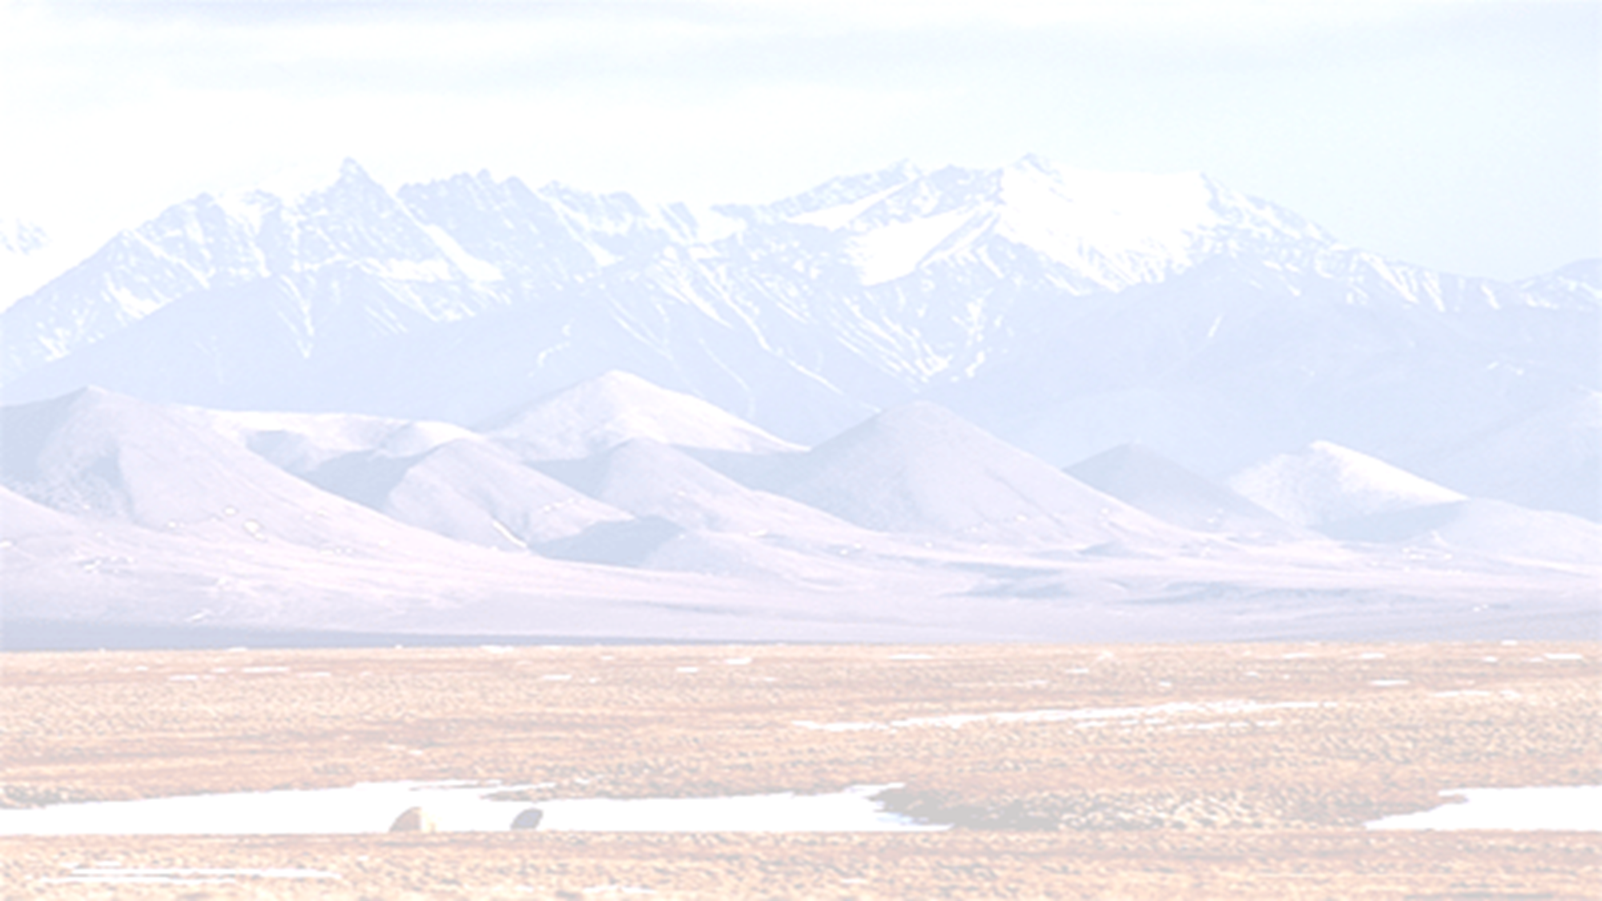
Arguments against drilling
The drilling may not yield the amount that has been predicted. This means that the huge biodiversity in the area will be destroyed for no reason
Environmentalists state that the required network of oil platforms, pipelines, roads and support facilities, not to mention the threat of foul spills, would play havoc on wildlife.
The wildlife refuge could be disturbed by humans, with animals lives and migratory routes being disrupted
The US FISH AND WILDLIFE SERVICE has stated that the 1002 area has a "greater degree of ecological diversity than any other similar sized area of Alaska’s north slope." The FWS also states, "Those who campaigned to establish the Arctic Refuge recognized its wild qualities and the significance of these spatial relationships. Here lies an unusually diverse assemblage of large animals and smaller, less-appreciated life forms, tied to their physical environments and to each other by natural, undisturbed ecological and evolutionary processes."[
The Gwich'in tribe adamantly believes that drilling in ANWR would have serious negative effects on the calving grounds of the Porcupine Caribou herd that they partially rely on for food.
By drilling for new fossil fuel reserves it doesn't encourage the move to renewable fuel in order to reduce emissions
It could be decades before the oil starts leaving the well meaning that it will not help secure the USA energy immediately.

Slide 20
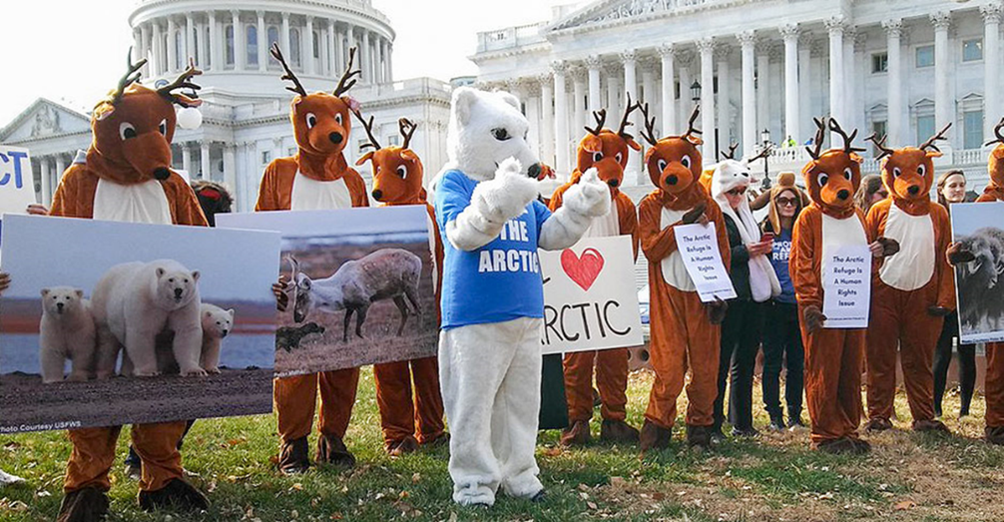
Key players in the ANWR debate:
Labour Union - they are for drilling in ANWR because they believe that it will reduce the dependency on foreign oil and will create 750,000 jobs in Alaska alone with 25,000 in maintenance and support. However they are not fully supportive due to the environmental impacts caused by it.
The Sierra Club - They are against drilling for oil in ANWR because they believe that we should explore and protect the refuge and the wildlife.
The Gwich’in Nation - this group are again against drilling. These are the natives of the Arctic in which there are 9,000 of them in 15 communities. They believe that the environmental damage would be too great. They rely on the 180,000 caribou on the coastal plain of Alaska which could be disputed by the drilling.
The Inupiat People - They are for drilling in ANWR due to the fact that it will create many jobs for them. Although they believe that it will impact the environment they do not think that it will affect them so they therefore are not bothered about the drilling in ANWR.
For each key player write a 100 word speech
Here are some videos to help you decide;
For
http://www.youtube.com/watch?v=rT8GG...eature=related
Against
http://www.youtube.com/watch?v=ewbHB...eature=related

Slide 21
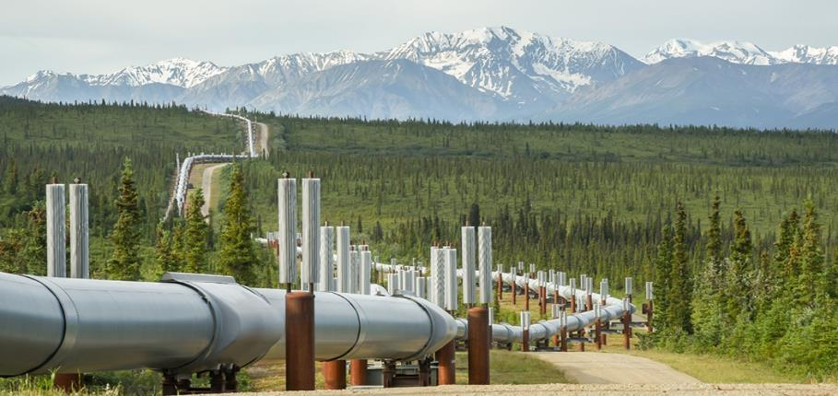
What strategies can be used to maintain cold environments?
Managing the risks facing cold environments
Cold environments provide one of the last wilderness areas on Earth and have fragile ecosystems. Economic development puts these ecosystems at serious risk of damage and therefore these areas need to be protected. Striking a balance between economic developments and protecting cold environments can be achieved through careful management. Some of these management strategies include:
International Agreements
Antarctica is often described as ‘the last wilderness on Earth’. It has remained undeveloped since the signing of the 1959 Antarctic Treaty. The treaty:
only allows the use of Antarctica for peaceful purposes, military activities are forbidden.
promotes co-operation among international scientists.
bans the disposal of nuclear waste.
has enforced strict controls on tourism and landing sites to reduce the impact of tourists.
International agreements allow standards to be set to ensure that economic development does not happen at the expense of the environment. For example the Antarctica Treaty is supported and recognised by 53 countries (2016).
Technology
Technology used to access minerals and fossil fuels should be managed carefully to avoid the destruction of wilderness areas. It can provide environmentally friendly solutions to some of the challenges faced by developing cold environments. An example of this is the use of stilts to raise the Trans-Alaskan pipeline above the ground and insulation of the pipe, to reduce the risk of thawing permafrost. Pumping stations enable the oil to flow over mountainous areas in the region.
Sustainable development which involves the use of appropriate technology for the environment could provide a solution.

Slide 22
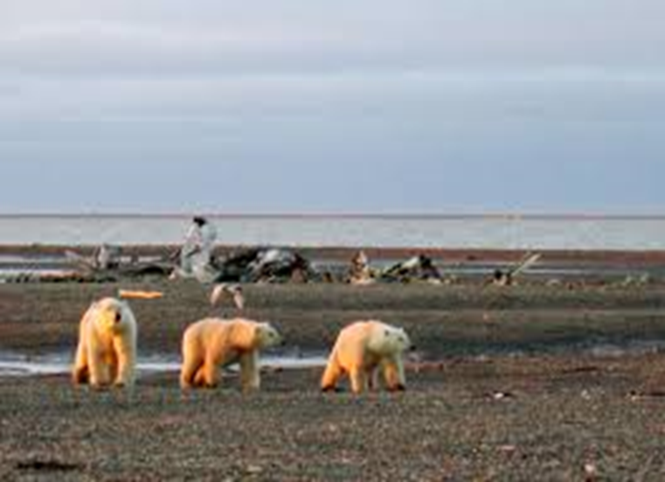
Action by governments
Governments play a key role in ensuring that technology is used responsibly in cold environments. They have the power to create laws which state how cold environments can and should be used. These laws can be supported by different countries through the use of international agreements.
Since oil was found in Alaska in the 1960s the US government has been involved in protecting the environment. Marine habitats and fishing have been monitored by the National Oceanographic and Atmospheric Administration (NOAA). Also, the Western Arctic Reserve has been set up in the north of Alaska protecting the area from oil and gas extraction.
Conservation groups
Conservation groups can put pressure on governments not to exploit the resources found in cold environments. Many conservation groups believe that cold environments should be protected from any human activity so that they can remain in a pristine condition. This management strategy does not allow for any economic development.
A number of conservation groups including the Worldwide Fund for Nature (WWF) work with governments, organisation, businesses and communities to protect biodiversity across the Arctic. The WWF Arctic Programme was launched in 1992 to work with governments on issues such as climate change, polar bears, shipping and oil and gas.

