Slide 1
Contemporary Urban Environments
Geography A-Level Transition Activities

Slide 2
Task 1: Global Patterns of Urbanisation
Conduct some research to find out the largest cities in the world in 1950, 2000 and 2050.
How have the size of the cities changed? How have their location changed
Rank | 1950 | Population? | 2000 | Population? | 2050 | Population?
1
2
3
4
5
6
7
8
9
10

Slide 3
Task 2: London – a Global City
Global City: A city which has great influence on a global scale, because of their financial status and worldwide commercial power.
Create a mindmap using the template on the next slide to show evidence that London is a Global City. Use annotated images and data to complete your mindmap

Slide 4
Business/Trade
Population/Migration
London: A Global City
Politics
Culture

Slide 5
Task 3: New Urban Landscapes
Read this webpage summarising different types of New Urban Landscape.
To what extent does Manchester display evidence of having new urban landscapes? Annotate the map on the following slide to show evidence of the following:
Town centre mixed developments – Spinningfields, Exchange Square, Castlefield, NOMA
Cultural and heritage quarters – HOME/First Street
Gentrified areas – Northern Quarter
Stretch and Challenge
Is there any evidence of defensible space/fortress cities in Manchester?

Slide 7
Task 4: Poynton Profile
Create a Profile showing changes to the urban area of Poynton. Your profile should include
At least three maps – one from the present day, and two historical to show the changes (take screenshots from this website, the side-by-side function is excellent for comparing historical and present day). These should be annotated
A timeline of key events relating to the urban area
Photographs showing to illustrate the changes
Stretch and Challenge
What would the thoughts of the following people be on the change happening in Poynton?
An elderly local resident
A middle-aged local resident
The leader of the Parish Council
A newcomer to the village
A council leader in the urban area

Slide 8
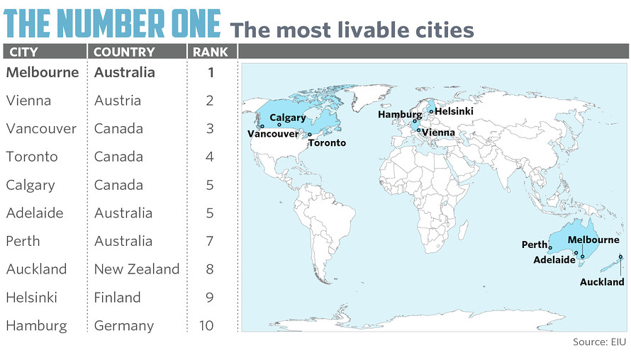
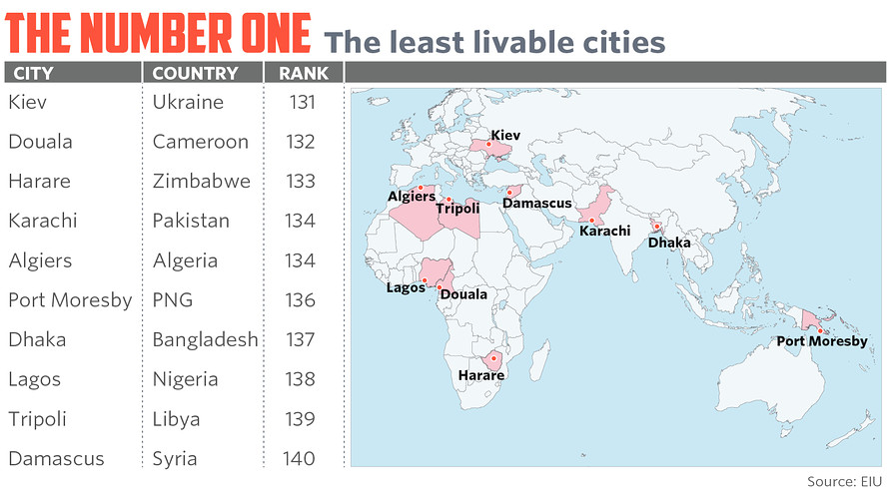
Task 5: Liveability
‘Liveability’ is described as the characteristics of a city which improve the quality of life for people living there. Read the article on the next slide.
Research of one of the most and least liveable cities and create a case study using images and words to show makes each city liveable or not.
For each city, comment on the following characteristics:
Stability
Healthcare
Culture and Environment
Education
Infrastructure

Slide 9
http://www.marketwatch.com/story/the-10-most-livable-cities-in-the-world-2016-08-18
In a study of the world’s 140 major cities, not a single U.S. city makes the top 10 list for the “most livable.”
The Economist Intelligence Unit published its annual livability report, with Australia and Canada, as usual, dominating the list. The top five cities, located in Austria, Australia and Canada, all remained unchanged from last year’s list. One U.S. city, Honolulu, ranked among the top 10 cities with the most improved livability scores over five years (its score is 94).
Increasing instability in the world is causing volatility in the scores of many cities. Violent acts of terrorism in many countries including Turkey, Bangladesh, Pakistan, France, Belgium and the U.S. were responsible for changes in some of the rankings. Paris has dropped 3.7% in its livability score over the past five years to No. 32.
The analysts assigned each city a rating based on more than 30 qualitative and quantitative factors, such as health-care availability, social or religious restrictions, quality of public transport, threat of terror attacks and prevalence of crime. Scores range from one, which is considered intolerable conditions, to 100, which is ideal.

Slide 10
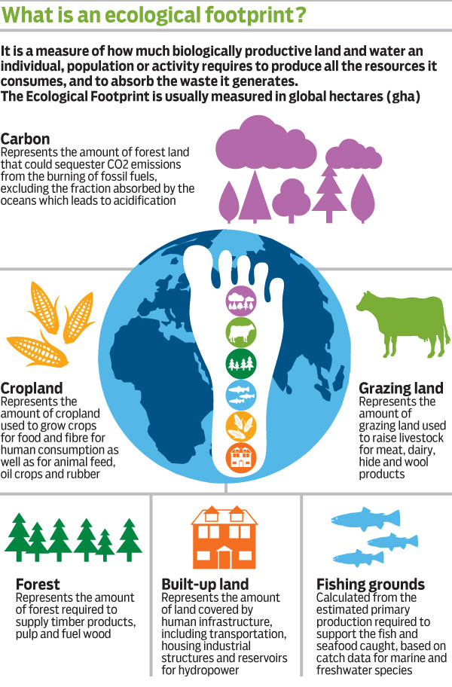
The footprint of a region is the area of land and sea required to maintain its levels of consumption, both to provide food and materials and to absorb waste and pollution
How much land is required to produce the resources a population consumes and absorb the waste produced?
Use the link below to see how much you would need for your lifestyle
http://www.footprintnetwork.org/en/index.php/GFN/page/calculators/
Task 6: Ecological Footprint

Slide 11
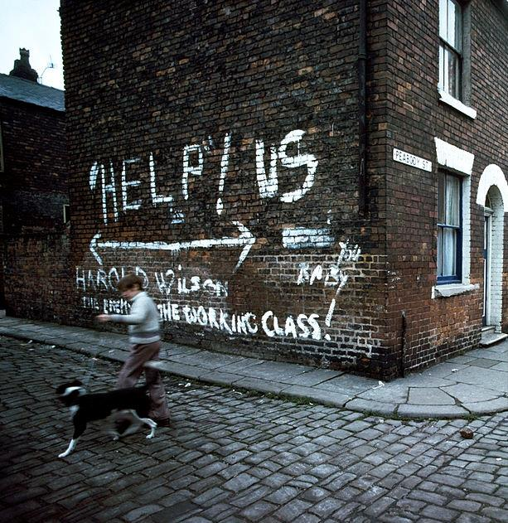
Changing Places
Geography A-Level Transition Activities

Slide 12
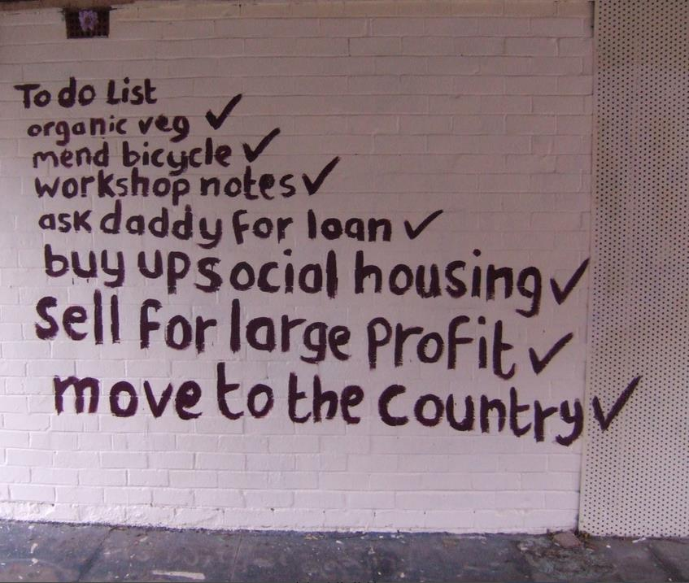
Task 1: Sense of Place Toolkit
Create a ‘Sense of Place Toolkit’ for Poynton (or your local area). This should promote what is special and unique about your area.
You can present this however you choose – it could be collages under different headings, a booklet or a poster. Some information you could use includes:
Showcasing local landmarks/places of interest
Photographs and media (this could include literature, music, art, tv and films)
History and culture
‘Insider knowledge’ or little known facts
Maps and demographic information
Sense of Place Toolkits are used by businesses in particular areas (often tourist related) to promote what is special about their area to visitors and clients.
There are some examples of Sense of Place Toolkits here and here. These are in much more detail than we are expecting but may give you an idea of what to include.

Slide 13
Task 2:Manchester’s Bee-haviour
Manchester has traditionally been represented by the symbol of a bee. This was initially linked to the mills- ‘hives of activity’- with the workers ‘as busy as bees’. More recently it symbolises the city’s sense of invincible unity and pride.
To what extent is Manchester’s emblem of the bee modelled in everyday behaviour in the city?
Create a visual mindmap to demonstrate how the symbol of the bee is modelled in behaviour in Manchester. Include words and annotated images on your mind map. Use the images on the next slide as a starting point. (also use maps, tv, film, music, poetry, photos, data)

Slide 14
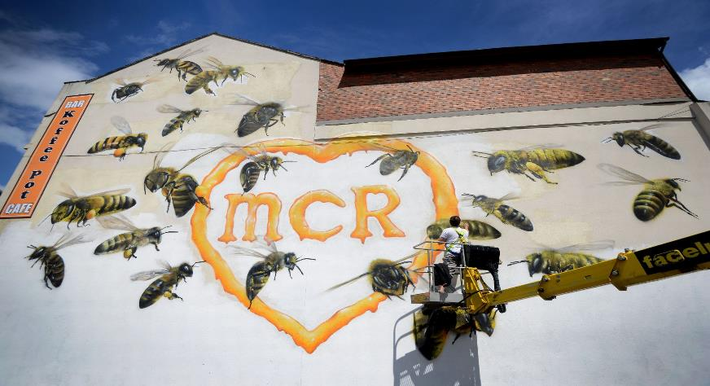
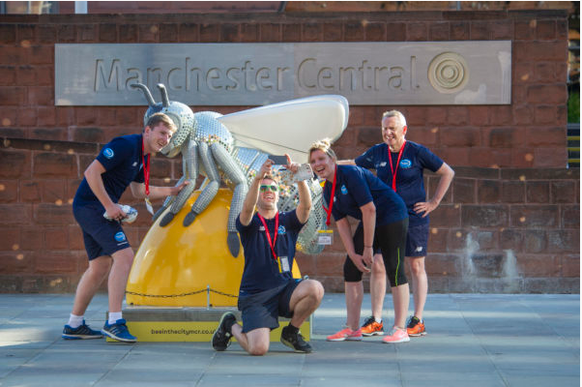
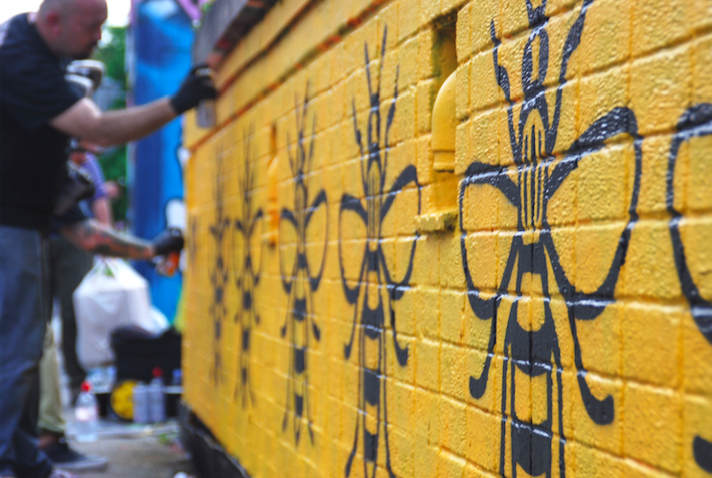
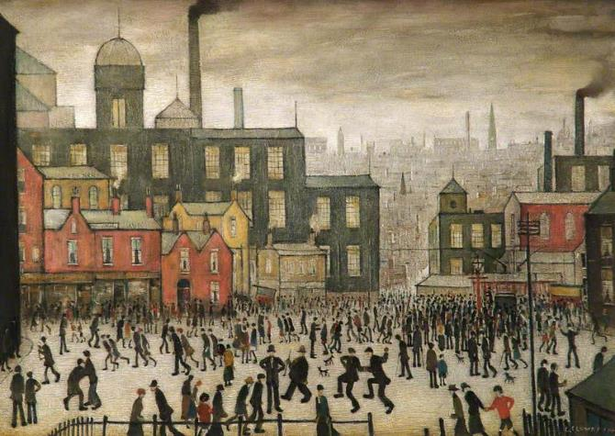
Bee mural on The Koffee Pot, Oldham Street (22 bees for the 22 killed in the Manchester Arena attack)
Bee in the City, Manchester Central
A community of street artists decorating a wall
L. S. Lowry “Our Town”

Slide 15
Representations in images
Representations in the space
What does the bee symbol mean for behaviour?
Representations in popular culture

Slide 16
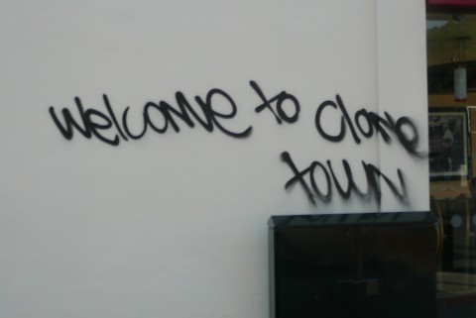
Task 3: Placelessness
Places that lack a "sense of place" are sometimes referred to as "placeless" or "inauthentic." Placeless landscapes are those that have no special relationship to the places in which they are located—they could be anywhere.
Read the article on the following two slides, the article referred to in the third line is here.
Can you think of any ‘placeless’ places in and around Manchester? Collect images of three different ‘placeless’ places in Manchester and explain what it is that makes them ‘placeless’.
Complete a Clone Town Survey for your local high street using Google Streetview. Link here for survey and instructions.

Slide 17
Place in Action
While many of these issues surrounding place may seem quite abstract, they lie at the heart of what it is to live in the twenty-first century. Consider three examples. First, let us return to the story of the Angel of the South. Behind Rachel Cook’s account is a concern that, in the twenty-first century, places are becoming homogeneous. Everywhere we go we see McDonald’s and Starbucks. Even in our homes we see the same kinds and styles of furniture, cutlery, foodstuffs and other produce supplied by the likes of Ikea and Tesco. Because of this, she suggests, it is becoming harder to detect the beating pulse of place. Works of public art are one way she believes this can be rectified (a contentious assertion that could be subject to scrutiny by students at school and university). This story is a familiar one. Consider the following extract from a governmental report, High Street 2015:
‘Whole categories of shops, including newsagents, non-symbol group grocers and bookshops are likely to become an increasingly rare feature of our high streets. Additionally, the homogenisation of supply will lead to few traditional or niche products being available to consumers. Essentially, the situation highlighted by the New Economics Foundation of “Clone Town Britain” is likely to develop. The range of suppliers is also likely to be diminished. This will reduce the scope of products offered, with many regional products being lost and the retail offer becoming increasingly standardised across the country’

Slide 18
It is noticeable that alongside considerations of the economic and social effects of chain stores such as Tesco there is an emphasis on the aspect of place and the problem of standardisation. The term ‘Clone Town Britain’ was coined by the New Economics Foundation in their 2004 report (New Economics Foundation, 2004). It signifies places where the high streets are dominated by chain stores and there is a distinct lack of independent stores. The worst offender in a 2005 survey was Exeter, where only one shop on the High Street was identified as independent. While many university students choose to focus on retail issues in their dissertations, they are mostly concerned about the economic effects of out-of-town shopping on small stores. The issue of place, as such, is rarely considered.

Slide 19
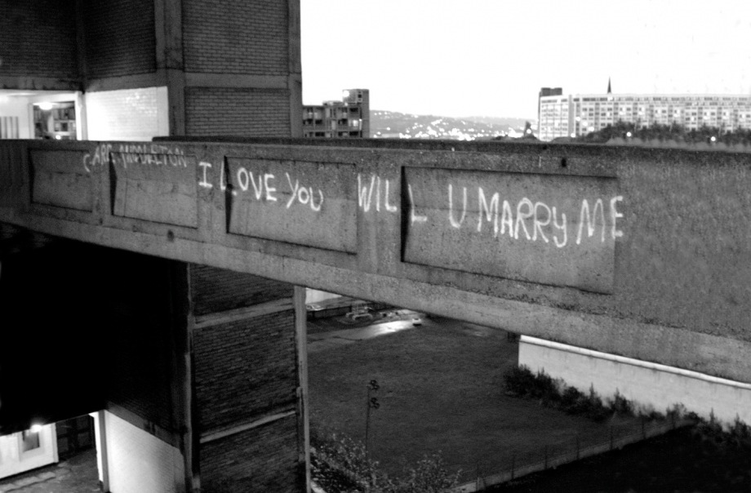
Stretch & Challenge
Find an image of Manchester. Annotate it to show what assumptions could be made about the place, and also what is missing.
Task 4: Representation of Place
Study the photographs on the following slide. What assumptions do you make about each place solely based on the images.
Annotate each of the images to show the assumptions that you make about the places shown in the photos. This could include:
  Where it is
  Who lives here
  What it is like to live here
  How you might feel if you visited this place
Representation refers to the description or portrayal of someone or something in a particular way. As geographers we learn about places through different representations.
Some representations of place are attempting to communicate something specific about a place or to challenge our view of a place.

Slide 20
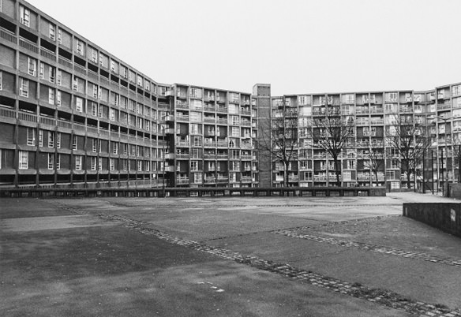
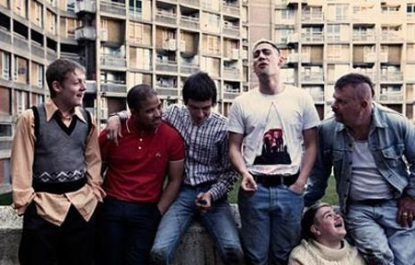
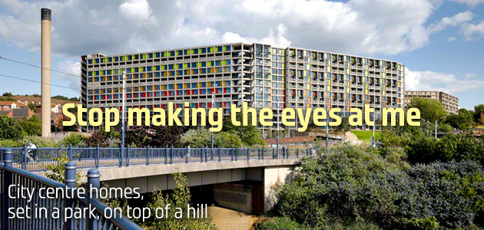

Slide 21
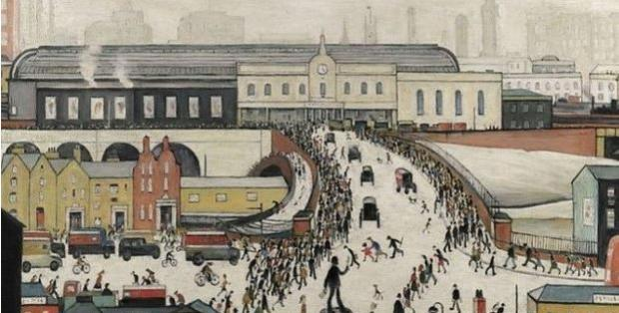
Task 5: Qualitative and quantitative sources
Stretch & Challenge
Critique your sources:
What do they assume?
Who are they for?
What is missing?
Who is the audience?
For a place of your choice, (there is lots on Manchester, although you may want to choose an area within Manchester) find two quantitative and two qualitative sources that represent your place.
Annotate these to show how your place is represented. Pick out similarities and differences between your sources.
Places can be represented by a variety of quantitative sources (census data, maps, house prices) and qualitative data (photographs, paintings, songs, poetry).
These sources can be used to demonstrate the changing nature of places, and people’s lived experiences.

Slide 22

Global Systems and Global Governance
Geography A-Level Transition Activities

Slide 23
Task 1: The Global Commons
Read pages 5 and 6 of this article on ‘the global commons’ and have a go at the below activities.
Explain what is meant by the term ‘global commons’ in two sentences.
Summarise why the global commons are important and the threats to them in 5 bulletin points.
Identify the global commons in 4 key images.
Challenge yourself
What is Global Governance? Why is it important?

Slide 24
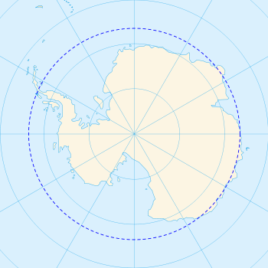
Task 2: Antarctica – a global common
An outline of the contemporary geography, including climate of Antarctica to demonstrate its role as a global common and illustrate its vulnerability to global economic pressures and environmental change.
Label the following features on to your map:
  60 degrees South/45 degrees south
  Antarctic Circle
  The Ross Ice Shelf and the Ronne Ice Shelf
  The Ross Sea and the Weddell Sea
  The Southern Ocean, the Atlantic Ocean, the Pacific Ocean and the Indian Ocean
  Cape Horn, Cape Agulhas, Cape Leeuwin
  3 research stations:
    Amundsen-Scott
    McMurdo
    Davis

Slide 25
Task 2: Antarctica – a global common
Watch this clip on youtube:
https://www.youtube.com/watch?v=CDV5t614yoI
Describe the physical geography and climate of Antarctica
Draw a climate graph for the Amundsen-Scott research station – use the data provided.
Remember you are drawing both sets of data on the same graph so you need two axes – be careful to read from the correct axis when plotting the different data sets.
Month | Precipitation (mm) | Temperature (°C)
January | 0.3 | -28.4
February | 0.6 | -40.9
March | 0.2 | -53.7
April | 0.1 | -57.8
May | 0.2 | -58.0
June | 0.1 | -58.9
July | 0.0 | -59.8
August | 0.0 | -59.7
September | 0.1 | -59.1
October | 0.1 | -51.6
November | 0.1 | -38.2
December | 0.3 | -28.0
Calculate the following:
Mean annual temperature
Total annual precipitation
Annual temperature range
Annual precipitation range
Take it further:
Research the climate data for the other two research stations. Draw climate graphs for those and compare the climates.
How are they different? Why?
Take it even further:
What is the Antarctic Convergence?

Slide 26


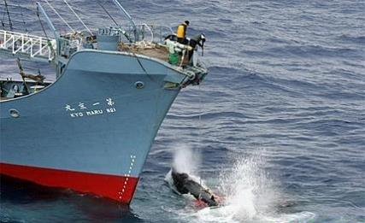

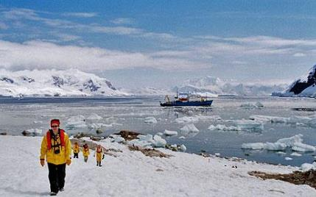

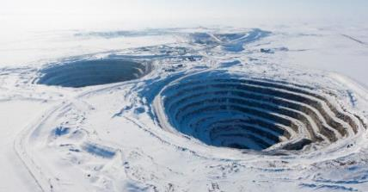

Task 3: Threats to Antarctica
Read this Geofile ‘Antarctica – Politics, Resources and Tourism’. Describe and explain the 4 main threats to Antarctica.
Thinking Points
Why is Antarctica so threatened?
Who is responsible for managing these threats?
What has been done to try to control these threats?
Are the methods in place to control the threats working?
How do you think these threats will change over time?
Is Antarctica an important global common? Why?

