Slide 1

POYNTON HIGH SCHOOL
SIXTH FORM
Post 18 Pathways Information June 2022

Slide 2

Introduction from Mr Hardman,
Director of Sixth Form

Slide 3

Mr Hardman, Director of Sixth Form
 rh@phs.cheshire.sch.uk
Mrs Hardicre, Year Leader
 clh@phs.cheshire.sch.uk
Mrs Bibby, Sixth Form Support Officer and Careers Lead
 sacb@phs.Cheshire.sch.uk

Slide 4

Please follow us in the Sixth Form on Twitter for ongoing updates
PHS_SixthForm

Slide 5
Post 18 Pathways
Our Sixth Form students progress on to a huge range of destinations from university and higher education courses, apprenticeships (both higher and degree level), employment and Gap years.
We hope this document will outline the support they will be given at school and provide you some useful sources of information as parents supporting a young person making these huge decisions.
There is a great deal of information out there and countless opportunities; we cannot possibly cover everything in school. Therefore, whatever a students’ aspirations, it is essential that they are proactive about finding out the facts and researching opportunities for themselves; we can provide advice and make suggestions but, ultimately, the decision is theirs.

Slide 6
What options are there?
University & Student Finance
Degree Level Apprenticeships/ Apprenticeships
Study Abroad
Gap Years
Jobs and Careers
Higher Education College

Slide 7
The UCAS Pathway
The majority of our students progress to university therefore a considerable emphasis has to be placed on this process during the applications cycle September to January
Students will all start their own UCAS application. We recommend all students do this at this stage, even if they are not certain they wish to finalise a university application.
The UCAS Hub offers students information on a variety of options such as Conservatoires, apprenticeships and employment.
Students will need their GCSE results/certificates to enable them to complete the education section of the UCAS form.
All students to attempt first draft of their personal statement which they should email to their form tutor prior to the summer break.

Slide 8
The UCAS Pathway
Researching courses – go to https://digital.ucas.com/search
For students uncertain about what subject they might like to study there are a number of online research tools such as:
https://www.theuniguide.co.uk/a-level-explorer
https://www.careerpilot.org.uk/information/higher-education-at-18/decide-which-course-to-do
There is a section for parents on UCAS including a free newsletter that you can sign up for to help you to support your young person in their application:
https://www.ucas.com/undergraduate/applying-university/ucas-undergraduate-advice-parents-and-guardians

Slide 9
The UCAS Pathway
We would encourage all students to make use of the two resources below, both of which will aid their UCAS journey. Additionally the Hub feature apprenticeships as well so is a great resource for those students seeking to develop both options.
The UCAS HUB
https://www.ucas.com/what-are-my-options/create-your-ucas-hub-today
The Hub is your space on UCAS, you can personalize it, pin interesting pages so you never have to look for them again, use the statement builder, the search tool, the tariff calculator and the notepad to keep everything in one handy place.
Unibuddy
https://www.ucas.com/chat-to-students
In a time when students are not able to visit universities in person, the Unibuddy platform through UCAS gives students the opportunity to chat live to students and staff from their chosen institutions in a safe, moderated environment.

Slide 10
The UCAS Pathway – what grades do you need?
University offers are given on grades (e.g. ABB) or a tariff points calculation (e.g 136 points). To understand more about tariff points go to: https://www.ucas.com/ucas/tariff-calculator
Students generally apply for up to 5 places, we recommend applying for a range of courses with varying grade/tariff point requirements.
Check the Entry Requirement detail on UCAS Course Search, make sure you are clear on HOW the tariff points are made up (e.g. you may be required to gain a certain grade in one or more subjects).
From September onwards, subject teachers will be asked to give students a prediction for UCAS applications. Student’s course choices should be in line with these predictions. Our predictions are always optimistic, but also realistic. A student’s course choices should also be optimistic, but realistic.
Early entry students (i.e. those applying for medicine, dentistry, veterinary, Oxford or Cambridge) will be our priority in September due to their early October deadline for application.

Slide 11
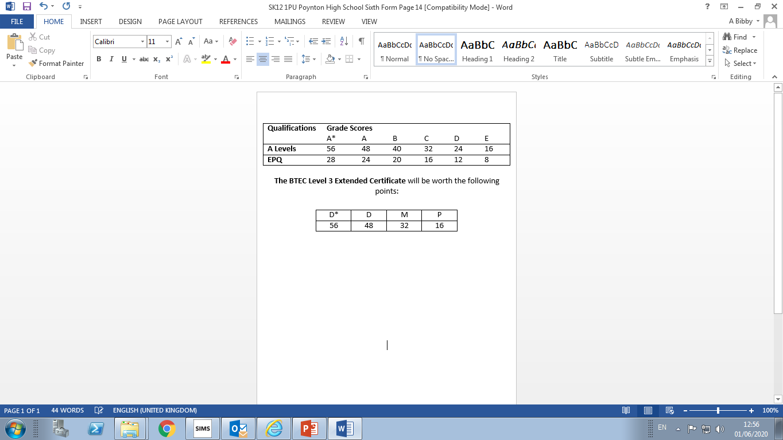
UCAS Tariff Points
So for example, if you are predicted a Distinction in your BTEC, and grades B and C in your A levels, you will gain 120 UCAS Tariff points.

Slide 12
The UCAS Pathway – Open Days
We advise students to register with the universities of their choice to participate in their open days.
We will authorise two absences for Open days during school time. Please attend any other Open Days at the weekend.
A good central resource for all open days is https://www.opendays.com/calendar/

Slide 13
The UCAS Pathway – school support network
Subject Teachers – write a personalised subject reference for each student in their class.
Form Tutor - checks and gives feedback on Personal Statement first draft. Collates, personalises and edits a reference for each student in their form group.
Sixth Form Team link -checks and gives feedback on personal statement second draft, checks course choices are within grade parameters, finalises reference.
Sixth Form Support Officer – checks full form & qualifications listed shortly prior to submission for accuracy and completeness.
All students meet with Mr Hardman for a final form/statement/reference check and application is submitted once they agree it.

Slide 14
The UCAS Pathway – key to success… communication, communication, communication!
It is essential students take responsibility for their elements of the UCAS process and keep their Form Tutor, subject teachers and designated Sixth Form Team link informed of where they are up to in their application.
Students are given deadlines to meet and it is essential they respect these deadlines to ensure we have enough time to prepare quality, personalised references for each student, and to ensure we meet the UCAS deadlines. Failure to meet the UCAS deadline means the university can ignore the young person’s application if they feel they have received sufficient applications.
Reference writing is time consuming and our teaching staff need to be able to plan when they will do this to fit in with their teaching commitments. It is important that students are considerate of this.

Slide 15
THE PERSONAL STATEMENT
Word-processed, prepared off-line in Verdana font size 12
Cut and paste on to application form after review by Form Tutor and Sixth Form Team link
47 lines of text available - 4000 characters
Often this will be your only contact with Admissions Tutors as many universities do not interview prospective students
Must be high quality/standard of English and grammar!
NB Please discourage students from passing their statement round lots of people at the same time, this leads to confusing mixed messages about content which in our experience, can leave students very frustrated.

Slide 16

WHAT TO INCLUDE IN
PERSONAL STATEMENT
Why chosen course, what interests student about the subject?
Illustrate this with examples of ‘Super-curricular’ involvement to show subject engagement (books read, journal articles, TV series, podcasts etc)
Relevant experience and skills developed through A levels and extra-curricular activities.
Specific career plans where known.
75%-25% ratio of academic to personal.
Employment and sports, musical, leisure interests to demonstrate relevant skills (e.g. teamwork, time management, commitment, communication)
Special circumstances Admissions Tutors should be aware of?

Slide 17
HOW CAN PARENTS HELP ?
Participate in Open Days with your young person to help them compare different institutions and courses. Read course descriptions in detail, for example a History Degree code V100 can have very varied content, assessment and requirements at different institutions.
Encourage early completion of the application form. Students who leave the application to the last minute often find the process very daunting and stressful.
Students often find the ‘selling’ themselves aspect of a Personal Statement difficult – encourage them to promote their suitability and enthusiasm for the course. Additional guidance is available at:
https://www.ucas.com/undergraduate/applying-university/how-write-ucas-undergraduate-personal-statement
Check Personal Statement for spelling, grammar and content (as per previous slide).

Slide 18
Higher Education Colleges
You usually have to be 18 or older to take a higher education course. They’re usually taught in universities, colleges, specialist institutions like art schools or agricultural colleges
Higher education qualifications are very varied and can include diplomas, bachelor degrees, foundation degrees (such as the Art Foundation course), post-graduate degrees.
You may wish to explore HE options such as:
https://stockport.ac.uk/university-level
https://macclesfield.ac.uk/higher-education/
https://www.reaseheath.ac.uk/higher-education/higher-education-student/

Slide 19
Student Finance
For information about student finance please see below and a summary from Manchester Metropolitan University (provided 2019)
https://www.ucas.com/undergraduate/student-life/getting-student-support/undergraduate-student-finance-and-support
https://www.gov.uk/student-finance

Slide 20
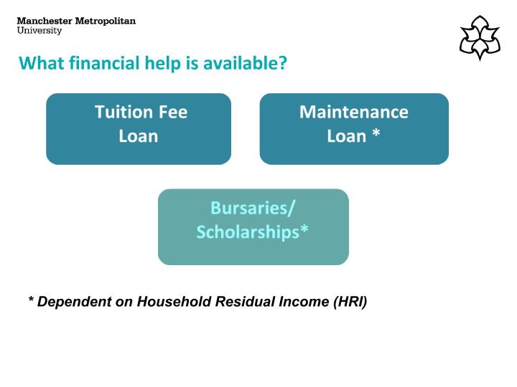

Slide 21
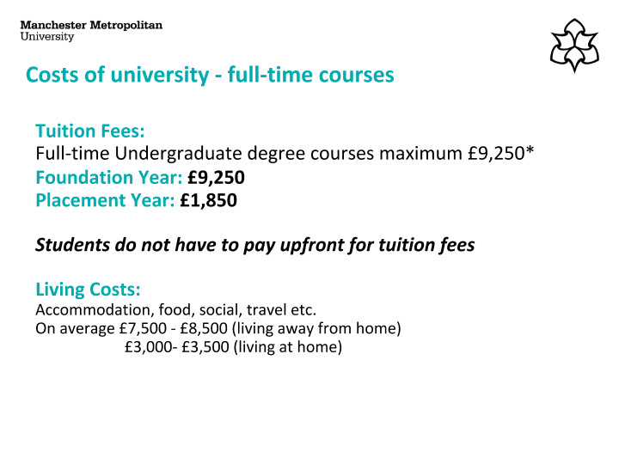

Slide 22
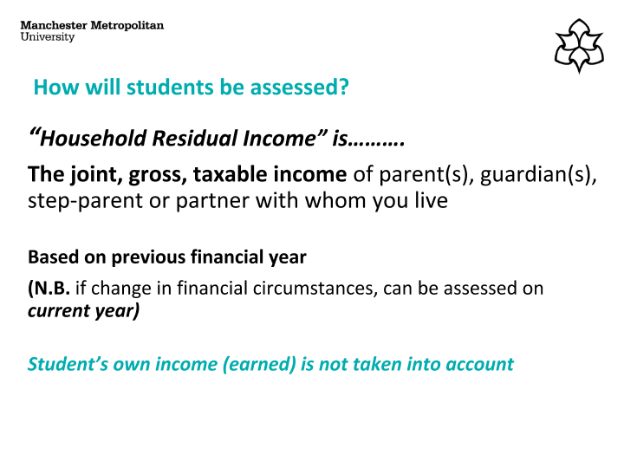

Slide 23
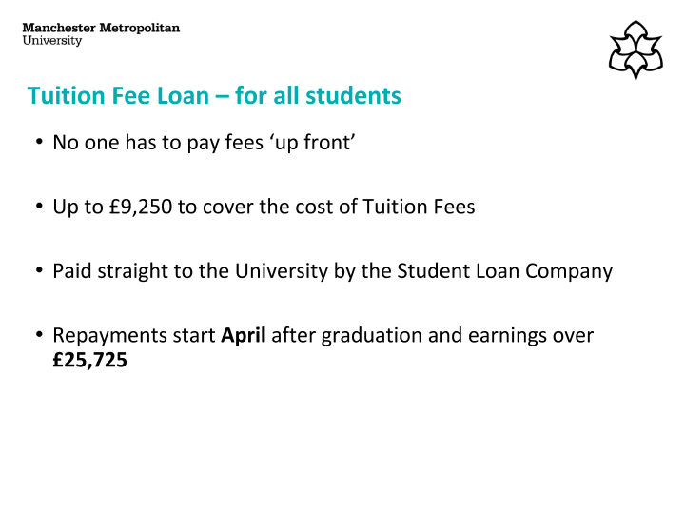

Slide 24
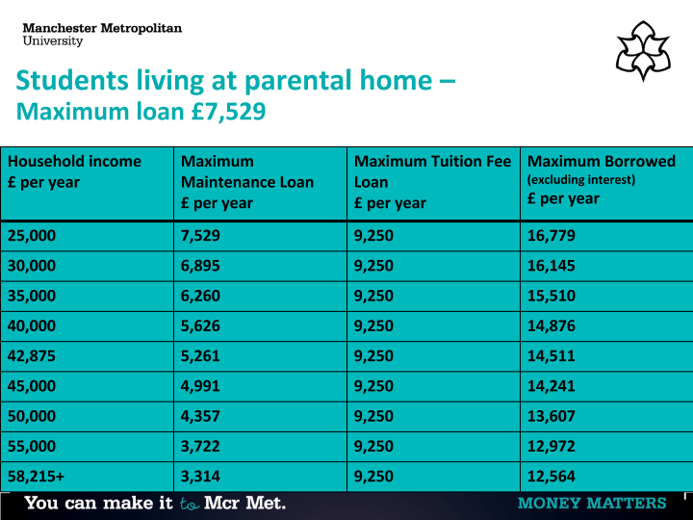

Slide 25
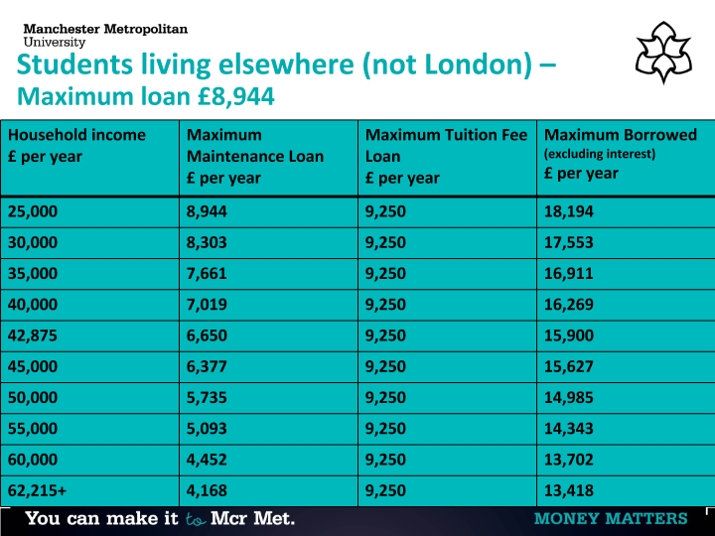

Slide 26
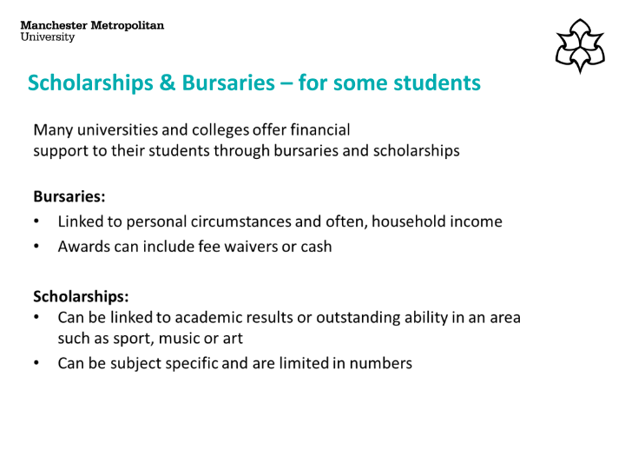

Slide 27
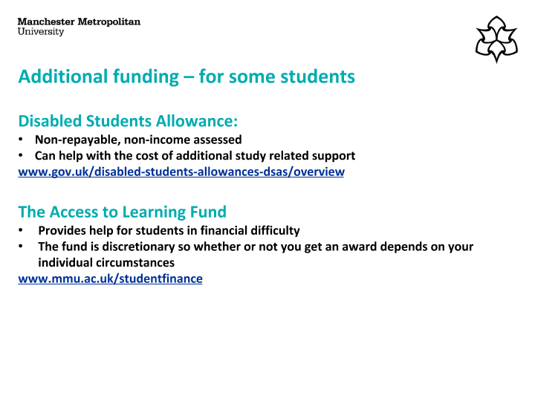

Slide 28
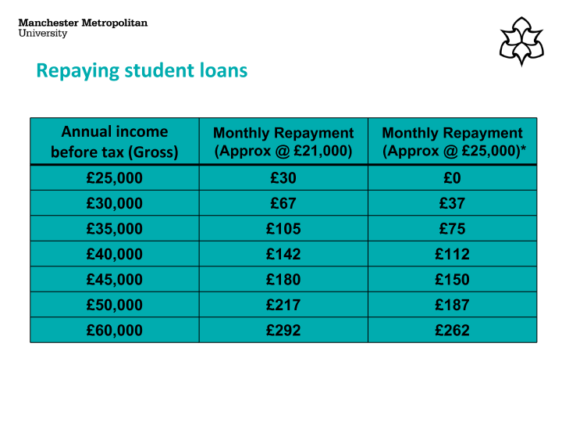

Slide 29
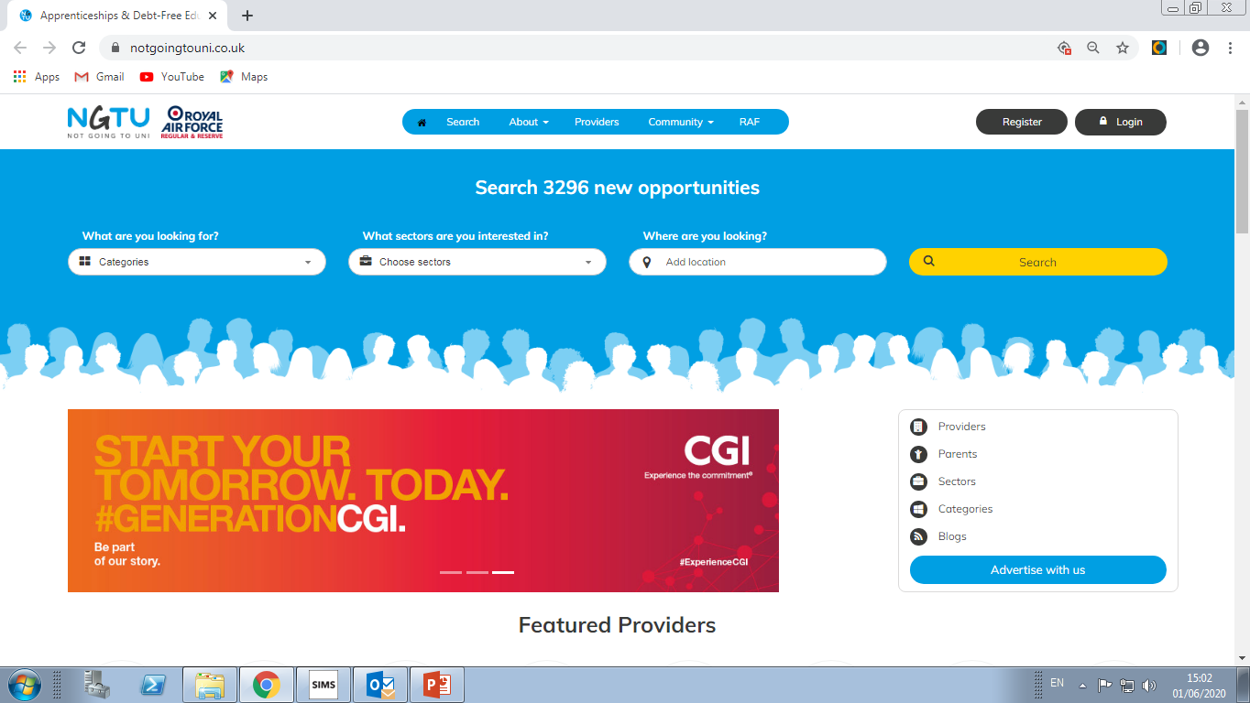
www.notgoingtouni.co.uk
A useful site for students and parents detailing a range of post 18 options

Slide 30
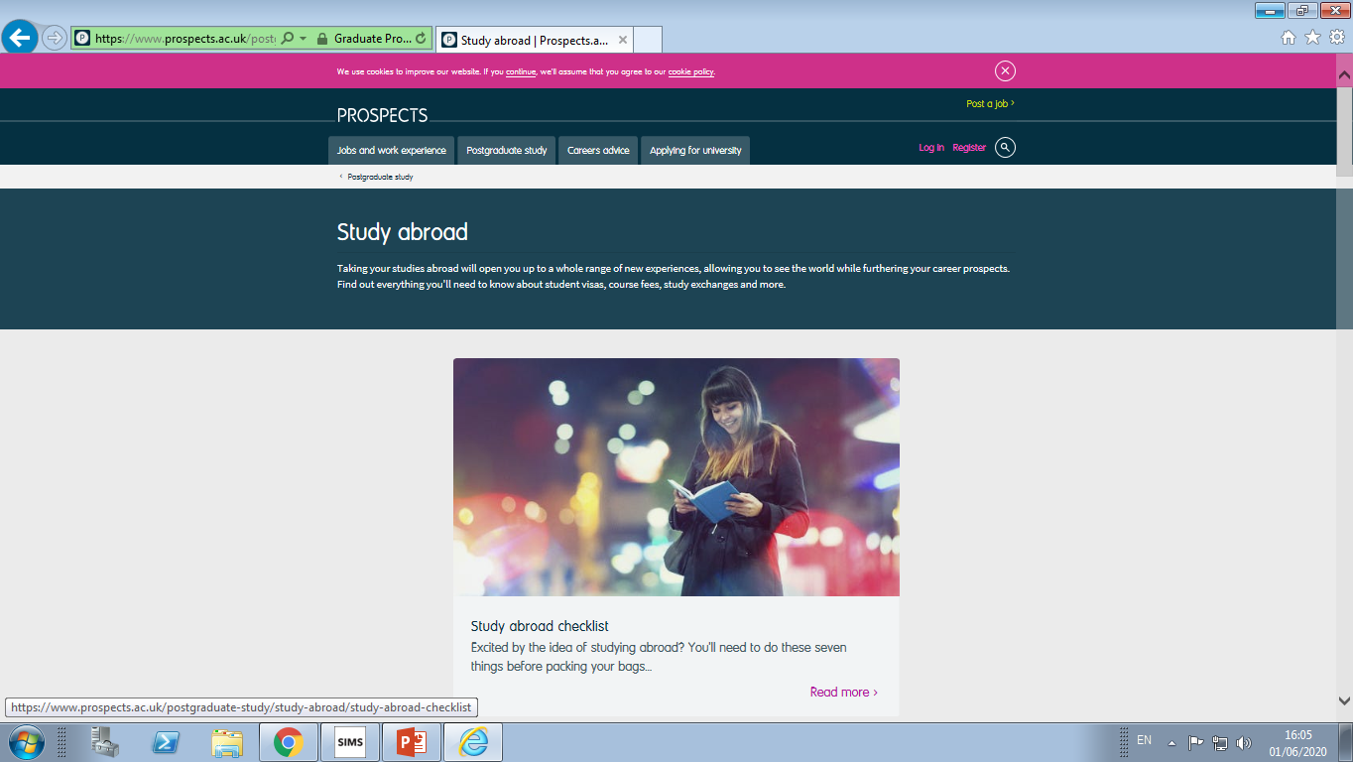
Study Abroad
A useful site detailing study abroad options by country.
https://www.prospects.ac.uk/postgraduate-study/study-abroad

Slide 31
Apprenticeships and Employment
Students who wish to progress to an apprenticeship or employment after their Sixth Form studies will be supported through the Employment Readiness Programme.
Students follow an alternative schedule of activities designed to enhance employability on Student Development Days when other students are completing UCAS applications and activities.
Students are encouraged to cultivate different options during Sixth Form and it is not unusual for students to complete a UCAS application alongside apprenticeship/employment applications and we will can be flexible in our support with this.

Slide 32
Apprenticeships and Employment - timelines
There are no fixed timelines for apprenticeship and employment recruitment as different organisations recruit at different times of the year. NB some do start recruiting as early as the Autumn Term.
We recommend students explore the Amazing Apprenticeships website for advice and support in the application process: https://amazingapprenticeships.com/
There is a parent section on this website to help you support your young person in their search for an apprenticeship, including a parents newsletter that you can subscribe to: https://amazingapprenticeships.com/parents/
All students should register for vacancy alerts with the government’s apprenticeship service at: https://www.findapprenticeship.service.gov.uk/apprenticeshipsearch

Slide 33
Apprenticeships and Employment
There are a number of levels of apprenticeships, the A levels and BTEC courses our students study are level 3 qualifications, so our students usually progress to higher (level 4 or above), or degree level apprenticeships. For a more detailed explanation of the nature and structure of apprenticeships we recommend students download, save and work through the following guide:
https://amazingapprenticeships.com/app/uploads/2020/03/Interactive-Student-Guide_2020.pdf
Additional information for parents and students can be found at:
https://www.ucas.com/understanding-apprenticeships
Or
https://www.apprenticeships.gov.uk/apprentice/what-is-an-apprenticeship#

Slide 34


Slide 35
Degree Level Apprenticeships
These increasingly popular, and surprisingly broad ranging apprenticeships offer students paid employment and the opportunity to study for a full Bachelors' degree at the same time.
Manchester Metropolitan University is one of the UK’s largest providers of these Degrees and would normally support our information evening. The information that follows outlines the structure and content of these courses and careers.
Manchester Metropolitan University hosts two Degree Apprenticeship information evenings a year, usually in November and March. We suggest interested students register their interest at: https://www.mmu.ac.uk/apprenticeships/students/

Slide 36
Degree Level Apprenticeships
Please see below a link to an MMU recorded Degree Apprenticeship presentation: https://youtu.be/upiuApSzpyE
Some other useful resources
MMU website - https://www.mmu.ac.uk/apprenticeships/students/
Student case studies - https://www.mmu.ac.uk/apprenticeships/students/case-studies/

Slide 37
Jobs and Careers
Some students may wish to proceed directly to employment and not follow any of the routes detailed earlier in this document.
Many jobs/careers do not require degree level qualifications such as the emergency services, armed forces, flight cabin crew, sales executives etc.
Some students may wish to start their own business.
Some starting points for research are: https://www.jobsandcareersmag.com/ https://www.indeed.co.uk/Find-A-Job-jobs https://entrepreneurhandbook.co.uk/starting-a-business/

Slide 38
GAP YEARS
A gap year offers students the opportunity to gain skills and experiences, while giving them time to reflect and focus on what they want to do next.
A gap year can also enhance their chances of higher education studies – if they decide to apply for uni, they could tailor their gap year to relate it to the subject area they plan to study.
A productive gap year can be valuable on a student’s CV – many employers value the experiences students have gained if they’ve actively managed their time, set themselves goals, and stretched themselves.

Slide 39
GAP YEARS
For information about planning a gap year go to: https://www.ucas.com/alternatives/gap-year/gap-years-ideas-and-things-think-about
https://www.gapyear.com/
For a structured, paid Gap Year students may consider the Year In Industry Scheme, it is a great way to gain professional, industry experience and can be used as an opportunity to ‘try’ a career or industry prior to committing to university study: https://www.etrust.org.uk/the-year-in-industry
For students with a desire to travel on a Gap Year: https://frontier.ac.uk/

