Slide 1


How many of our challenges can you complete?
Email any of your responses to transition@phs.Cheshire.sch.uk

Slide 2
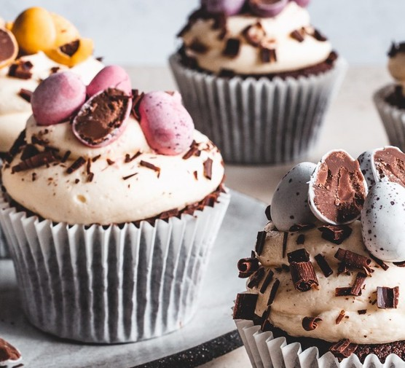

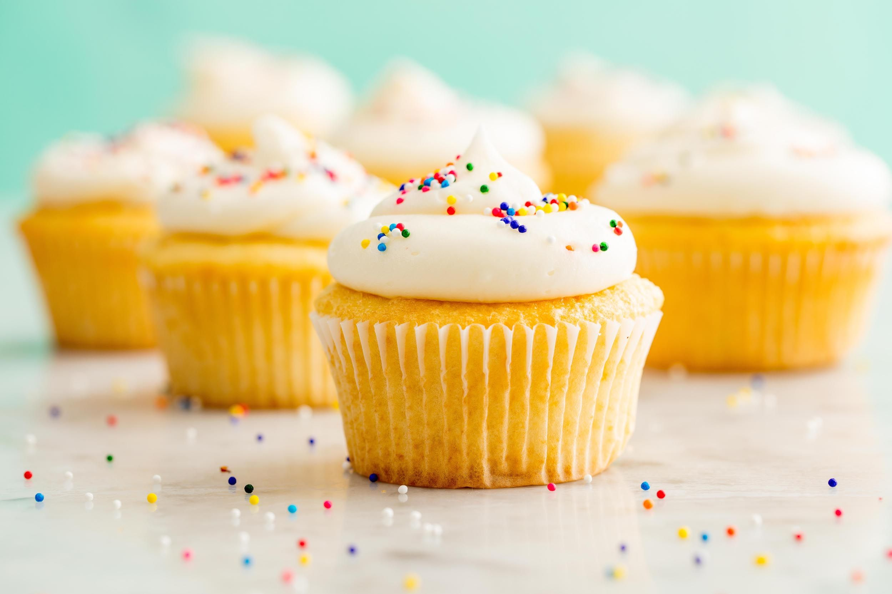
Challenge 1 - cupcake
Watch the clip from Miss Corry and see if you can copy Poynton’s very own Mary Berry!
Send in a picture of your cupcakes!
https://youtu.be/evxAFHzwOWg
transition@phs.Cheshire.sch.uk
Title: Challenge 1-cupcake
Name & Primary school

Slide 3
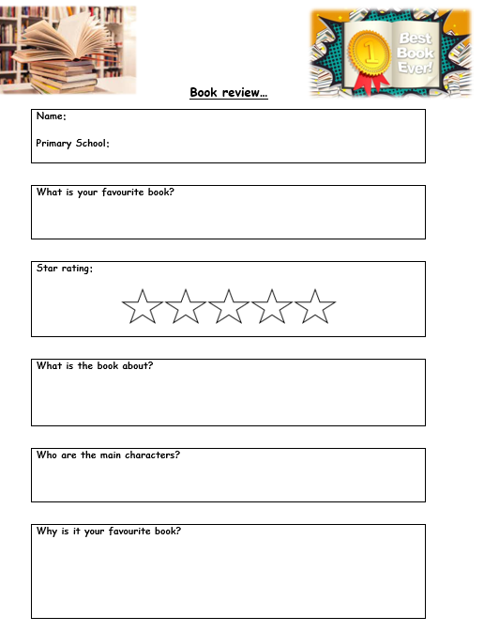


Challenge 2 - What’s your favourite book?
We’d love to know what you’re reading and what your favourite book is and why?
Please write a book review on your favourite book…
transition@phs.Cheshire.sch.uk
Title: Challenge 2 – favourite book
Name & Primary school

Slide 4


Challenge 3 –
Guess where?
Whilst on your holidays send us pictures of your travels from Poynton to Hazel Grove to wherever you may go and lets see if we can guess where you’ve been?
Email your picture to transition@phs.Cheshire.sch.uk
Title: Challenge 3 – Guess where?
Please tell us your name and primary school along with the picture.

Slide 5
Challenge 4 – PE ball skills
See the link below to view the Challenge video from our PE teacher Mr Megarrell
https://www.phs.cheshire.sch.uk/challengefortnight1
Send your results to transition@phs.Cheshire.sch.uk
Title: Challenge 4 – PE ball skills
Name & Primary school

Slide 6
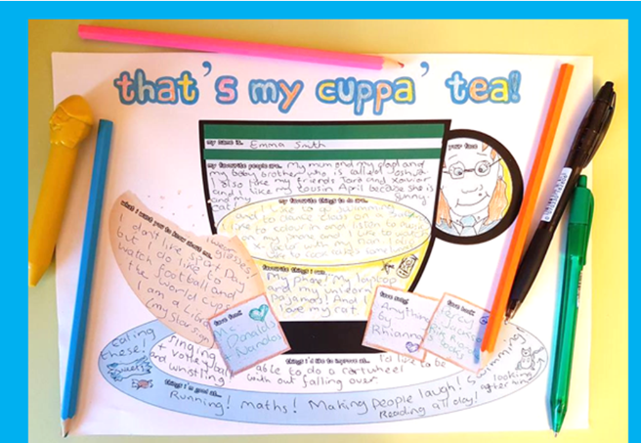
Challenge 5 – That’s my cuppa tea
We want to find out about you so click the template and fill in the bits about you.
Email us
transition@phs.Cheshire.sch.uk
Title: Challenge 5 – that’s my cuppa tea

Slide 7
Challenge 6 – wellbeing booklet
https://www.phs.cheshire.sch.uk/_site/data/files/users/6FC3C5504A840744B8182453A3057E54.pdf?pid=1668
Click the link and fill in the well-being booklet from our website.

Slide 8
Challenge 7 - Science
Email your findings
transition@phs.Cheshire.sch.uk
Title: Challenge 7 - science
Name & Primary school

Slide 9
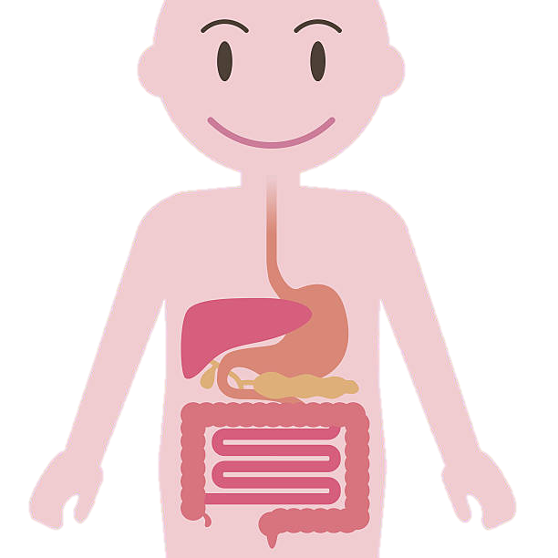



Can you find out which organs were used to help you digest your breakfast this morning?
What do they all do?
Draw your digestive system?
……
…a phrase that can be spelt out using the symbols of elements in the Periodic Table?
(use the table on the next slide)
email your findings to transition@phs.cheshire.sch.uk
Make a Compass
Cut a circle of paper or card and float it in a bowl of water. Straighten a paper clip, rub it in one direction with a fridge magnet for 1 minute.
Carefully place the paperclip on the paper and it will point from North to South.
Can you explain what makes it point in that direction?

Slide 10
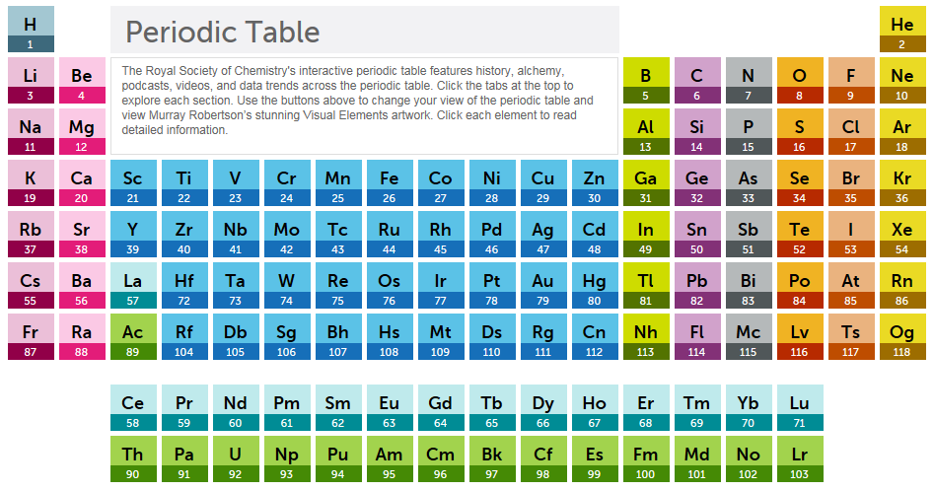

The Periodic Table
click on the picture to be taken to an interactive version

Slide 11
Challenge fortnight…
All information can be found on the website and the extra documents you may need to complete each challenge.
Remember you do not need to do all of them but have a go and see how many you can complete.
We are looking forward to meeting you in person but this will help us get to know you before you arrive!

