Slide 1
Thinking
Can you figure out what these machines are actually doing?
Why is the code in a 1 ← 10 machine the same as the number being put in?
What does the code 1011 actually mean from a 1 ← 2 machine?

Slide 2
How many dots? 1 ← 2
16
8
4
2
1

Slide 3
How many dots? 1 ← 3
81
27
9
3
1

Slide 4
How many dots? 1 ← 10
10000
1000
100
10
1

Slide 5
What happens? 1 ← 1

Slide 6




What happens? 2 ← 1
$$\frac{1}{16}$$
$$\frac{1}{8}$$
$$\frac{1}{4}$$
$$\frac{1}{2}$$
1

Slide 7
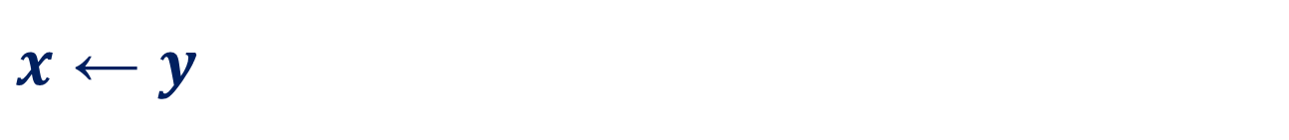
$x$ ← $y$
What other weird machines can you make?
Can you find the value of a dot in each of the boxes you make?

