Slide 1
Exploding Dots

Slide 6
Questions: Dot Patterns
Where will the dots appear if there are 13 to begin with?
Where will the dots appear if there are 50 to begin with?
What pattern of dots will there be if there are 67 dots?
What pattern of dots will there be if there are 256 dots to begin with?

Slide 7
Questions: Dot Patterns
How many dots where there if the number pattern is 101?
How many dots where there if the number pattern is 10011?
How many dots began if the pattern is 10000001?

Slide 9
Questions: 1 ← 3
What is the code for 4?
What is the code for 13?
What code shows 20?
What number has the code 1022?
What number has the code 2111?
What number has the code 1000201?

Slide 10
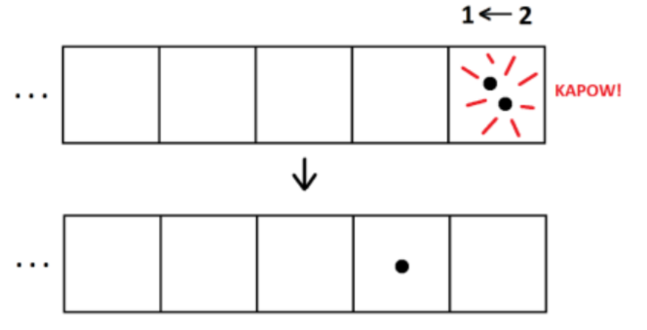
Drawing Dot Patterns
Here is a drawing of a 1 ← 2 machine showing what happens when two dots are put into the machine

Slide 11
Proof: 1 ← 3
Using a similar drawing of a machine
Show that the code for four in a 1 ← 3 machine is 11.
Show that the code for thirteen in a 1 ← 3 machine is 111.
Show that the code for twenty in a 1 ← 3 machine is 202.
I have the code of 2041 in a 1 ← 3 machine
Is this a ‘stable’ code. If not can you show me what happens?

Slide 12
Questions: 1 ← n
What is the 1 ← 4 code for 13?
What is the 1 ← 5 code for 13?
What is the 1 ← 9 code for 13?
What is the 1 ← 5 code for 12?
What is the 1 ← 9 code for 20?
What is the 1 ← 10 code for 13?
What is the 1 ← 10 code for 37?
What is the 1 ← 10 code for 5846?

Slide 13
Thinking
Can you figure out what these machines are actually doing?
Why is the code in a 1 ← 10 machine the same as the number being put in?
What does the code 1011 actually mean from a 1 ← 2 machine?

