Slide 1
Twenty Divided Into Six

Slide 2
Twenty Divided Into Six
1
2
3
4
5
6
7
8
9
10
11
12
13
14
15
16
17
18
19
20
Twenty number cards marked 1 to 20 are arranged into 6 piles.
Each pile has the same total when all the cards are added together.
What cards went into each pile?

Slide 3
Which Scripts?

Slide 4
Which Script?
The number system which we regularly see and use in most European and English speaking countries is based on the Arabic number system introduced to Europe in the 10th Century. By the 14th Century, the previously used Roman numerals had been phased out.
However not all of the world has adopted this number system!

Slide 5
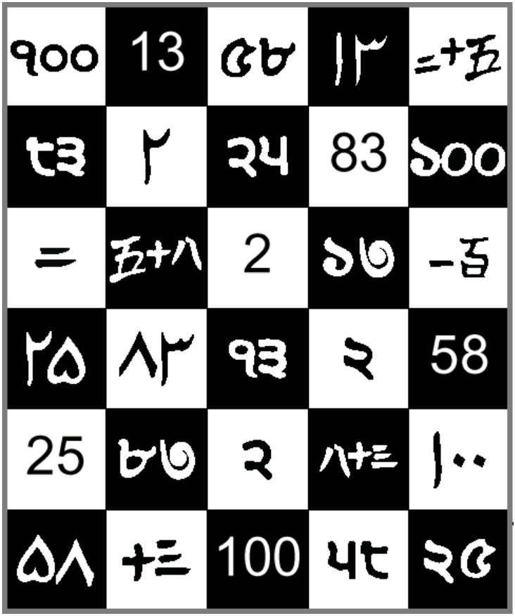
Which Script?
On the grid are numerals displayed in five different scripts
Cut out squares and group them into six numbers. Once that has been done match the equivalent scripts which match our Arabic number system
Can you write 51 in each script?

Slide 6
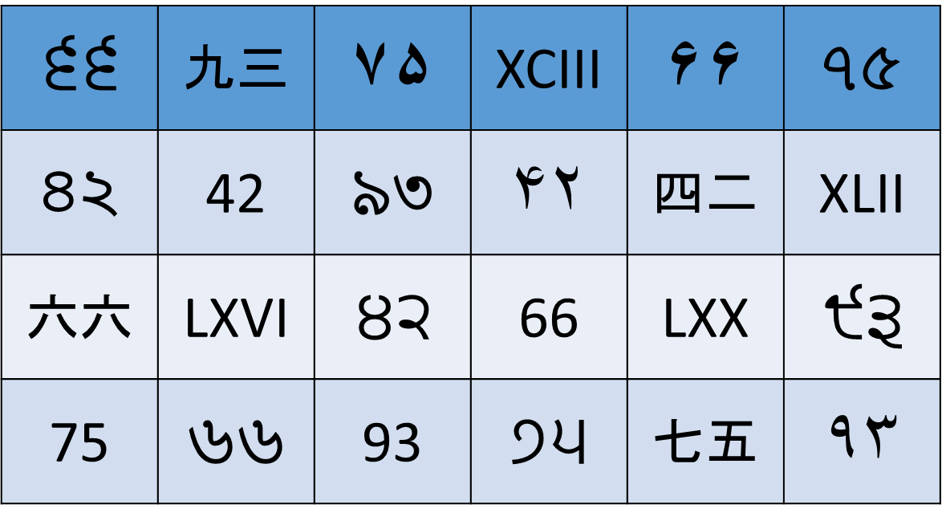
Extension
Can you create a times table grid for each script?
There will be gaps in your grid where you will need some more information
The extension sheet has
the remaining missing
digits but also a new
script!

Slide 8
Four Triangles

Slide 9
Four Triangles
If you cut a square diagonally from corner to corner you get four right-angled isosceles triangles
How many different shapes can you make by fitting the four triangles back together?

Slide 10
Four Triangles
You may only fit long sides to long sides and short sides to short sides.
The whole length of the side must be joined.
You might like to record what you do.
Does it make a difference if you turn one triangle over in this arrangement?
How are you making sure all your patterns are different?

Slide 11
Extension
If you have found all the possible arrangements are you able to justify that you have found all the possible variations?
If so can you predict and explain how many different arrangements there will be for five, six, seven etc triangles?
Why not make a display to put your triangles on. You may find it in your classrooms at PHS next year!

