Slide 1
Different Types of Problems
Word problems
Pictorial problems
Abstract problems
Fictitious problems
Real life problems
Problems involving measurement, time, geometry, money, manipulatives …

Slide 2
A Few Strategies
Pattern spotting
Working systematically
Finding all the possibilities
Using diagrams and pictorial information
Working backwards
Trail and improvement
Visualising
Conjecturing
Using manipulatives
Notes:
Note this list is not in any particular order

Slide 3
Problem-solving Process
Getting started
  try a simpler case draw a diagram
  represent with model act it out
2. Working on the problem
visualise work backwards
reason logically conjecture
work systematically look for a pattern
trial and improvement
3. Digging deeper
generalise verify prove
4. Concluding
communicate findings
evaluate

Slide 4
Developing Mathematical Habits of Mind
Being curious
Develop questions & curiosity
Being resourceful
Careful consideration and time
Being resilient
Perseverance, struggle and achievement
Being collaborative
Share ideas, help others

Slide 5
Twenty Divided Into Six – Lesson Plan
Twenty Divided Into Six is a simple task that every student will be quick to engage with but will be one in which students will also be quick to quit! Students should be encouraged to have some resilience and persevere with it and adopt a methodical method and record their ongoing findings
This task benefits from group interaction but with individual members working together and sharing what they find within their group. Allow some time at this stage for students to become stuck before pulling all students together to discuss what they have found. Most students at this stage are using a method of trial and improvement, which can yield a correct results, albeit an incredibly unlikely one!
Students should be praised and encouraged for
Recording their trials.
The total of all the cards (210)
The total of the cards in each pile (35)
Once the total of each pile is found the task is a relatively easy one in which they build piles of 35. Obviously not all piles will have the same number of cards. At this point do not give any further guidance but it is a great opportunity to listen in on conversations and it can usually be a time where students who have given up, can get quite excited in a rush to get solutions!

Slide 6
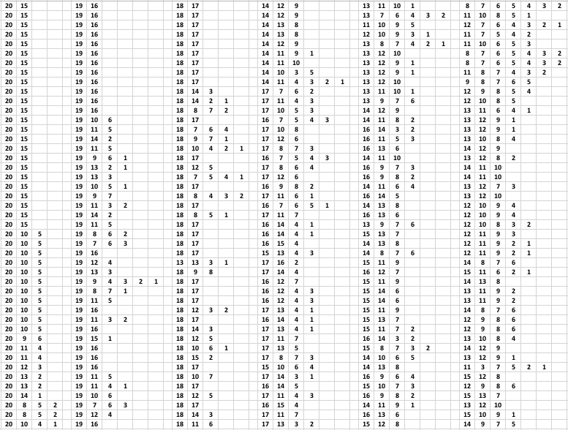
Twenty Divided Into Six – Lesson Plan

Slide 7
Which Scripts – Lesson Plan (Requires Worksheet)
The students will each get a copy of the numbers with the aim to arrange them into 5 piles of 6 numbers each of a different number system
The task at first glance can be quite daunting however there are some subtle changes in each script which should allow students to group the numerals together. Once they have grouped the numbers the task is then to find the equivalent numbers in each script. Finally they have to write 51 in each number
The extension task is to create a times table grid in each script. The numbers 4 6 7 and 9 are missing from each non Arabic numeral so an extension sheet will be needed to fill in these gaps. For an extra level of difficulty the Roman number system has been included here for the students to recall this knowledge. This extension task may be modified for other questions on numeracy such as basic operation, primes, factors and multiples even fraction problems

Slide 8
Which Script?
Arabic | 0 | 1 | 2 | 3 | 4 | 5 | 6 | 7 | 8 | 9 | 10
Eastern Arabic (Urdu & Persian) | ۰ | ۱ | ۲ | ۳ | ۴ | ۵ | ۶ | ۷ | ۸ | ۹ | ۱۰
Bengali | ০ | ১ | ২ | ৩ | ৪ | ৫ | ৬ | ৭ | ৮ | ৯ | ১০
Chinese | 〇 | 一 | 二 | 三 | 四 | 五 | 六 | 七 | 八 | 九 | 十
Gurmukhi (Punjabi) | ੦ | ੧ | ੨ | ੩ | ੪ | ੫ | ੬ | ੭ | ੮ | ੯ | ੧੦
Roman Numeral |  | I | II | III | IV | V | VI | VII | VIII | IX | X

Slide 9
Which Script - Extension
੬੬ | 九三 | ۷۵ | XCIII | ۶۶ | ৭৫
৪২ | 42 | ৯৩ | ۴۲ | 四二 | XLII
六六 | LXVI | ੪੨ | 66 | LXX | ੯੩
75 | ৬৬ | 93 | ੭੫ | 七五 | ۹۳

Slide 10
Four Triangles – Lesson Plan (Requires Worksheet)
Four Triangles is a simple activity which has a very low entry point but can offer some incredibly in depth deep understanding conversations.
A square can be cut diagonally to create 4 right angled isosceles triangles. In doing so a range of different shapes can then be created using these triangles.
The interactive whiteboard activity
https://www.geogebra.org/m/wu3Tr8y6
allows you to establish the constraints of this activity by calling students to the board asking them to use four triangles to make a new shape.
Long side to long side
Short side to short side
Whole sides connected together only
The worksheet can be used to help visualise the shapes which can then be copied straight onto dotty or square paper. Or the shapes can be drawn straight from the students visualised image onto paper.
Give the students some time working in pairs to see how they are they get on, before pulling them back together to find how they are getting on. This will lead into a discussion of finding a system for making successive arrangements, which means it is less likely any will be left out. Starting with just two triangles recording an exhaustive list of all the combinations before moving onto three triangles and then four. If students have not yet tried this, it is useful to try as there are less variables and students can concentrate on the basics before being overwhelmed by the possible permutations.

