Slide 1
Coded Hundred Square

Slide 2
Alien Number Grid
You have all numbers from 1 to 100 in a jigsaw of an alien species!
The number grid starts at the symbol for 1 and finishes with the symbol for 100.
Can you cut out the jigsaw and position the symbols correctly to give yourself the correct number grid?

Slide 3
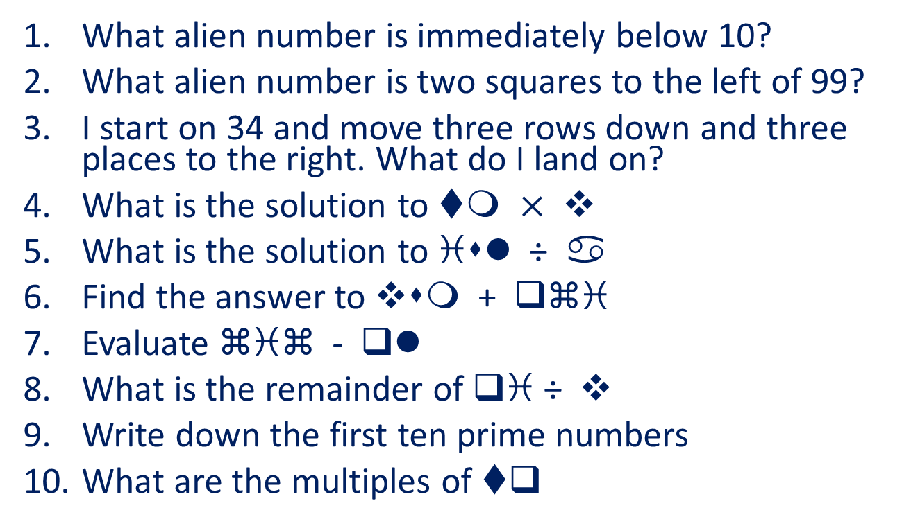
Alien Questions
Write your answers in our alien number system
What alien number is immediately below 10?
What alien number is two squares to the left of 99?
I start on 34 and move three rows down and three places to the right. What do I land on?
What is the solution to tm $×$ v
What is the solution to isl ÷ a
Find the answer to vsm + qzi
Evaluate ziz - ql
What is the remainder of qi ÷ v
Write down the first ten prime numbers
What are the multiples of tq

Slide 4
Sealed Solution

Slide 5




Sealed Solution
A set of six cards, each showing one of the digits from 0 to 5, is divided up between five envelopes. The sum of the cards inside it is written on each envelope
0 and 1 are put in the left most envelope, envelope “1”
3 and 5 are put in the middle envelope, envelope “8”
The remaining numbers are put in the right most envelope. What is it’s total? How do you know?
1
8
?

Slide 6
Sealed Solution
A set of ten cards, each showing one of the digits from 0 to 9, is divided up between five envelopes so that there are two cards in each envelope. The sum of the cards inside it is written on each envelope:
What numbers could be inside the “8” envelope?
7
8
13
14
3

Slide 7
Extension
Can you create a similar problem that someone else (even me!) could try?
You could alter the number of cards and envelopes but in doing so you may create multiple solutions. Be prepared!

Slide 8
What’s It Worth?

Slide 9
What’s It Worth?
There are 4 symbols, each symbol has it’s own unique value (a triangle does not the have the same value as a square etc)
The values of these shapes add together to give the total at the end of each row and column
By finding out the values of the shapes, can you find the combined total of the first column?

Slide 10
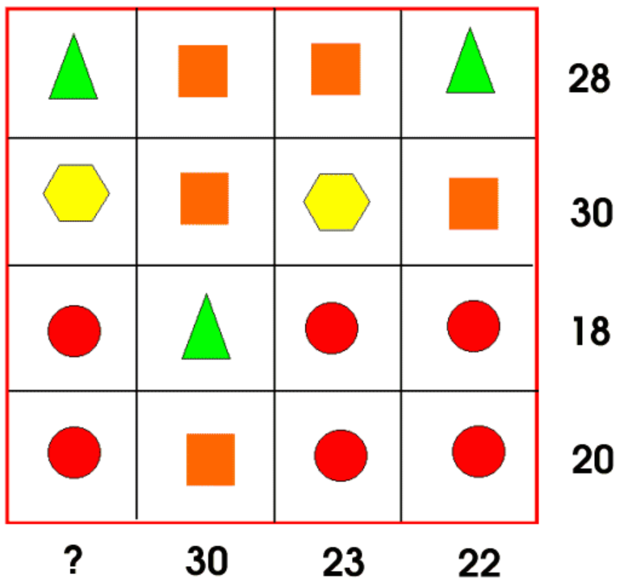

Slide 11
Reasoning
How did you come up with your solution? What strategies did you use to solve it. Could you write a step by step guide to solving another problem like this?

Slide 12
Extension
Can you create another similar puzzle to this? You could change the size of the grid or the number of shapes that you are using. The more shapes that you use the harder it becomes

