Slide 1
Reasoning is one of the NC aims
Children need to reason mathematically by following a line of enquiry, conjecturing relationships and generalisations, and developing an argument, justification or proof using mathematical language.
(DfE, 2013).

Slide 2
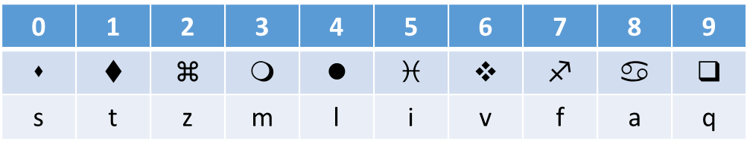
Coded 100 Square – Lesson Plan
Give the students the jigsaw. It should be apparent that columns will have a shared symbol and should therefore make the job easier to complete
The table shows the symbols, the corresponding number and also the wingdings equivalent English keystroke (should worksheets or additional problems be needed)

Slide 3
Sealed Solution – Lesson Plan
This task offers the chance for the students to work in a systematic way and is a great context in which to encourage them to explain and justify their reasoning. At each stage push for the explanation on how they know their answer.
This task works well with a visual aid of envelopes pre prepared numbers which fit in the envelopes and post it notes to write down the totals
Start small with the class modelling the idea. A suggested path (but by no means should this be taken as an instruction) would be with the first slide of 6 cards and 3 envelopes. Demonstrate this again, however mix it up by putting 0 and 5 in the second envelope and recording the total. But then put two cards in the third envelope without showing them to the students but writing only the total on the outside of the envelope. Repeat this for the third envelope. (For example you could have 1 and 3 in the first and 2 and 4 in the second.) What numbers are in the two envelopes? How do they know? Try again, this time keeping 0 and 5 in the first envelope but suggest that you want to put the other cards in pairs into the envelopes, so that the totals on the other two are the same. What could you do? How do they know? At each stage, students can be working in pairs, perhaps using mini-whiteboards and digit cards to try out their ideas.
Continue like this, gradually building up the level of complexity, and each time focusing on students' clear reasoning. You could put the cards in the envelopes without showing any to the students, only writing the totals. Invite the students to say which numbers could be in the envelopes. Next, using four envelopes and cards 0−7, write 5, 11, 8 and 4 on the envelopes. How could they put numbers in the envelopes for the totals to be right? The final challenge is provided to solve the problem as it stands, with five envelopes and ten digit cards.

Slide 4
What’s It Worth – Lesson Plan
What’s it Worth provides a good challenge in reasoning, working with multiple unknowns.
Students should be encouraged to become stuck at this task and not be given too much support, however there are some entry points that students could be directed towards (see next page) if they have got to a dead end. There are many solutions to each of the shape’s values so a method of trial and improvement can be used but ultimately there is only one correct answer.
Once students have answered using whichever method they used. Write down their instructions to help them focus their reasoning.
There is another variant of this puzzle (albeit with fruit), which you can use as an extension to this task or as a replacement for the shape task
https://nrich.maths.org/fruitytotals/responsive.html

Slide 5




