Slide 1
Dozens

Slide 2
Dozens
Do you know a quick way to check if a number is a multiple of two?
Your task is to find the largest possible three-digit number which uses two randomly selected numbers, and any one digit number of your own, to make a multiple of 2.
Can you describe a strategy that ensures your first 'guess' is always correct?

Slide 3
Dozens
Now your task is to find the largest 3 digit multiple of three using the same process.
If you are feeling confident with your answer can you write down a way to explain to a year 5 student how you can be so sure every time?

Slide 4
Dozens
Now your task is to find the largest 3 digit multiple of four then the largest 3 digit multiple of six using the same process.
If you still feeling confident can you try and explain your answer using less than 20 words?

Slide 5
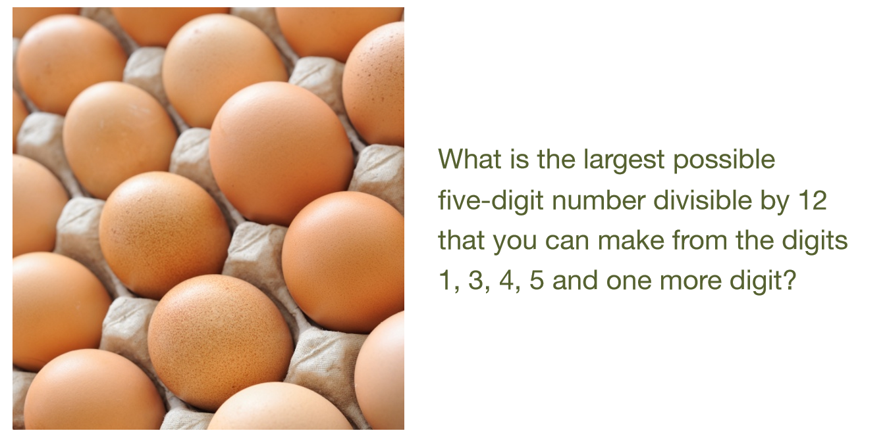

Slide 6
Shape Draw

Slide 7
Are you a Shape Detective?
I will give you some clues to a shape and it is your job to draw the exact shape as what I have

Slide 8
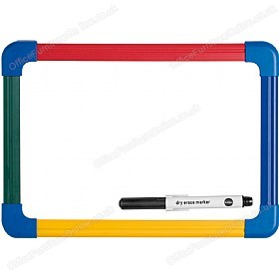
On Your Whiteboards
I will ask you to pick a number, underneath which will be a clue of my shape
Draw me a shape with as much detail as you have been given. Once it has been drawn hold it up for all to see
Do not be overly worried if yours is totally different to others!

Slide 9
The shape is a quadrilateral | The shape has two lines of symmetry | The areas of the shape is 24cm2
The shape has two pairs of parallel sides | The shape is not 3D | The shape is irregular
The shape’s perimeter is numerically larger than its area | The shape has four right angles | The length of each side is an even number
1
2
3
4
5
6
7
8
9

Slide 10
12cm
2cm

Slide 11
Your Turn!
Draw yourself any shape
Come up with 9 clues which will describe the shape
Don’t make your clues too obvious
“One side of the square is 5cm long”
Include some details which are useful, but we can do without
Try it out on your table partner!

Slide 12
Completing Quadrilaterals
This is a sub-title

Slide 13
Guess What
I am thinking of a quadrilateral and I want you to find out which one it is by asking me questions to which I can only answer yes or no. I promise that I won’t cheat by changing my shape! I have it drawn on a piece of paper already
You cannot just ask me if it is an arrowhead etc
After each round of questions I want you to draw the shape you are thinking. Do not be concerned by the shapes of others!

Slide 14
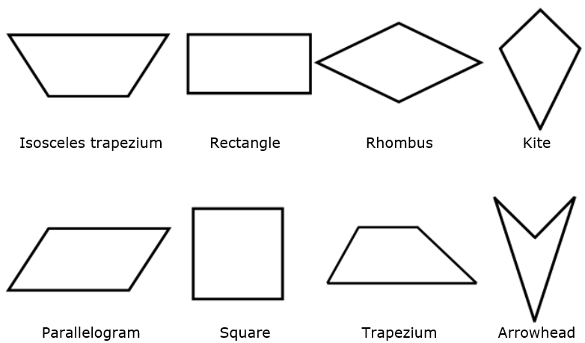
Guess What

Slide 15
Your Turn
Who wants to challenge me?
I know I can guess your shape by asking you only three questions

Slide 16
Guess What

Slide 17
How did I do it?
In your partners devise a way in which I can correctly predict your shape every time

Slide 18
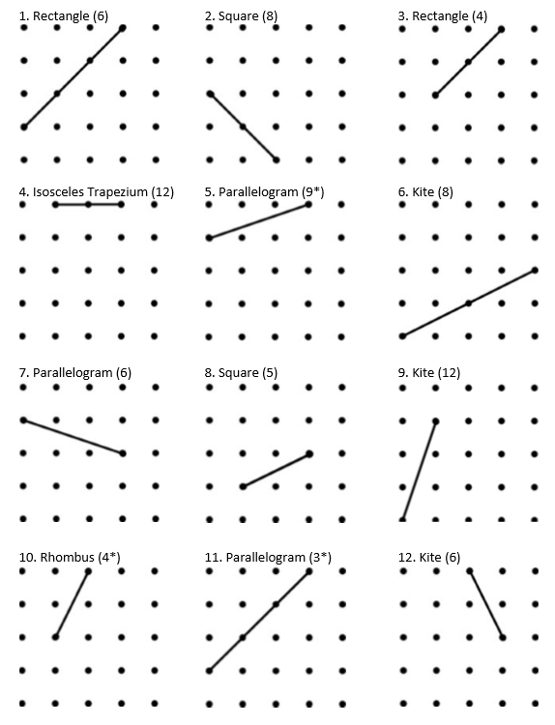
Completing Quadrilaterals
On the worksheet you should join the dots to create a quadrilateral
You cannot shorten or extend the line given and you must use it as one of your sides
The number in brackets is an
extra challenge for you to create a shape which has this number as
its area

Slide 19
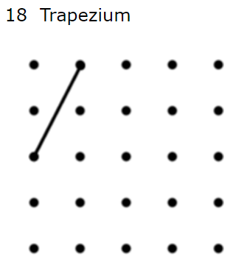

Drawing Areas
If there is more than one possible shape that you can draw… try to find the one with the largest area.

Slide 20
Answers
1) 6 rectangle
2) 8 square
3) 4 rectangle
4) 12 isosceles trapezium
5) 19 parallelogram
6) 8 kite
7) 6 parallelogram
8) 5 square
9) 12 kite
10) 4 rhombus
11) 3 parallelogram
12) 6 kite
13) 6 arrowhead
14) 8 kite
15) 8 rhombus
16) 3 rhombus
17) 4 arrowhead
18) 9 trapezium
19) 8 parallelogram
20) 8 isosceles trapezium
21) 3 kite
22) 4 arrowhead
23) 9 kite
24) 9 trapezium

