Slide 1
Revision Timetable
Here is an example timetable for you to use. You can use this or create your own.
Creating a revision timetable is a really useful way to plan and organise your time to make sure you cover everything you need to ahead of your exams. You should also plan breaks and downtime into your timetable.
 | Monday | Tuesday | Wednesday | Thursday | Friday | Saturday | Sunday
16:00 – 16:30 | English | Maths | Science | Language | Science
16:30 – 17:00 | Maths | History | Geography | English | RS
17:00 – 17:30 | Exercise | Fun | Exercise | Fun | Exercise
17:30 – 18:00 | Geography | Science | RS | Maths | Fun
18:00 – 19:00 | Tea | Tea | Tea | Tea | Tea
19:00 – 19:30 | Language | RS | English | History | Friends
19:30 – 20:00 | Relax | Relax | Relax | Relax | Friends

Slide 2
 | Monday | Tuesday | Wednesday | Thursday | Friday | Saturday | Sunday
16:00 – 16:30 | English | Maths | Science | Language | Science
16:30 – 17:00 | Maths | History | Geography | English | RS
17:00 – 17:30 | Exercise | Fun | Exercise | Fun | Exercise
17:30 – 18:00 | Geography | Science | RS | Maths | Fun
18:00 – 19:00 | Tea | Tea | Tea | Tea | Tea
19:00 – 19:30 | Language | RS | English | History | Friends
19:30 – 20:00 | Relax | Relax | Relax | Relax | Friends
I have left the weekend blank on this example timetable as the times here might not work at the weekend.
However, you should try to include the same amount of revision on weekend days as on weekdays – fit in your 4 30 minute chunks when they suit you!
You can then colour code your timetable so you can clearly see what subjects you are doing and when

Slide 3
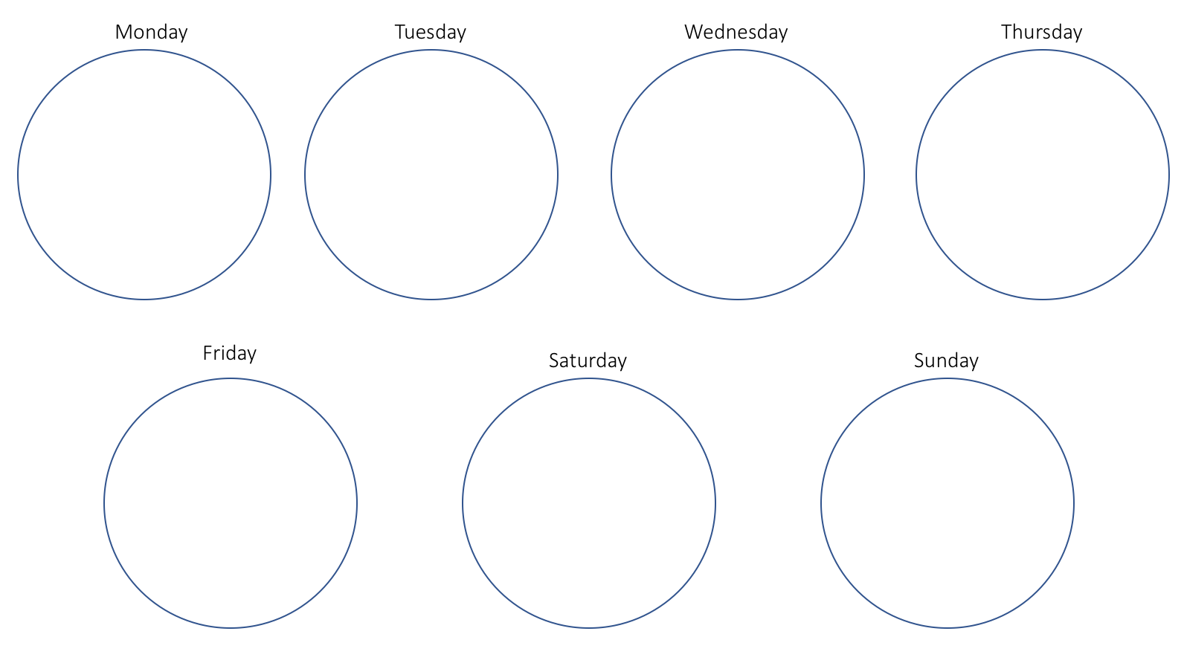
Keeping Track of Your Revision
Monday
Each circle represents 2 hours. The coloured circle above tells me I have done 30 minutes of 4 subjects (I have used the same colours as on my revision timetable).
Doing this everyday in a week will help you to keep track of how much you have revised and in which subjects – this is useful as:
It should give you confidence that you have worked hard and prepared!
You can clearly see which subjects you have done less revision for, so you know to focus on them the next week.
You might decide that each 2 hour circle could be for each subject rather than day – that way you can see how much revision you have done for each subject. Any circles that aren’t filled by the end of the week can be the focus for the following week!

Slide 4
 | Monday | Tuesday | Wednesday | Thursday | Friday | Saturday | Sunday
16:00 – 16:30 | English | Maths | Science | Language | Science
16:30 – 17:00 | Maths | History | Geography | English | RS
17:00 – 17:30 | Exercise | Fun | Exercise | Fun | Exercise
17:30 – 18:00 | Geography | Science | RS | Maths | Fun
18:00 – 19:00 | Tea | Tea | Tea | Tea | Tea
19:00 – 19:30 | Language | RS | English | History | Friends
19:30 – 20:00 | Relax | Relax | Relax | Relax | Friends

Slide 5
 | Monday | Tuesday | Wednesday | Thursday | Friday | Saturday | Sunday

Slide 6
Monday
Tuesday
Wednesday
Thursday
Friday
Saturday
Sunday

Slide 7
English
Maths
Science
RS
Geography
History
Language

