Slide 1


Slide 2

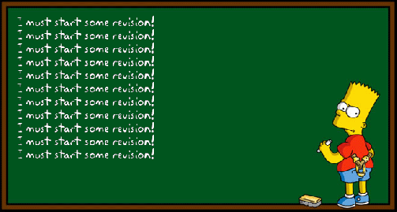

We do not need to fear the word REVISION!
Start now and it will pay off in the future…
Here are 10 top tips on how to revise…

Slide 3
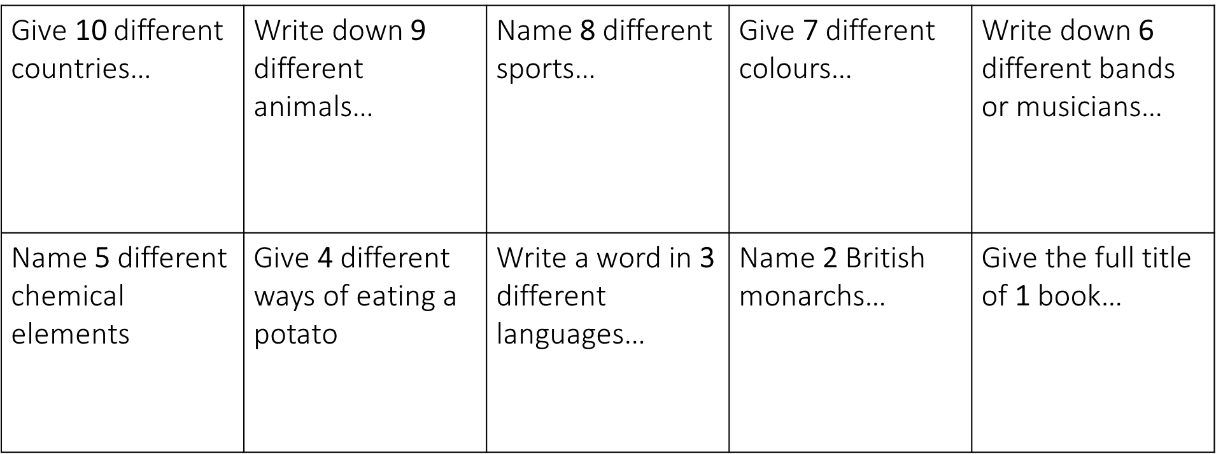
Tip 1 – get thinking…

Slide 4
Revision Remedies
Active revision strategies for now and the future
The aim of these sessions is to give you some useful revision activities, which you can use throughout the school year but also to help you with assessments, mocks and ultimately external exams.
A really important part of effective revision is taking an active role in what you are doing. You need to move the knowledge you have gained into your long term memory – to do this, you must test yourself and practice what you have learnt.
Another key part of effective revision is knowledge retrieval and being able to recall information…
Look back at your answers – recall and retrieval in action! You have shown that you are able to recall knowledge, so you can do it.
FEELING CLEVER: can you spot an academic link between the 10 starter examples? If you need a clue, look at your timetable…
Notes:
Link – 10 subjects (some are tenuous!)

Slide 5
Tip 2 – Memory and retrieval
Can you make a quiz from a topic you have worked on and then test yourself?
It can be 10 questions, maybe multiple choice or just simple 1 word answers to test you knowledge.
Don’t forget to reward yourself if you get 10/10

Slide 6
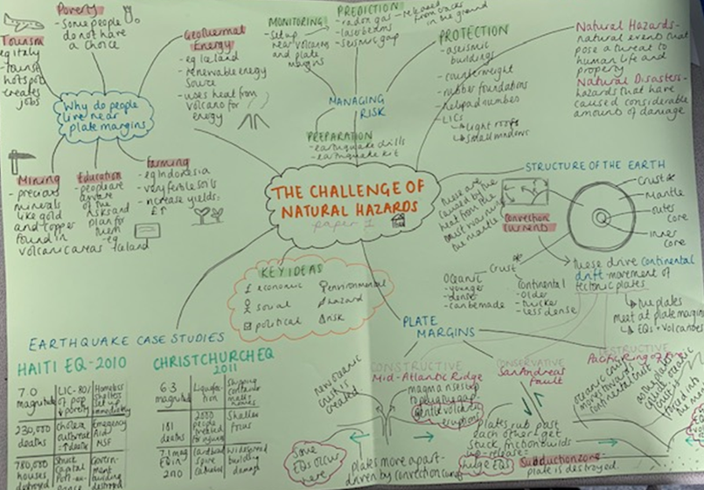
Tip 3 – Mind maps
Mind maps start with a blank piece of paper and the topic of your choice in the middle.
Now write everything you can remember about that topic all around
You can draw pictures/diagrams to help
Then look back at your notes/books and see if you can add anything extra on the page

Slide 7

Tip 4 – cue cards
10x7cm pieces of card
Key word on one side
Description/example/definition on the other
Test yourself
Quick, easy and small to carry around!

Slide 8


Tip 5 – set yourself small goals that you can achieve!
Each week start with setting yourself 3 or 4 goals on what you want to achieve.
Example…
I’m going to complete 1 mind map for history
I’m going to read my English book every night for 15 minutes
I’m going to practice my maths for 20minutes on Monday, Wednesday and Friday
I’m going to complete my homework each night as part of my revision
The main thing is to keep it realistic and manageable for YOU!

Slide 9
Tip 6 – create a revision timetable
 | Mon | Tues | Wed | Thurs | Fri | Sat | Sun
30mins | Maths | History Mind map | Science cue cards | French cue cards | Music | Maths | Geog
10mins | B | R | E | A | K
30mins | English | Geog | RS | PD mind map | ICT | English | Sci
10mins | B | R | E | A | K
Test yourself |  |  |  |  |  | French | Geog
Other activities | Netball |  | Dance |  |  | See my friends
Create a table
Keep it realistic and manageable as you will also have other activities.
Things to include…
Breaks
Testing
Different revision ideas
All subjects
Other activities

Slide 10

Tip 7 – Reduce and transform
Read a topic from a subject of your choice using your exercise books
Now close the book and see how many facts you can write down in 10 bullet points
The aim of this is to keep your work organised and readable

Slide 11

Tip 8 – post it
Use colour
Use post-its
Be creative on ways to remember key words
Find a space in your bedroom to display them!

Slide 12

Tip 9 – self-care
Take time out
Limit screen time
Get out in the fresh air
Listen to music
Exercise
See friends
Sleep
Eat well
Focus on a positive
Reward yourself

Slide 13

Tip 10 – Chose what works for you!
Have a go at some of the methods I’ve shared in my top tips
See which one you like doing or which helps you the most
Keep it realistic
Keep it do-able
And say well done when you’ve achieved it!

Slide 14
What next…
In school we’ll have a revision week in form before the exams
Bring with you a subject you would like to work on
Bring colours to get creative
We’ll do the rest together!

Slide 15
Other websites which might help…
https://www.bbc.co.uk/bitesize/levels/z4kw2hv
https://classroom.thenational.academy/subjects-by-key-stage/key-stage-3

Slide 16

Let’s build the tools now so you are exam ready…
Yr7 – Yr8 – Yr9 – Yr10 – Yr11 – Yr12 – Yr13 and beyond

Slide 17


