Slide 1

Modern Foreign Languages online lesson
Can you speak like a Jedi?
Learning Objective: To be able to solve puzzles in different languages
To get us started:
How many languages are there in the world? 2800 – 4200 – 6500
Can you name a language that reads right to left?
In which country is the Cymreag spoken?
Which proportion of the world languages are spoken in Africa? Half – 10% - a third?
Notes:
At High school, you will learn one of 3 European languages: French, German or Spanish. However, language learning is not just about these 3. it’s also about noticing patterns and working out meanings
Answers to the quiz at the end of the lesson

Slide 2
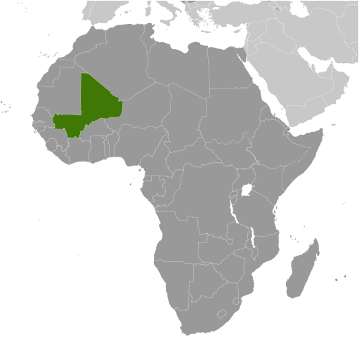
Can you count in Bambara?
Bambara, also known as Bamana and Bamanakan, is spoken mainly in Mali in West Africa. It has about 6 million speakers.
Notes:
This activity is to show students that you don’t need to know anything about a language to work out some words for yourself.

Slide 3
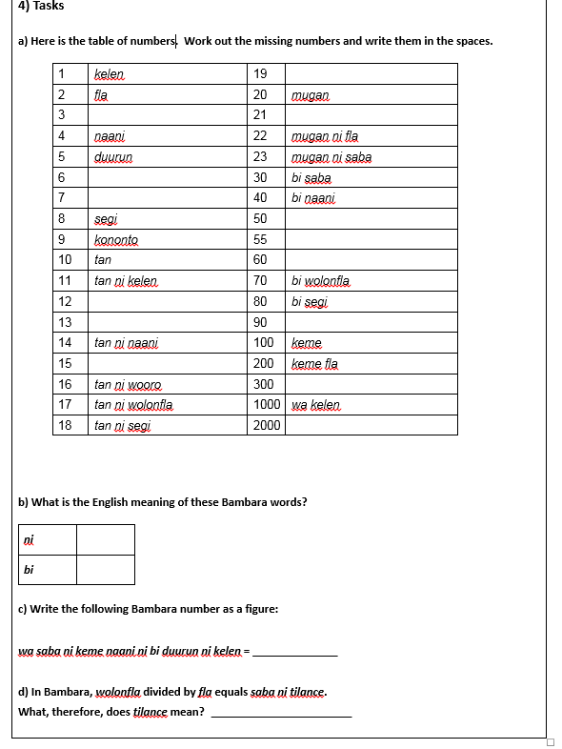
you will now study a list of numbers in the Bambara language. Some are missing!
Look carefully at the table and think about:
a) any patterns you notice which are used to form the numbers
b) how you would write the missing numbers
Notes:
Students in groups of 2 or 3 depending on numbers, activities b-d are extensions
10min max

Slide 4
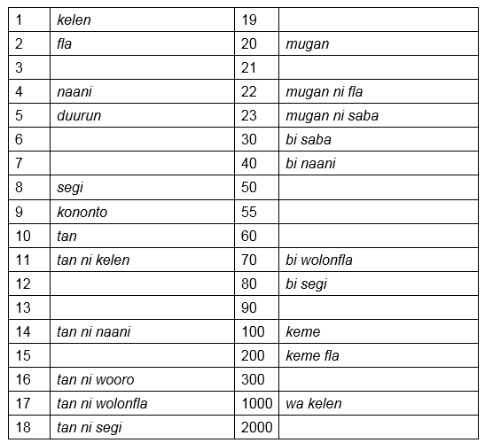

Slide 5
Can you count in Bambara? The answers
tan ni kononto
1 | kelen | 19
2 | fla | 20 | mugan
3 |  | 21
4 | naani | 22 | mugan ni fla
5 | duurun | 23 | mugan ni saba
6 |  | 30 | bi saba
7 |  | 40 | bi naani
8 | segi | 50
9 | kononto | 55
10 | tan | 60
11 | tan ni kelen | 70 | bi wolonfla
12 |  | 80 | bi segi
13 |  | 90
14 | tan ni naani | 100 | keme
15 |  | 200 | keme fla
16 | tan ni wooro | 300
17 | tan ni wolonfla | 1000 | wa kelen
18 | tan ni segi | 2000
saba
mugan ni kelen
wooro
wolonfla
bi duurun
bi duurun ni duurun
bi wooro
tan ni fla
tan ni saba
bi kononto
tan ni duurun
keme saba
wa fla

Slide 6
Write this number as a figure
wa saba ni keme naani ni bi duurun ni kelen = ______________
3451
Now, write a number in Bambara and ask your partner to work it out

Slide 7
Yoda speak
Not all languages are real, some are made up in books or films. I
For example, in Star Wars, Yoda, the Jedi Master, has his own language.
In his sentences, Yoda uses his special ‘Yodaspeak’ word order.
Look at the sentences and think about what they mean and how they are different to ‘regular’ English sentences.
Your father he is.
Much to learn you still have.
Help them you could.
Go I will. Good relations with the Wookies I have.
Lost a planet Master Obi-Wan has.
A domain of evil it is.
Always two there are.
Notes:
Language is not just about words it is also a different way of seeing the world and that’s reflected in the syntax or word order.
Students can do a “think-pair-share” type activity or a whole class discussion

Slide 8
What are the rules of Yoda speak?
To make a sentence into Yodaspeak, you need to remember 2 things:
The verb (action or doing word)
The subject (the person or thing who does the action)
Your father he is.
subject
verb
Notes:
Ask students to work out where the verb and subject go in a Yodaspeak sentence: they both go at the end of the sentence

Slide 9
Can you turn these sentences into Yodaspeak?
English sentence | Pure Yodaspeak
I cannot teach him.
A Jedi’s strength flows from the Force.
I have become sick
This move by Chancellor Palpatine is disturbing.
Teach him I cannot
From the Force a Jedi’s strength flows
Sick I have become
Disturbing this move by chancellor Palpatine is
Notes:
Now we know how to make a sentence in Yodaspeak, can you rewrite these English sentences into Yoda’s language?

Slide 10
Answers to the quiz
How many languages are there in the world? 2800 – 4200 – 6500
Can you name a language that reads right to left?
In which country is the Cymreag spoken?
Which proportion of the world languages are spoken in Africa? Half – 10% - a third?
Hebrew, Arabic, Persian, Urdu, Azeri for example
Wales
Notes:
1- There are roughly 6,500 spoken languages in the world today. However, about 2,000 of those languages have fewer than 1,000 speakers. The most popular language in the world is Mandarin Chinese. There are 1,213,000,000 people in the world that speak that language.
2- Azeri is the language from Azerbajian, Persian or Farsi is spoken in Iran, Hebrew in Israel, Arabic in the Middle East, Urdu in Pakistan and India
4- Most of the world’s languages are spoken in Asia and Africa.

