Slide 1
Rainforests :
Where are they located?
Why are they found there? What are their physical features?

Slide 2


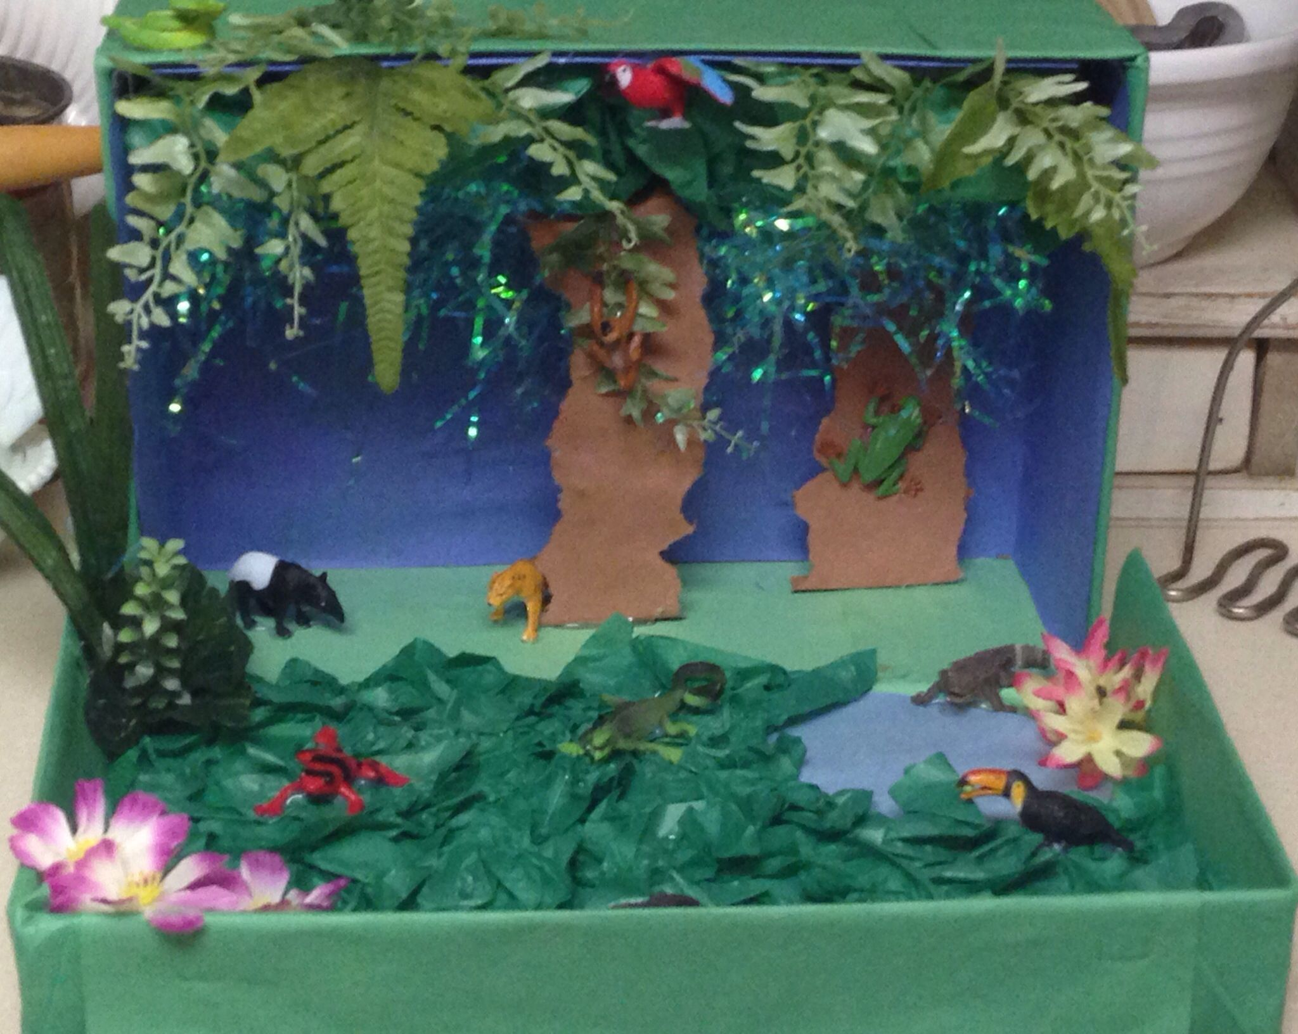
What will I need for these sessions…
Today… paper and a pen.
Later… craft materials as we are going to create a rainforest in a box!

Slide 3
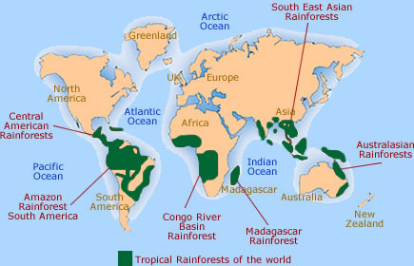

C= Continents?
L= Latitude?
O = Oceans?
C= Countries?
K = Knowledge
Where are they located?
Describe where tropical rainforests are located.
Rainforests are found on the continents of __________
They are found along the _______ line of latitude.
Some of them are found around these oceans__________.
Countries where they are located include _________.
Other facts that I know about rainforests are________
Equator
Image: https://www.theschoolrun.com/homework-help/rainforest-habitats

Slide 4
Describe where tropical rainforests are located.
Rainforests are found on the continents of South America, Africa, Asia and Oceania.
They are found along the equator line of latitude.
Some of them are found around these oceans – The Atlantic Ocean, Indian Ocean and Pacific Ocean
Countries where they are located include Brazil and the Democratic Republic of the Congo.
Other facts that I know about rainforests are….

Slide 5
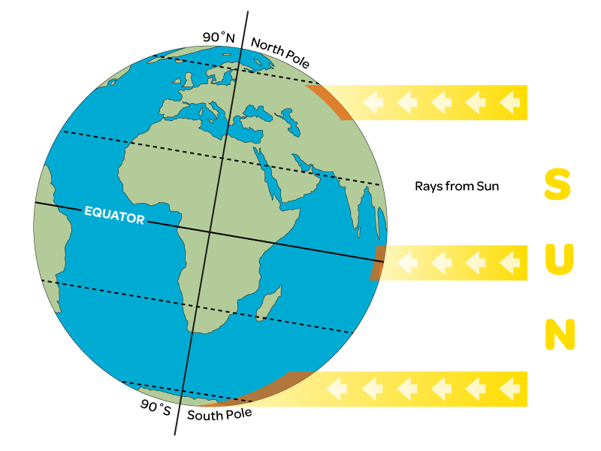
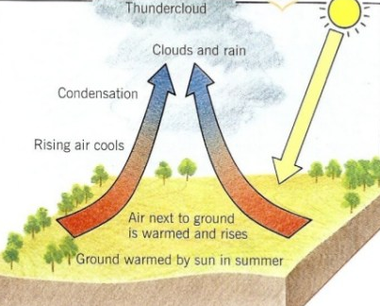
Why are they found there?
Concentrated sun’s rays means that the water evaporates, this creates clouds and RAIN – lots of it!
Image : oddizzi.com

Slide 6
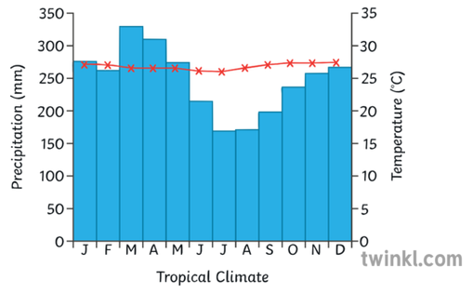
Tropical rainforests are very hot, humid and wet.
They get around 2500 mm of rain a year.
The average temperature is 28°C.
There are no seasons in tropical rainforests; the weather is consistent all year round.
Describe the climate of the tropical rainforest.
The temperature does not fall below _____° C all year.
The month with the most rain is ____.
The ‘driest’ months are______
There are _____ seasons in the rainforests.

Slide 7
Lesson 2

Slide 8
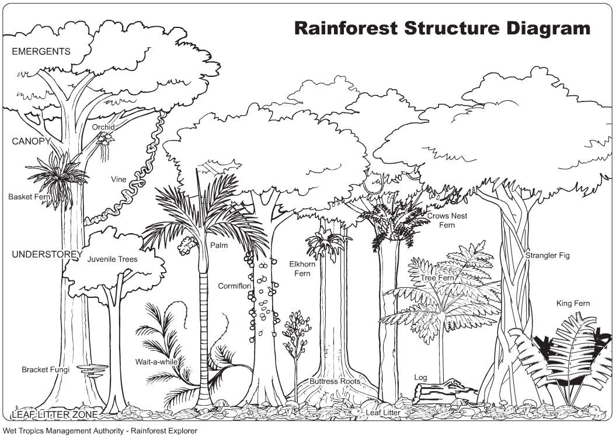

What are their physical features?

Slide 9
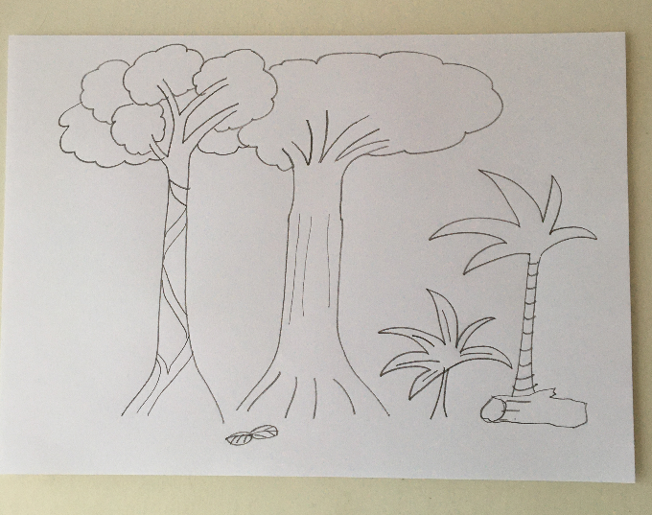
Drawing by Mrs Hardman

Slide 10

Canopy
The second highest layer - 30-45 metres.
The crowns of the trees knit together to form a dense canopy.
The canopy blocks out the sun from lower layers and intercepts (catches) rainfall.
It contains the most plant species.
The emergent layer
The tallest layer - over 40 metres.
Contains only a few tall trees which grow taller than the trees of the canopy.
The plants are made for living in dry conditions because it’s very sunny.
They have small, waxy leaves to prevent them drying out.
Birds, monkeys, frogs, sloths, lizards, snakes and many insects live here.
This layer contains the most animal species.
Some creatures never go to the forest floor.
Eagles, butterflies, small monkeys and bats all live here

Slide 11
Forest floor
Very little light reaches the forest floor (2%) - so plants grow slowly.
The ground is covered in fallen leaves, rotting branches and twigs and a network of shallow roots.
When a tree falls, light is able to get in. This encourages young plants like vines to grow fast. They compete for the extra light and soon fill the gap.
Understory
Low light conditions (2-15%).
Quite open - there is only dense vegetation along rivers and in openings where light gets in.
Plants adapted to low light grow here.
Jaguars, leopards, tigers, elephants and gorillas are found in different rainforests around the world.
Lots of insects live here.
Birds, butterflies, frogs, snakes and lots of insects live here.

Slide 12
Lesson 3
The plants and animals of the rainforest

Slide 13


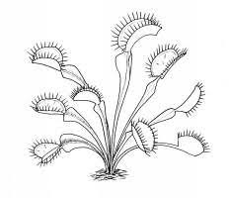
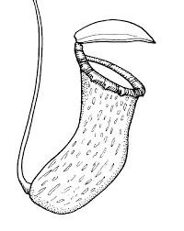
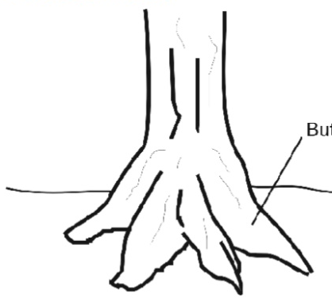
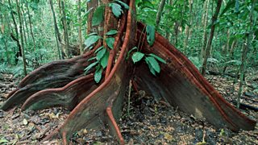
How have the plants adapted to the conditions in the rainforest?
Plants grow thick leaves with drip tips and waxy surfaces to allow water to drain quickly to prevent rotting.
Some plants called 'epiphytes' are flowering plants which grow on tree trunks and branches to get light. They get food from the air and water, and their roots hang in the air, eg orchids.
Rainforest soils are poor, and most nutrients are in the top layers, so roots are generally shallow.
Buttress roots join the tree far up and help to support it.
They also allow it to gather more nutrients.
Carnivorous plants are meat-eating plants that attract insects using smelly nectar and then trap them

Slide 14





Only a small percentage of the animals live on the forest floor. Many live in the trees.
It is thought that in the Amazon rainforest there are over 2,000 species of birds and 1,500 species of fish.
There is also thought to be 50,000 kinds of insects in a single square mile.
Piranhas eat meat and plants and live in the Amazon river.
They have been around for millions of years.
They can grow up to 35cm long.
Sloths are three times stronger than us.
They poo a third of their body weight in one go.
Sloths are blind.
They are faster in water than on land.
It takes sloths 30 days to digest a leaf.
Sloths can fall 100 feet without injury.
Flying squirrels are sociable and noisy.
They glide from tree to tree using a flap of skin in-between their arms and legs.
They can glide for up to 46metres!
They are nocturnal
The toco toucan can be 63cm high.
They prefer to hop from branch to branch through the forest rather than fly.
They eat seeds, nut and sometimes eggs!
Their beak is very light, it has a honeycomb texture
The hissing cockroach can be 2-3cm long.
They live on the forest floor and eat fruit and plants.
They each make a different hissing noise and can recognize each other!

Slide 15
Lesson 4
Rainforest in a box!

Slide 16
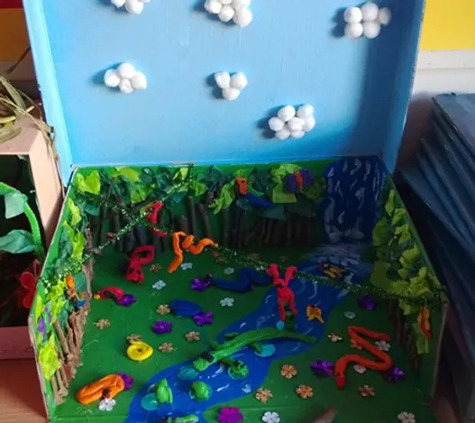
Image : Pinterest

