Slide 1

PiXL Maths App
Things to know:
Your son/daughter is one of our 1.2 million account holders.
Just under 1/5 of all students who sat their Maths GCSE (2018) in England, Wales or Northern Ireland had used the Maths App to prepare for their exam.
With regular use it has been shown to raise attainment within a year by at least 1 grade.

Slide 2
PiXL Maths App
What does the app do?
Uses online questions to assess your child’s knowledge across more than 200 skills to raise awareness of their strengths and areas to develop.
Provides video and PowerPoint support to enable learners to target areas of weakness.
Reproduces the same question but with different numbers so that learners can apply their knowledge.
DIAGNOSIS
THERAPY
TESTING

Slide 3
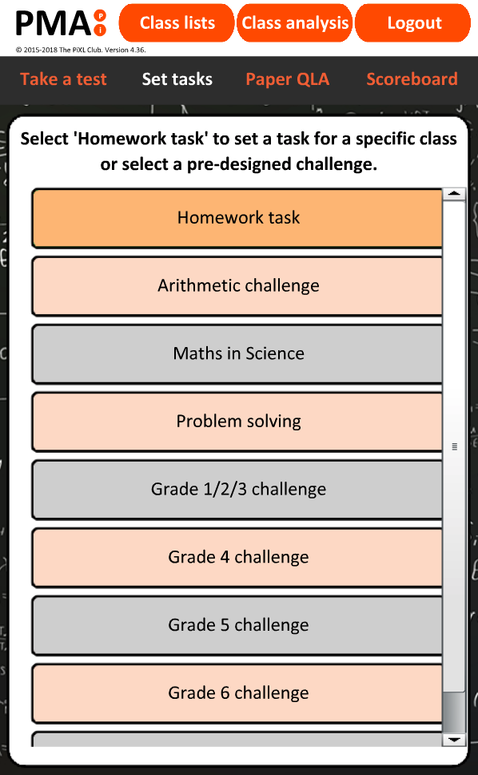
PiXL Maths App
More than 200 skills.
That is quite a lot!
Where should my son/daughter start?
Sometimes it is hard to know what to do with a blank canvas. Therefore we have structured graded challenges under “set tasks” to help students start along a particular path.

Slide 4
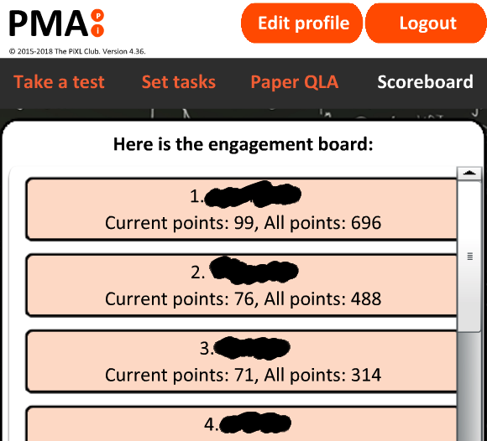
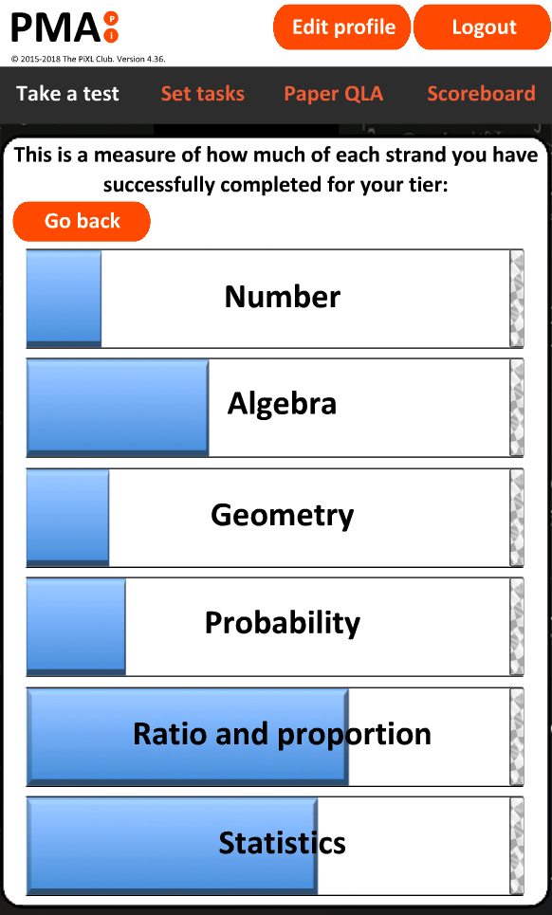
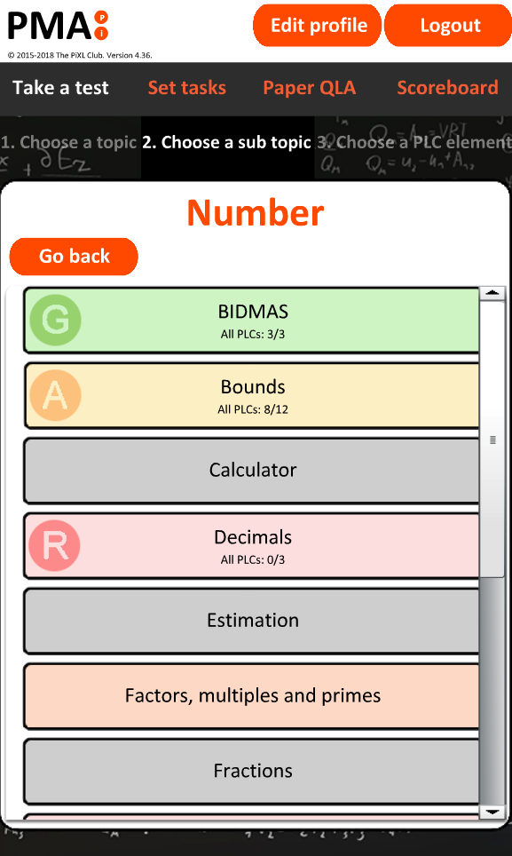
PiXL Maths App
How does my son/daughter know how they are doing?
Their success line
Question selection menu is RAG rated
Class engagement scoreboard
Their teacher also sees an overview and will shape written reports, conversations and their teaching to continuously target their needs.

Slide 5
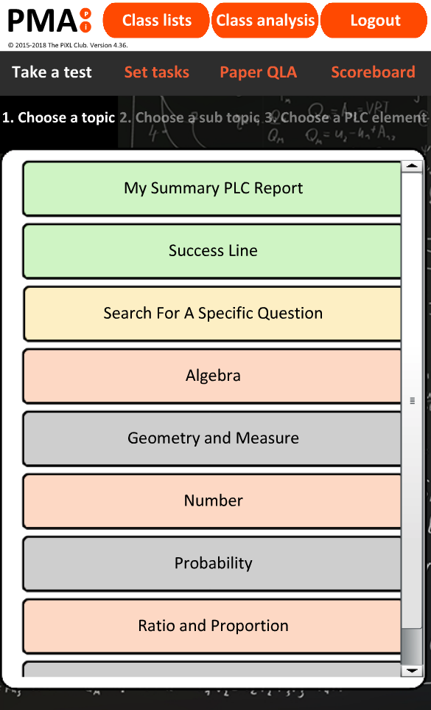
PiXL Maths App
So how can I help?
Encourage your son/daughter to use the app on top of their other home learning. They can use the search facility under “Take a test” to help target a specific skills or the “Daily challenge”.
If you are teaching your son/daughter a particular skill, try and use the techniques shown in the videos/PowerPoints.

