Slide 1


Success Fair
Useful Revision Techniques

Slide 2
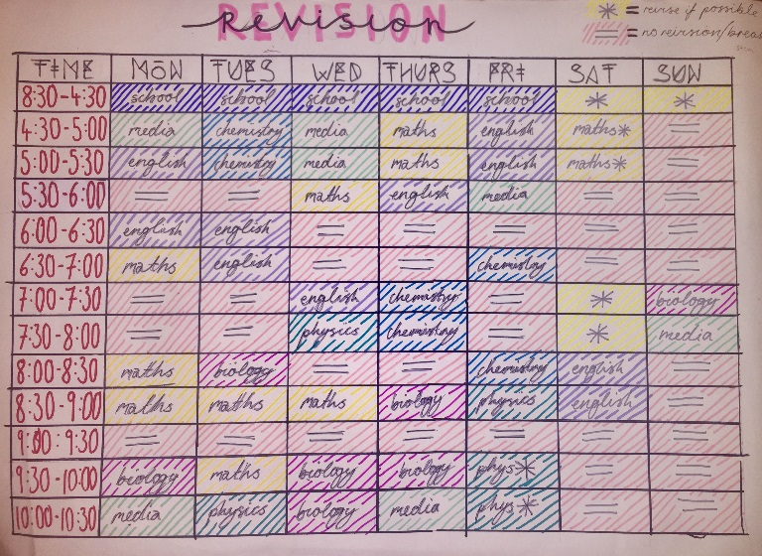

General Advice
Set a revision timetable to ensure all subjects are covered – mix your favourite/easiest subjects with some of the harder subjects you are not looking forward to.
Set achievable goals – this should be something specific that you can check, for example “create a timeline of the causes of WWII”, rather than “revise WWII”.
Take regular breaks – your revision will be much more effective if your brain is functioning well! Plan yourself some nice treats in between revision sessions.

Slide 3
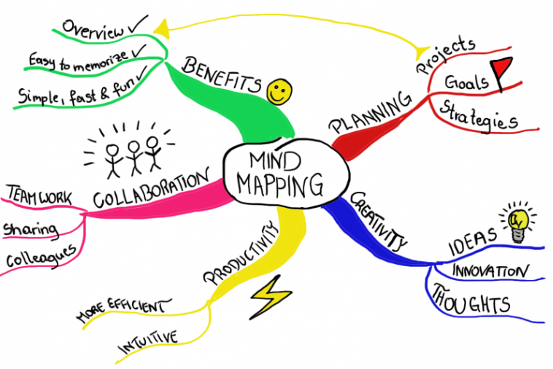
General Advice
Use the specifications and past paper questions to know what you are working towards.
Do something active – highlighters can make a text look much prettier, but reading alone is not enough to remember large amounts of information. Make your own notes or try teaching the material to a classmate.

Slide 4
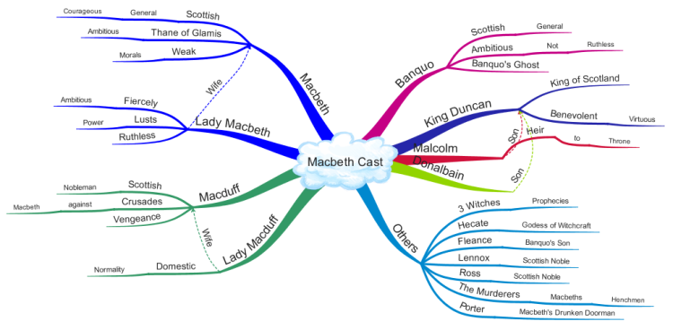
Technique 1 – Mind maps
Mind maps are a useful tool for summarising information on a topic. Start with the topic or key question in the centre and begin by breaking this down into the key ideas, sub-themes or ‘branches’. Then, add on the ‘twigs’ by adding on all related ideas.
Keep the information short, ideally single words
Use different colours for different branches
Make sure all ‘branches’ and ‘twigs’ relate back to the key theme/question
Try to create links between branches – can something fit into 2 sub-themes? What is the link?
Worried about making it messy? Try an online mind map generator:
app.mindmapmaker.org
www.mindmup.com

Slide 5
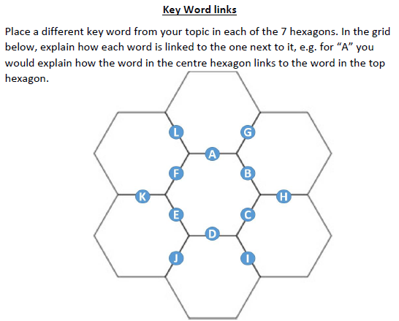
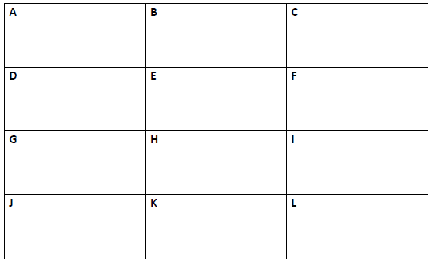
Technique 2 – Key word links
Coming up with key words for a topic is a great starting point, but in an exam you will have to be able to explain the significance of each one or link ideas together to make a point.

Slide 6
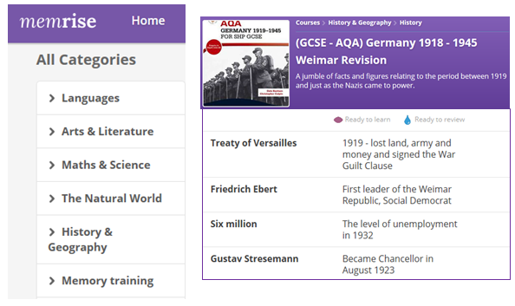
Technique 3 – Retrieval practice
The best way to truly learn something is to test yourself repeatedly: revision, re-revision and re-re-revision.
Using websites like Memrise and Quizlet can be good for learning key words (vocabulary in languages, for example), definitions or equations. These websites work by constantly re-testing you at increased intervals on things you have already learned – you should aim to do the same thing in your own revision.
At the end of a revision session, write yourself a quiz of key questions. When you come back to this subject a few days later or the following week, start by testing yourself on this quiz to check you still remember what you previously revised. Maybe give a copy of the quiz and the answers to your parents so they can test you randomly around the house!

Slide 7
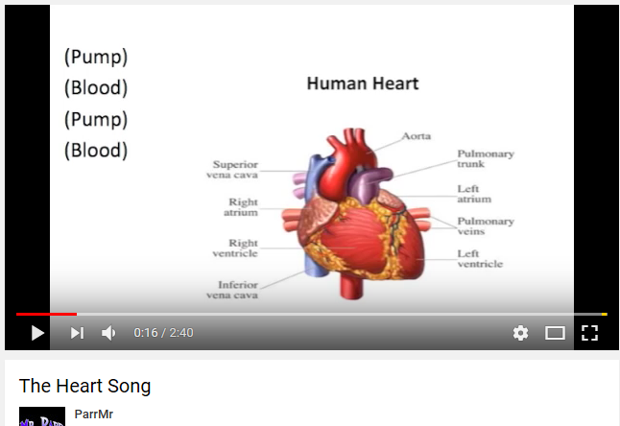

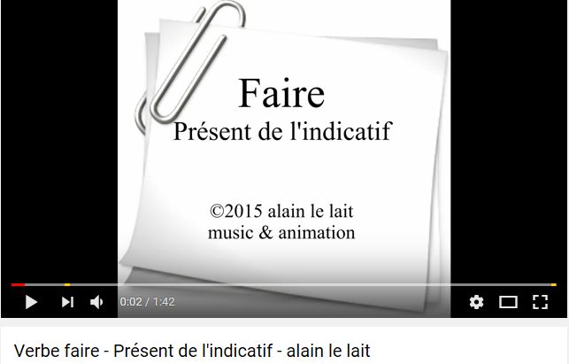
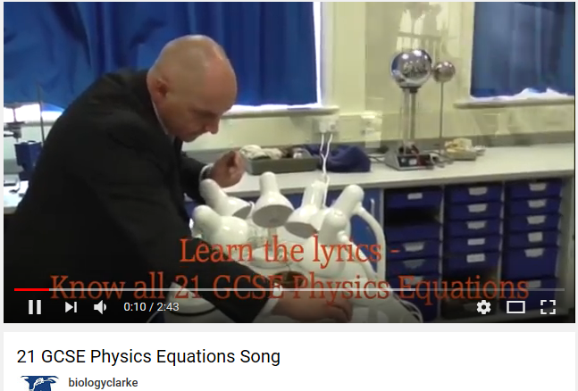
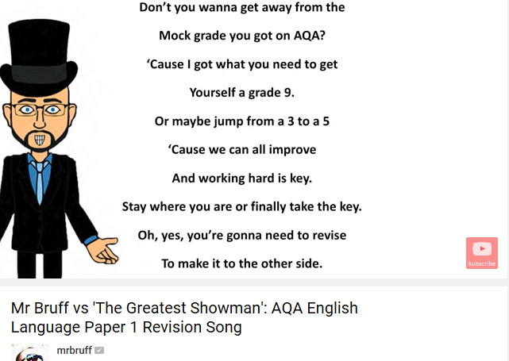

Technique 4 – Learn through song
Your brain is really good at remembering information heard through music. Just turn on the radio and see how long it takes you to sing or hum along to the first song that comes on – you have thousands of song lyrics and melodies stored away in your long-term memory!
See if you can find songs (or write them if you’re particularly musical) that link with topics you are revising. YouTube is a great resource for this.

Slide 8


Technique 5 – Space for a post-it
Use post-it notes with key facts, figures, equations, key words, quotes etc. around your house in the places you see most often –the back of the bathroom door, the fridge, the kettle, the corner of the TV, the outside of the shower or the mirror where you put on your make-up.
Not only will you see these post-it notes every time you go to that place, but you will begin to associate the place with that fact. Try having a different subject in different rooms of the house or on different coloured post-its. In your exam, go on a mental tour of your house to remind you of where the post-its where and what was written on them.
You could even try putting 2 post-it notes on top of each other with a question on top and an answer underneath.
(This is maybe a little too far)

Slide 9

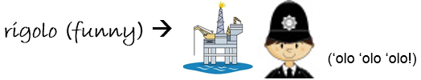
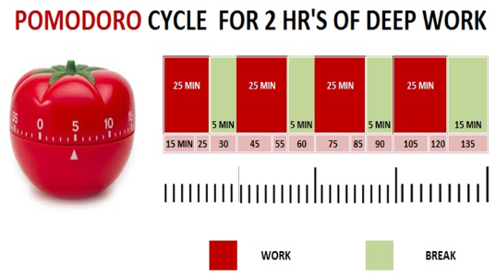
Some other things to try
Record yourself – use the voice recorder on your phone to record yourself reading out some important notes or information and listen back to it while you’re on the bus on before you go to bed.
Make links between things you are trying to remember. Try turning your notes into a story or depicting them through a series of pictures.
Schedule regular breaks. Try the Pomodoro method to keep your brain active (and learn the Italian word for ‘tomato’ at the same time!)

