Slide 1


Success Fair:
A ‘How to Guide’ to Revising the Right Way
General Tips:
Effective revision involves retrieval practice, success relearning, assessing and testing your knowledge too!
Effective revision is just re-reading and highlighting
Revision is individual – find out what works for you; this might be different to what works for someone else!

Slide 2
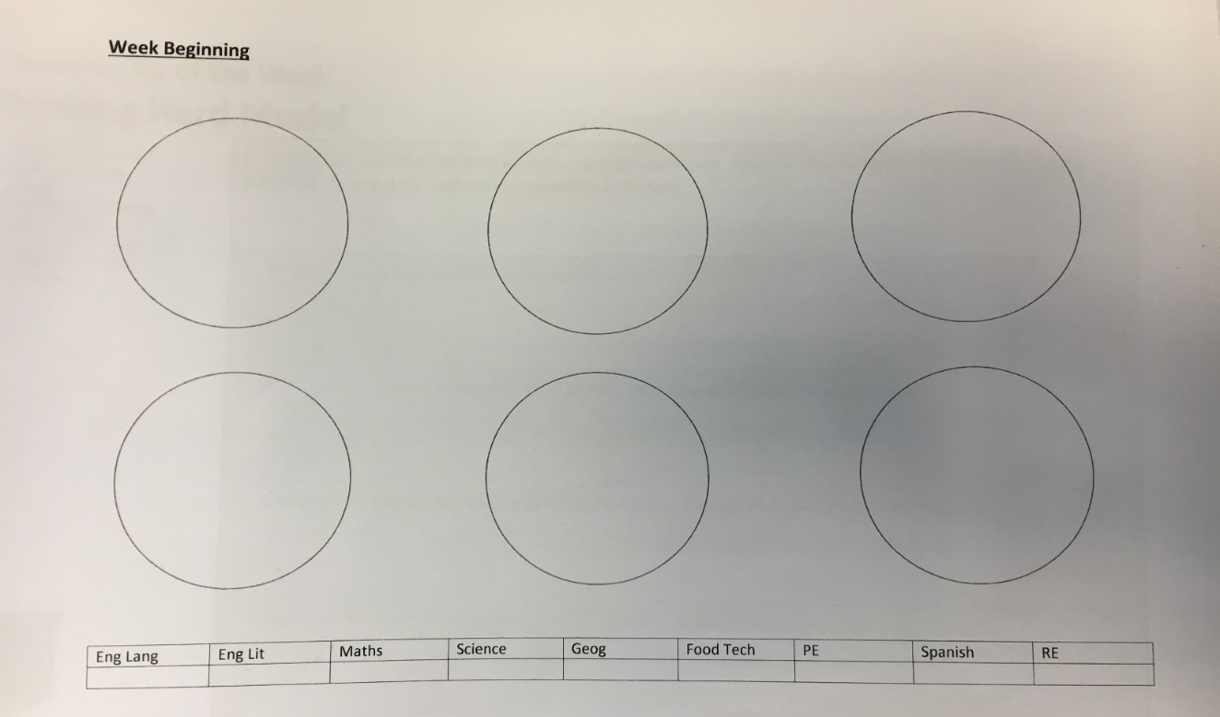
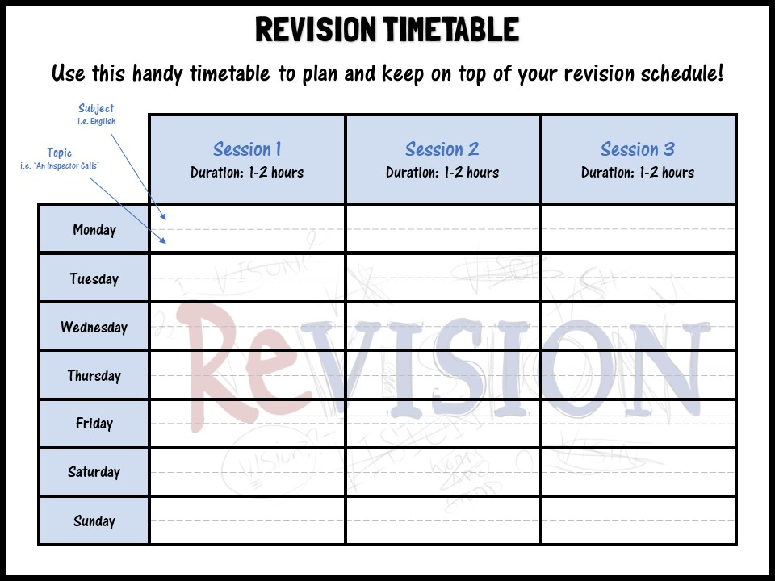
A ‘How to Guide’ to Revising the Right Way
Keeping Track:
Keep a record of everything that you revise
Make a really clear plan before you start
Allows for coverage of all subjects
STAY MOTIVATED!
Reward yourself – take proper breaks and do something for you
Short bursts of revision – little and often is best
Look for gaps and plan how to fill those in

Slide 3
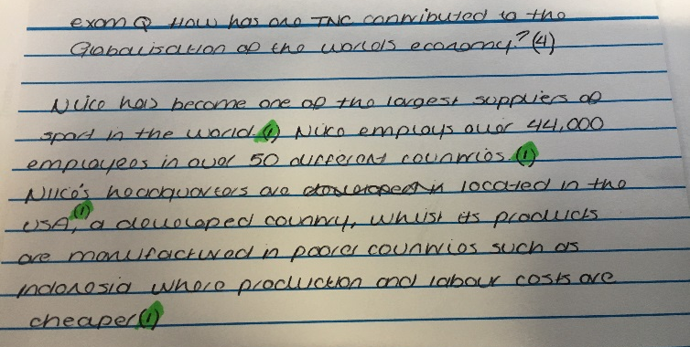
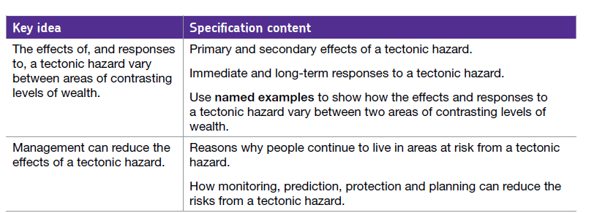
A ‘How to Guide’ to Revising the Right Way
Use the Specification:
Learn what is in the exam
Develop knowledge of the ‘language of the exam’
What are the command words?
How will they phrase the questions
What are the key terms to look out for?
Specifics are sometimes given in the specification
2 examples of an EQ
Haiti (LIC) and Christchurch (HIC)
Effects
Responses
Then you can make up a practice question using the words of the specification:
‘The effects of tectonic hazards are worst in poorer areas’
To what extent do you agree? (9 marks)
3Ps
Link to reducing effects

Slide 4
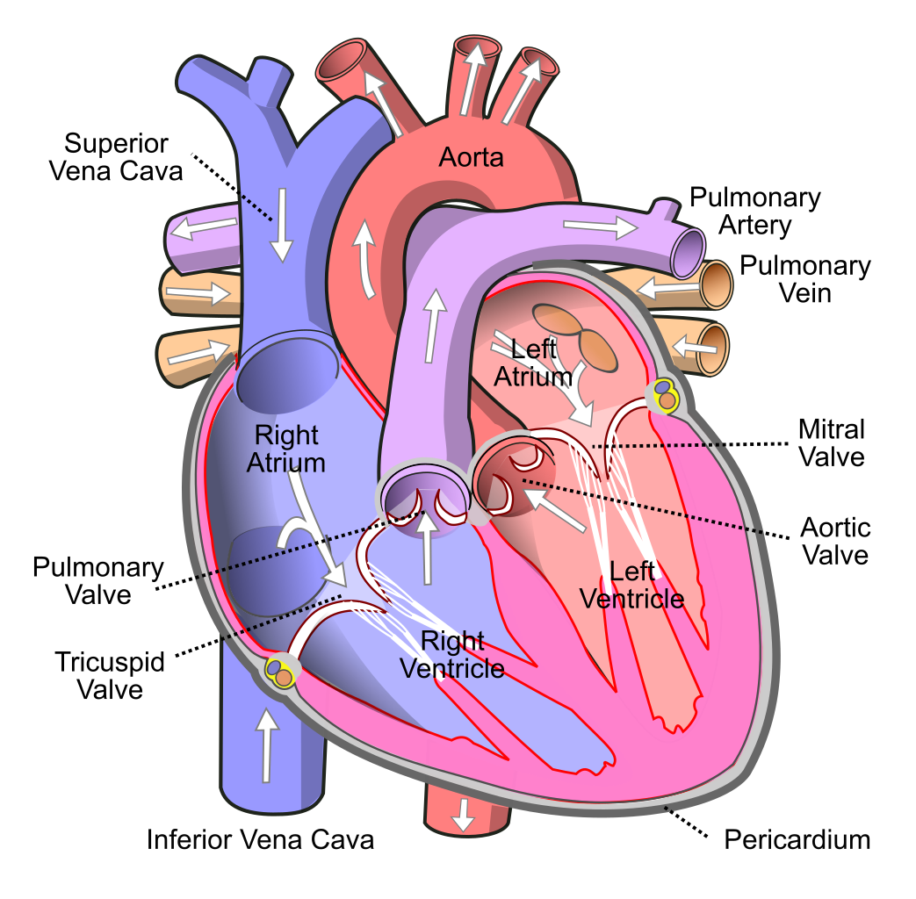

A ‘How to Guide’ to Revising the Right Way
Set Clear Targets:
‘I am going to revise the heart’
OR
Look at the specification and see what is required…
‘I’m going to draw and label the heart to show the flow of blood around the body’
‘I am going to revise Macbeth’
OR
Look at the specification and see what is required…
‘I’m going to revise the key themes and characters from Macbeth’

Slide 5




A ‘How to Guide’ to Revising the Right Way
Taken from the specification
Create a Checklist:
Topic | What have I done?
Causes of WW1 | Revision Clock Practice Qs
WW1: Stalemate | Revision Clock from memory
End of WW1 | Spider diagram Practice Qs
A range of activities including practice and knowledge recall
Pay extra attention to the RED – complete activities to move it to amber/green
This is a really easy way to keep track of what you have done for each subject. You should feel confident that you have revised a full subject when you complete a subject checklist!

Slide 6
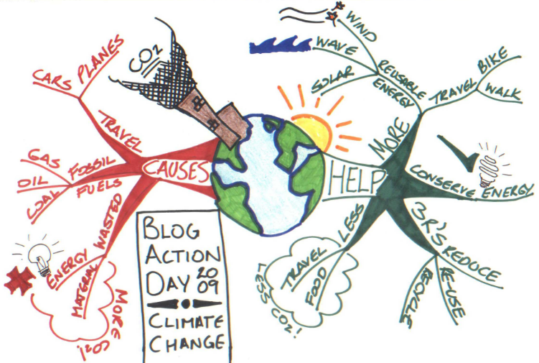
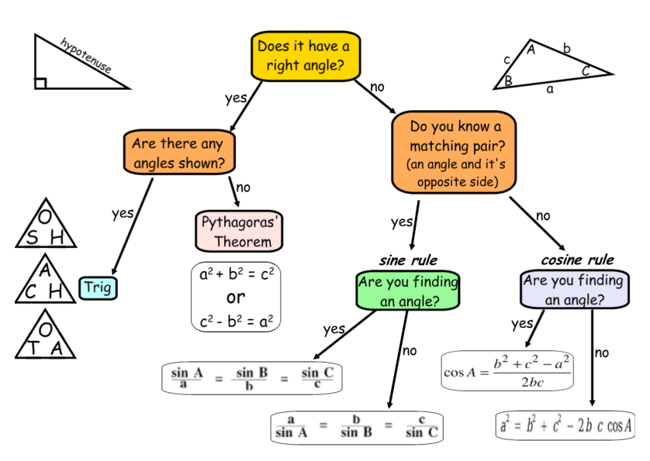
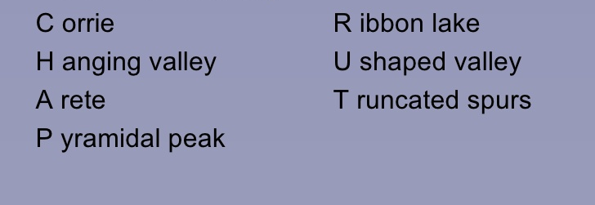
A ‘How to Guide’ to Revising the Right Way
Information Gathering:
Mind Maps
Name of the topic in the middle (taken from the specification)
Add different parts of the topic to it
Use images/colours/highlighters
2. Flow Charts
Particularly useful in subjects like Science, Maths and Geography
Shows understanding of processes
Breaks a subject down into small steps
3. Mnemonics
Form associations with information that is difficult to recall.
Create vivid mental pictures
Make up stories to remember a sequence of information
Glacial Features….’Chap Rut’

Slide 7
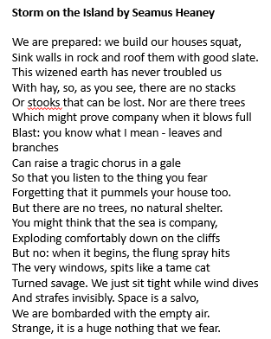
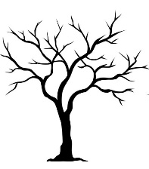

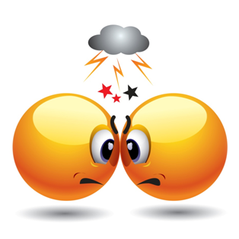

A ‘How to Guide’ to Revising the Right Way
Transform Seamus Heaney’s ‘Storm on the Island’ into images to show the key themes
Reduce and Transform:
‘Sustainable communities are places where people want to live and work, now and in the future. They meet the diverse needs of existing and future residents, are sensitive to their environment, and contribute to a high quality of life. They are safe and inclusive, well planned, built and run, and offer equality of opportunity and good services for all.’
Reduce this definition of a sustainable community into 10 words. What features of New Islington fit this description?

Slide 8
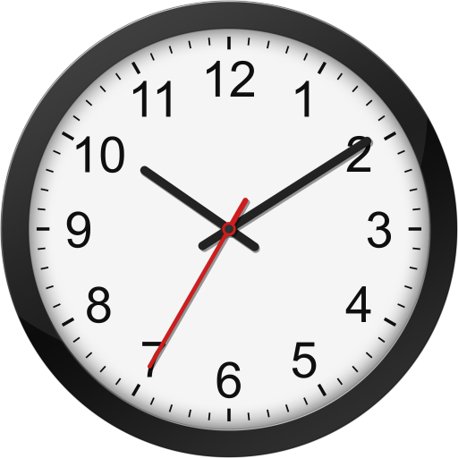
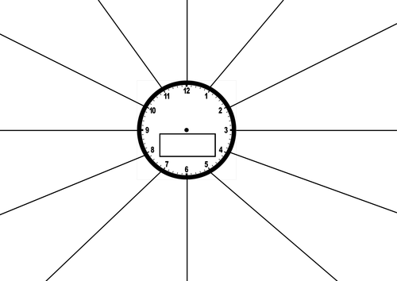
A ‘How to Guide’ to Revising the Right Way
Know the timings of the exam
If you have 30 mins to complete 30 marks, spend about 1 min per mark – eg 9 mins for a 9 mark question
Practice these timings at home
Practice:
Revision needs to be active
For example:
  Complete a revision clock,
  Have a break,
  Complete a timed exam question on what you have just revised,
  Use your revision clock to mark your exam question
To practice recalling knowledge:
Try completing a revision clock from memory
Then using a different colour fill in what you have missed with your exercise book and revision guide

Slide 9

A ‘How to Guide’ to Revising the Right Way
This is the key to revising the right way!
Active Revision:
Some other top tips:
Go back over your old assessments/tests
  Can you redo a question?
  Look at the SMART marking targets – are they complete?
Go back through your exercise books – have you completed all your SMART targets?
What would be the worst question to come up? Write it out and plan an answer
Spend some time practicing what you have learnt
Revisit revised topics a few days later to see what you can remember
Past Papers – these can be found on the website for the exam board
  https://www.aqa.org.uk/subjects/geography/gcse/geography-8035/assessment-resources
Quizzes- BBC Bitesize / Seneca Learning
Quick questions – eg ‘Tell me 3 things about…’
Regular assessments - PRACTISE
Revision should not be an overwhelming task – it might seem like it at the beginning BUT with clear planning, focus and motivation revision will be effective and help students to feel confident and prepared!

Slide 10
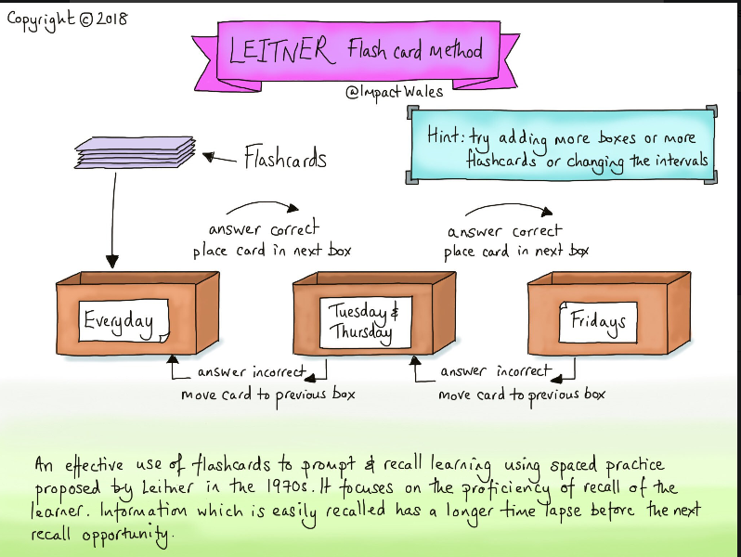

Slide 11


