Slide 1

Poynton High School
GCSE PE and Cambridge National Sport Studies
Filmed Evidence (FE)

Slide 2
Purpose of the PowerPoint
Inform students and parents of examination board requirements.
https://www.ocr.org.uk/qualifications/gcse/physical-education-j587-from-2016/
The link is from the GCSE page but is also applicable to CNAT
Advise students and parents about how we manage those requirements within the department.
Support and communicate to students and parents.

Slide 3
List of Sports – OCR
Team activities
Acrobatic gymnastics | Association football | Badminton
Basketball | Blind cricket | Camogie
Cricket | Dance | Figure Skating
Futsal | Gaelic football | Goal ball
Handball | Hockey | Hurling
Ice Hockey | Inline Roller Hockey | Lacrosse
Netball | Powerchair football | Rowing
Rugby League | Rugby Union | Sailing
Sculling | Squash | Table cricket
Table Tennis | Tennis | Volleyball
Water Polo | Wheelchair basketball | Wheelchair rugby
Individual Activities
Amateur boxing | Athletics | Badminton
Boccia | Canoeing | Cross country running
Cycling | Dance | Diving
Equestrian | Figure skating | Golf
Gymnastics | Kayaking | Polybat
Rock climbing | Sailing | Sculling
Skiing | Snowboarding | Squash
Swimming | Table Tennis | Tennis
Trampolining | Windsurfing
Highlighted = off-site activity
Red (bold) = new activity

Slide 4
Activity lists
This can be found on the OCR GCSE PE webpage (see 1st slide for link and next slide for document) and should be referred to for further support. The list may change at times and the electronic copy will be automatically updated on the website
All off-site activities must have Filmed Evidence (FE) that is sent away to the examiner – this is due to the activities being less accessible for schools to provide in-house or for live moderation
Activities that are more readily available in school and at live moderation can still have FE submitted, especially if the student plays at a higher level that the school level. This will help to support a higher score if applicable

Slide 5
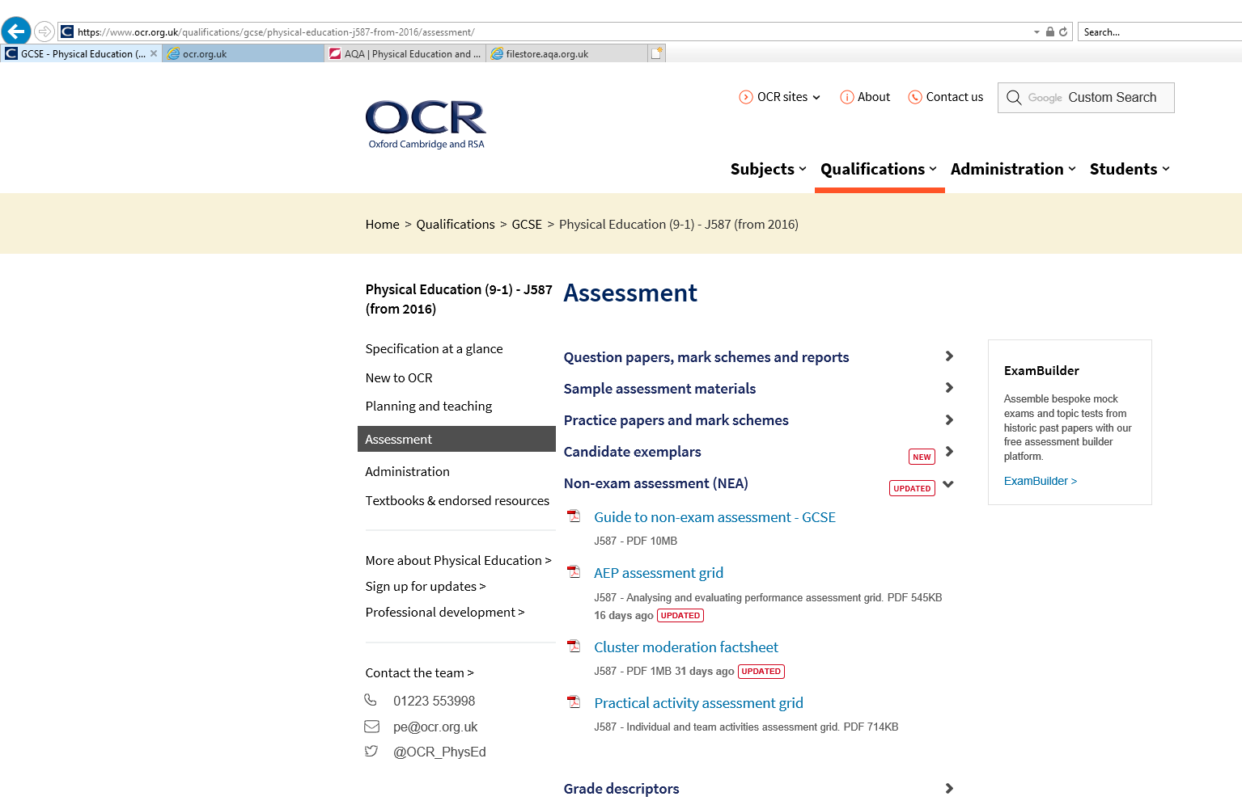

Slide 6
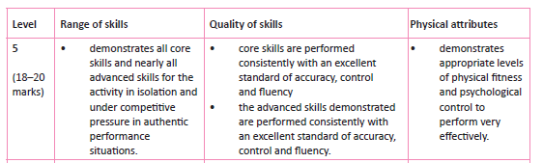
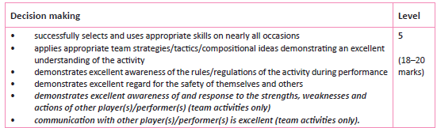
Assessment Grid for Practical Sports
This can also be found on the OCR GCSE PE website (Guide to NEA). It breaks down the scores given for practical activities
Scores are based on how the student performs in school and/or on the FE, so if FE is all we have it is really important that it is well executed

Slide 7
Key points about footage
Core and advanced skills may be filmed in isolation
All sports must be filmed in fully competitive context (i.e. game play, racing)
Make sure you identify yourself on the video i.e. share at the start of the video say your name into the camera and show your number (if appropriate)
There cannot be any editing during full competitive play except for batter/wicket keeper in cricket and some elements of equestrian activities
Footage must be good quality
You must highlight where you are at the beginning and throughout the performance by highlighting/circling yourself
Footage must be focused on you - don’t share footage
Please use a tripod/someone with a steady hand or position camera on something
Label clips
You need to start filming summer sports now – you won’t have next summer!
Please don’t get caught out with the weather/injuries
Use different angles if possible
Add a commentary to the video or a supporting written document to direct the viewer to the areas needed

Slide 8
Footage content
Each sport has a criteria that must be demonstrated/visible on the FE
It is broken down into core and advanced skills
All core skills must be demonstrated to achieve the higher scores. For example in Equestrian a high level performer who doesn’t include footage of tacking up because they see if as an ‘easy’ skill cannot score as well as they maybe should as they have not included all core skills in the footage.
Off-site FE is extremely important. This is the only evidence that we have to base a score off and if is isn’t sufficient enough then scores will be low. For example, we have had extremely competent swimmers but they have failed to provide competitive evidence from galas and so could not score them well no matter how good the skills content from training was.
One race or one floor routine in gymnastics is not enough. Multiple competitions are required to demonstrate consistency.

Slide 9
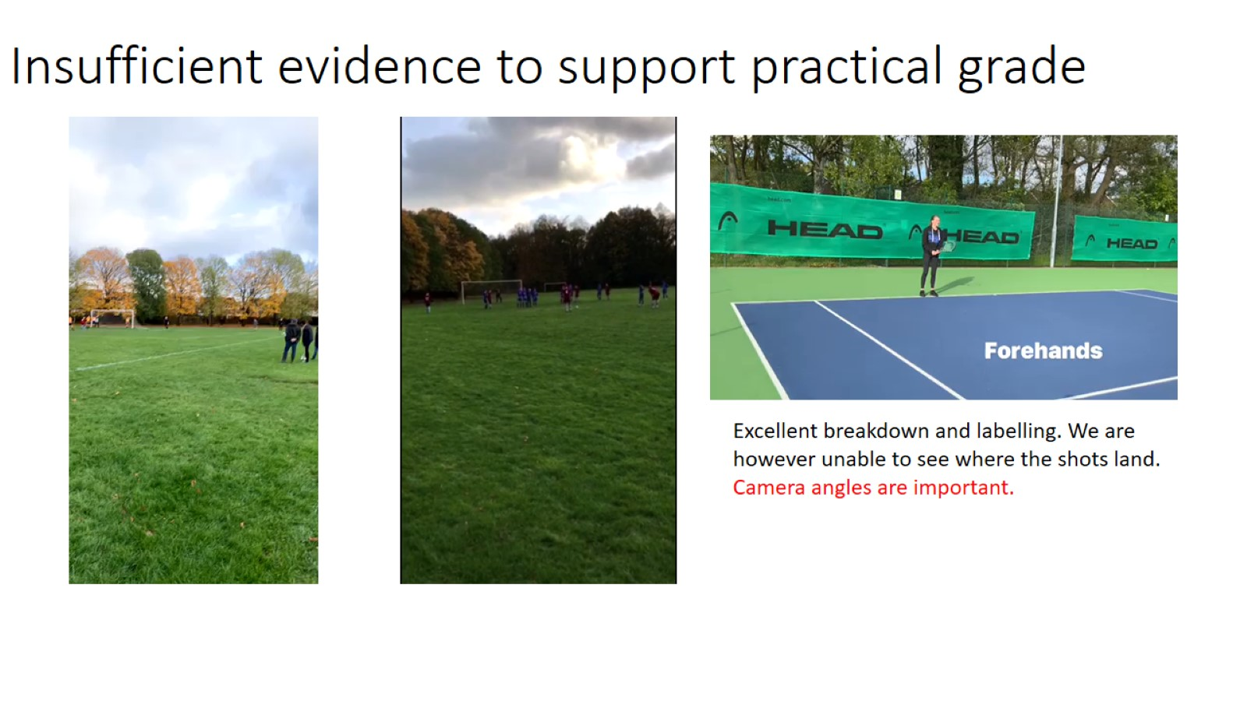
Insufficient evidence to support practical grade
Too far away and poor lighting

Slide 10
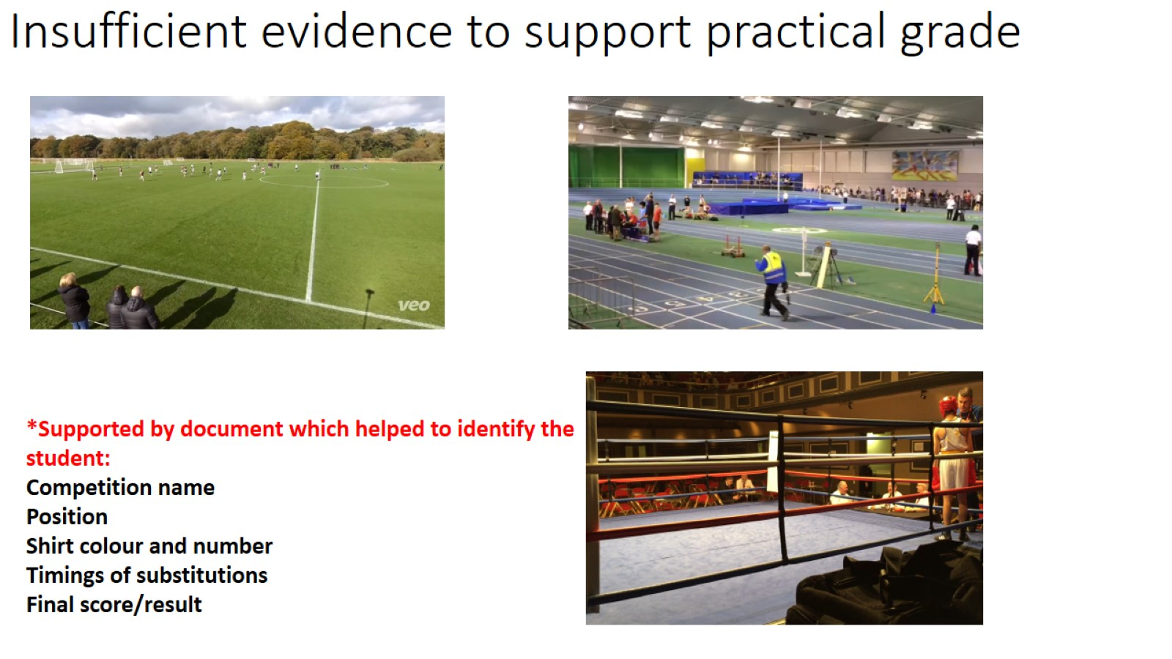

Slide 11
Examples of FE
The link below has some previous FE that students have completed.
The longest Skiing FE and the Equestrian FE are good examples (although the Skiing FE is missing competitive footage as it was not required at that time)
For Skiing competition students need to be competing to get the highest scores – if they aren’t but are very good skiers they can complete a number of timed runs to help increase their score but they will struggle to get the top marks due to lack of competition.
The GoPro Skiing FE is not suitable at all for FE submission. We cannot identify the student and it doesn’t show any technical display
The indoor Skiing FE would not score very high at all. It shows limited skill, the student is difficult to identify until right near the end and it isn’t labelled
The Table Tennis footage is from a good angle and shows hits and returns in a competitive game – it would benefit from another angle to see technical elements more closely and it would need to be supported by skill footage, ensuring that the student is also identified on the footage
PE videos for Parents

Slide 12
Student Profiles
All students need to have 3 assessed activities for GCSE and 2 for CNAT, ensuring that they meet the individual and team sport requirements for GCSE (1 team, 1 individual & then either/or for the 3rd activity)
Assessed & moderated internally – teachers assess students and then it externally moderated by OCR
Must be competitive (can include drill work)
Filmed Evidence (FE) needs to be submitted
Students need to plan ahead
All students will cover at least 3 sports during their GCSE/CNAT lessons, however, the time in lessons and on each sport will be limited so increasing ability is difficult, so students need to ensure they are committing to extra curricular or practicing outside of school. The next slides give examples of this.

Slide 13
Example 1 – Student 1
Plays rugby for Stockport rugby club. Footage will be needed as we cannot show LIVE footage on moderation day due to safety reasons
Plays school football – We would expect full commitment to school sport / clubs / lessons
Has no third sport…
This student will need…..
Rugby footage – from Stockport Rugby Club
Football footage – from school, live on the day or via video
Badminton/Athletics (individual) – in school, examined in school – expect full engagement in core and exam practical lessons. Must try to attend lunchtime or afterschool club,

Slide 14
Example 2 – Student 2
Swims for local club. FE will be needed to be sent to the moderator (off-site activity)
Has no second sport
Has no third sport
This student will need…
Swimming video footage – from local club (stroke work) MUST have competitive evidence of 2 events from numerous galas – not just training videos
Student must attend extra-curricular clubs in school (e.g. badminton and netball, athletics etc.), and participate full in core and exam practical lessons

Slide 15
Example 3 – Student 3
Plays academy football. Footage will be needed to help secure a higher score
Plays tennis for local club. Footage will be needed this summer. The same for Cricket, Athletics….Footage can not be collected during Year 11 Summer as footage has already been submitted.
No third sport
This student will need…
Academy football footage – Competitive games
Summer footage– from school, local club matches filmed from summer of Year 10, keep scorecards, records etc.
Badminton (individual) – in school, examined in school – Must try to attend lunchtime or afterschool club, participate in core and exam practical PE lessons with full engagement

Slide 16
Link for exam board advice
Assessment guide: Filming for NEA (J587)
This link is from OCR directly and reiterates what has been communicated in this PowerPoint.
It also breaks down some of the activities, giving advice on how and what to film, and the format to use for presenting the evidence

Slide 17

Students can hand in any footage at any time up until the final deadline. This is good practice as it allows teachers to assess the footage and decide if more footage is required rather than leaving it until the very end
Initial deadline: July Year 10
Final deadline: December Year 11

Slide 18
Any Questions?
Contacts
Mr Henderson (Head of PE) mhenderson@phs.cheshire.sch.uk
Mr Shaw (Coordinator of CNAT Sport) kshaw@phs.cheshire.sch.uk
Miss Wilson (Coordinator of GCSE PE) cwilson@phs.cheshire.sch.uk
Mrs Kennedy akennedy@phs.cheshire.sch.uk
Miss Hancock jhancock@phs.cheshire.sch.uk
Mr Megarrell cmegarrell@phs.cheshire.sch.uk

