Slide 1

APPRENTICESHIPS
SUPPORTING STUDENT PATHWAYS

Slide 2
Overview
The following guidance has been prepared to share with teachers, careers advisers and anyone else in the education sector supporting students, based in England, to make informed choices about their future.

Slide 3
Contents
Part 1: What apprenticeships are, their benefits, and how they work.
Part 2: How to understand the different apprenticeship levels and the choice of roles available.
Part 3: How UCAS can help support advisers and their students explore apprenticeship pathways.
Notes:
We’re constantly developing the Hub to keep improving the experience for students to enable them to make fully informed decisions:
The more the Hub is used and interacted with, the more personalised and useful the information will be.
Some examples:
Course recommendation updates for more personalised suggestions to aid decision-making.
Day in the life apprentice videos are a way for young people to see peer mentors doing an apprenticeship in a subject area they’re interested in to help them work out if an apprenticeship or traditional degree route is right for them
New subject guides – expanded list with a careers and outcomes focus, and a clearer view on routes and pathways into different subjects and careers
Peer-to-peer content guiding students through the decision-making process and laying out the options plus the pros and cons, clearly
Coming soon:
Personalisation phase 2 for Q1 2024, focusing on careers and subjects to help funnel students through more relevant UCAS content at the right time in their decision-making journey. This will be linked to what they favourite, and their onboarding responses.

Slide 4

Part 1: What’s an
apprenticeship?
It’s a real job where students learn, gain experience, study for a qualification and get paid.
An apprentice is an employee, with a contract of employment and holiday leave.
Over 650 different apprenticeships available, from Nuclear Engineer to Architect to Digital Marketer.

Slide 5
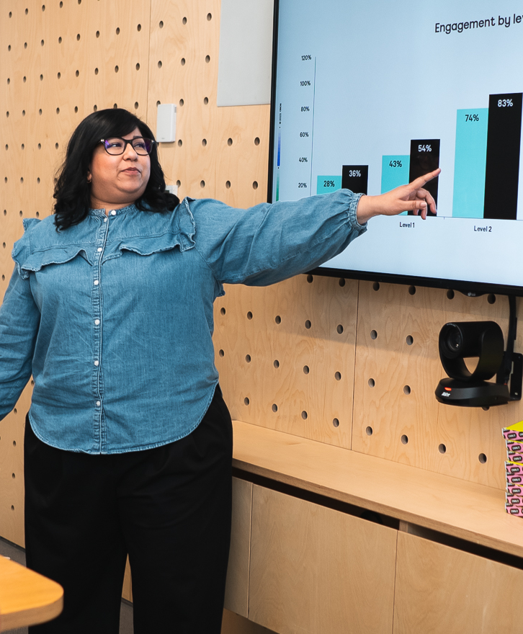
What are the
benefits?
Apprenticeships are funded by the Government and/or the employer so apprentices don’t have loans or tuition fees.
Wages vary depending on the industry but salaries can often be very competitive.
By the end of an apprenticeship, they’ll have the right skills and knowledge needed for their chosen career.

Slide 6

How does it work?
An apprenticeship takes between one to six years to complete.
Apprentices typically work for a minimum of 30 hours a week (and most will work full time, between 37 – 40 hours per week). Part-time options are also available in some cases.
Apprentices have time away from their day-job protected for study. This tends to equate to about a day a week and is also paid time.

Slide 7
Part 2: Apprenticeship levels
LEVEL 2
LEVEL 3
LEVEL 4+
LEVEL 6-7
Intermediate
Advanced
Higher
Degree
Job roles include Nuclear Operative, Junior Estate Agent, Rail Engineering Operative, Finance Assistant.
Job roles include
Chef De Partie, Fashion Assistant, Veterinary Nurse, IT Solutions Technician.
Job roles include Marketing Executive, Journalist, Clinical Dental Technician.
Job roles include Aerospace Engineer, Police Constable, Cyber Security, Ecologist.
GCSE
A LEVEL
FOUNDATION DEGREE+
BACHELOR’S OR MASTER’S DEGREE

Slide 8

Types of
apprenticeships
There are over 650 different apprenticeship roles to consider. Here are some examples:
Architect
Cyber Security Technician
Finance assistant
Software developer
Accounting & Taxation
Game Programmer
Boat Builder
Journalist
Solicitor
Event Assistant
Auto technician
Youth Worker
Civil Engineer
Sports Coach
Digital Marketer
Personal Trainer

Slide 9

Part 3: How UCAS can support
Students can use the UCAS Hub to:
explore industries, employers, locations, careers and jobs
shortlist their favourites
find out where to start
find out how to apply

Slide 10
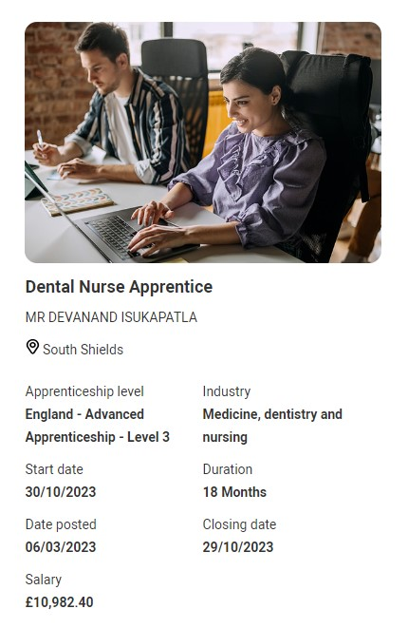
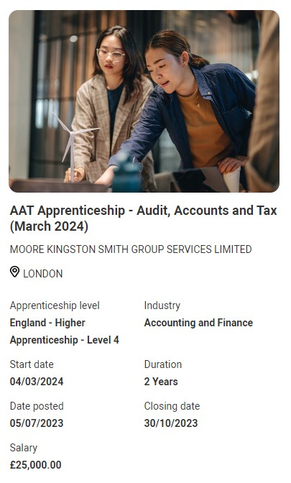
NEW: Student pathways side by side
For the first time students can now see apprenticeship opportunities alongside undergraduate courses.
The UCAS Hub enables them to explore all their options and build a profile in one place.

Slide 11



NEW: Smart Alerts
Smart alerts are a new matching service offered by UCAS.
The service enables students to be matched to regional vacancies.
Smart Alert Sign Up
Data Entry
Matching
Students register for Smart Alerts in their Hub account.
Students enter information on their preferences such as location and area of interest.
If this matches an employer’s search criteria, then they are invited to apply.

Slide 12
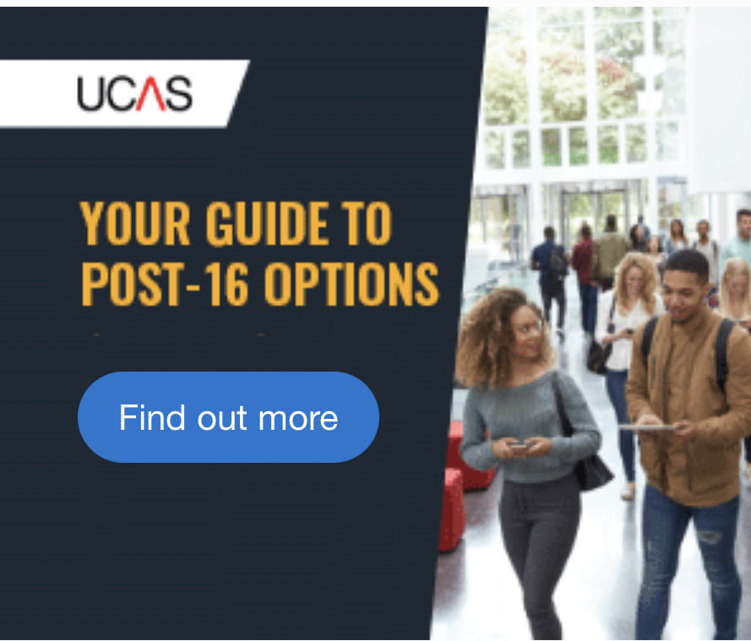
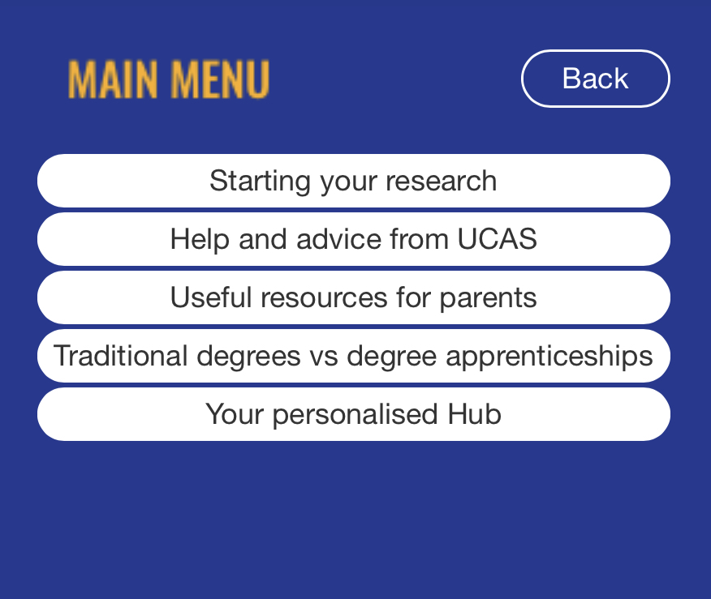
NEW: UCAS Widget
The newly updated UCAS widget can be hosted on your school or college’s website or Virtual Learning Environment (VLE) to link your students and parents to relevant pages on ucas.com.
From starting research to comparing different pathways the widget enables the user to go direct to relevant pages for help and guidance.
Find out more: www.ucas.com/widget

Slide 13

The student journey
Smart Alerts
Student defines interests and can sign up to get matched to potential employers in their area.
Advisers signpost students to the UCAS Hub
Student
registers in UCAS Hub
Explore undergraduate & apprenticeships
Build a profile
Search
for vacancies
Make an application
Everything in one place
Understand the options and access the
latest advice and guidance.

Slide 14

Visit www.ucas.com/apprenticeships

