Slide 1
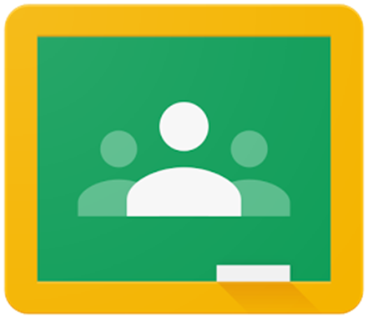
Google classroom

Slide 2

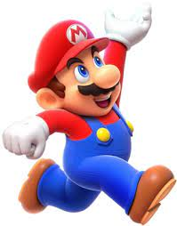



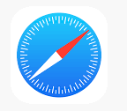
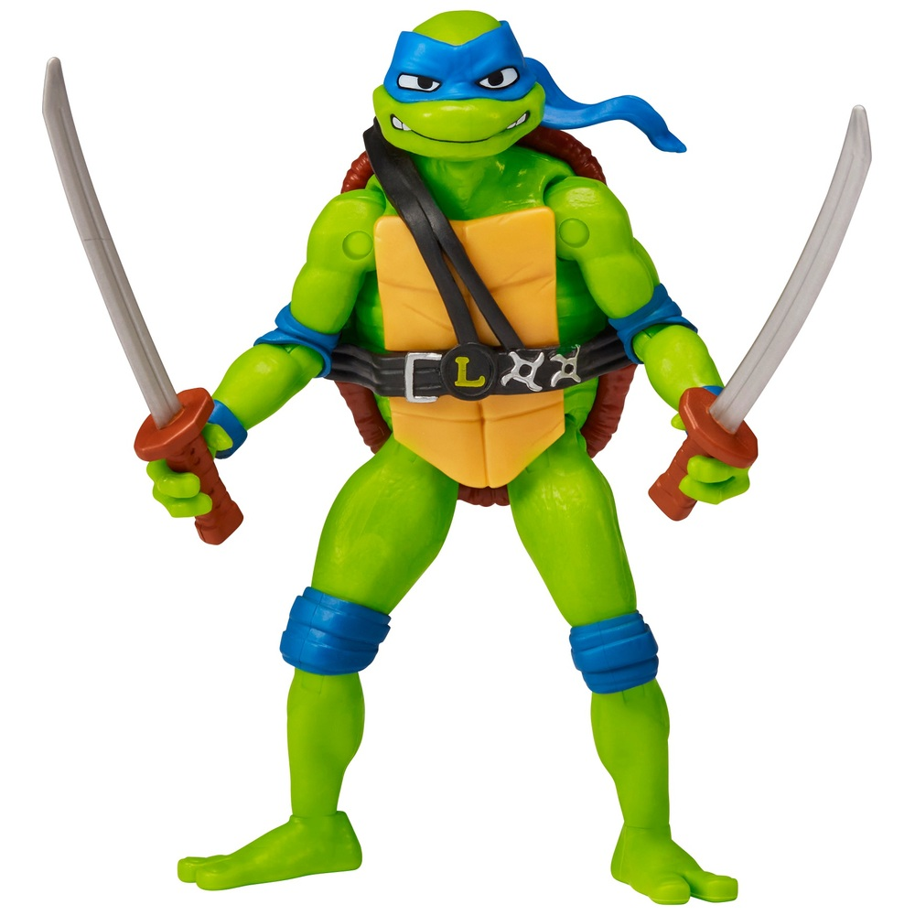


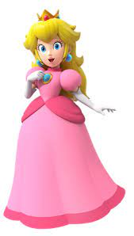






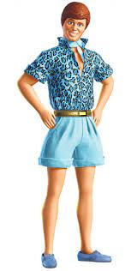
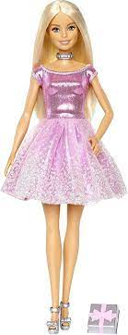



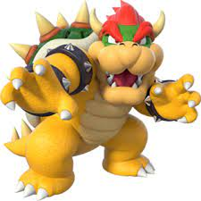


Can you name the characters, apps and games…
1 | 2 | 3 | 4 | 5 | 6 | 7 | 8
9 | 10 | 11 | 12 | 13 | 14 | 15 | 16
17 | 18 | 19 | 20 | 21 | 22 | 23 | 24

Slide 3
Can you name the characters, apps and games…
1 Facebook | 2 Mario | 3 Roblox | 4 Whatsapp | 5 Xbox | 6 Safari | 7 Leonardo | 8 Little mermaid / Ariel
9 Kirby | 10 Google chrome | 11 Minecraft | 12 Google | 13 Peach | 14 Firefox | 15 Google drive | 16 Apple
17 Fortnite | 18 Ken | 19 PlayStation | 20 Uno | 21 Bowser | 22 Fishdom | 23 Youtube | 24 Barbie

Slide 4
Google classroom login
Username…
“23 - first 4 letters of surname - first initial”
For example, for Joseph Smith in Year 7
23smitj@phs.truelearning.org.uk
Password…
Poynton22
Please note the capital P

Slide 5
School computer login
Username…
“23 - first 4 letters of surname - first initial”
For example, for Joseph Smith in Year 7
23smitj
Password…
“Phs - 8 digit date of birth” (please note the capital P)
For example, if born on 17th March 2010
Phs17032010
You will be asked to reset this after your first login

Slide 6
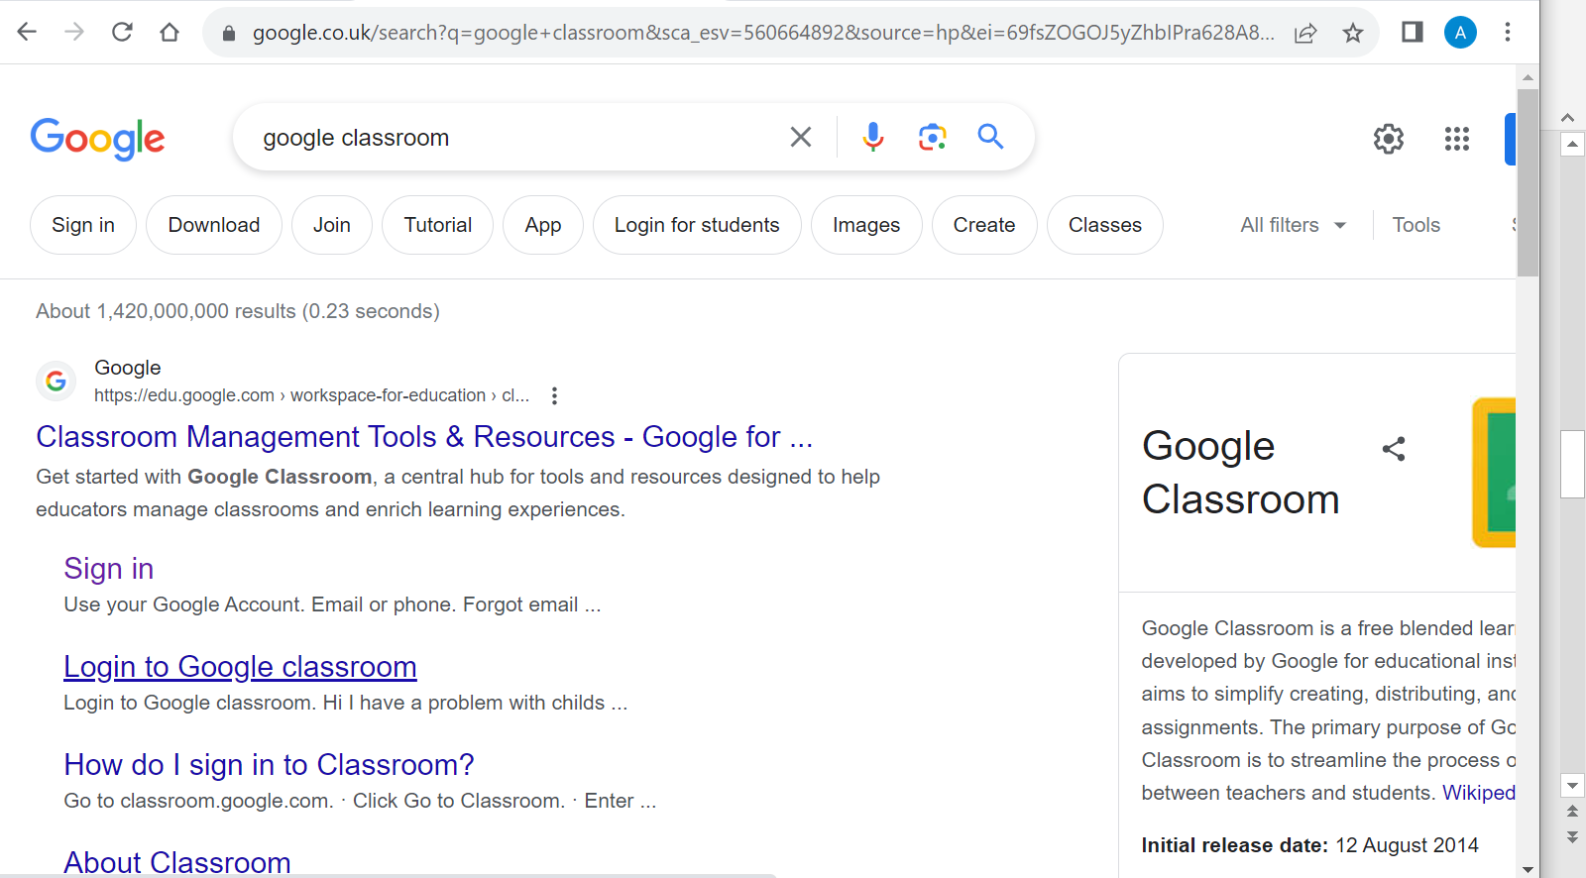
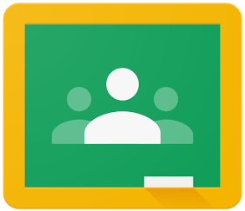
How to find things on google classroom?
Simply type in google classroom in your search engine and sign in using your details

Slide 7
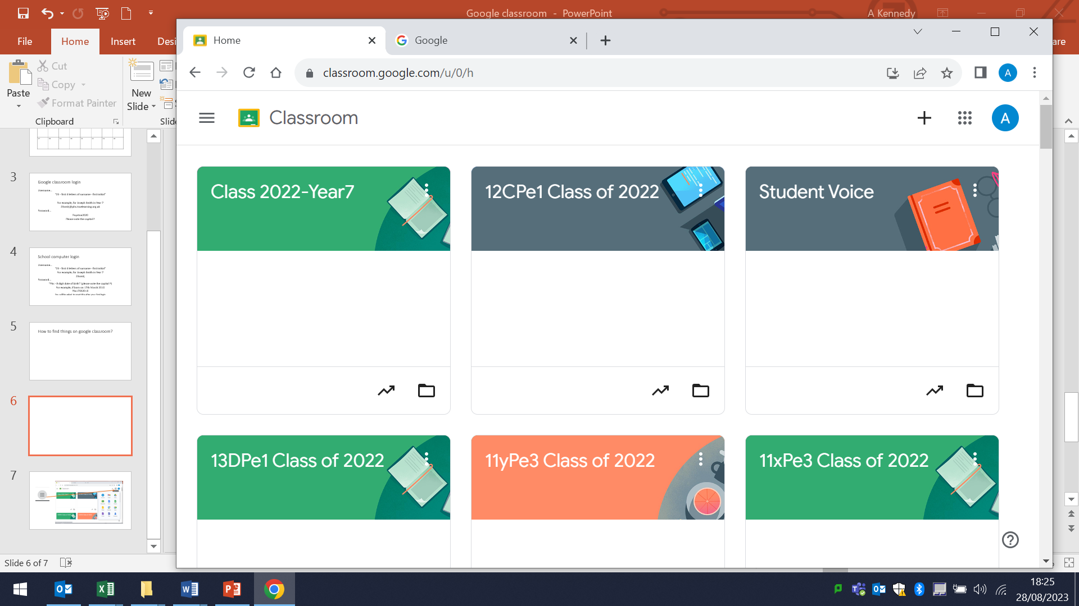
This symbol will take you to your…

Slide 8
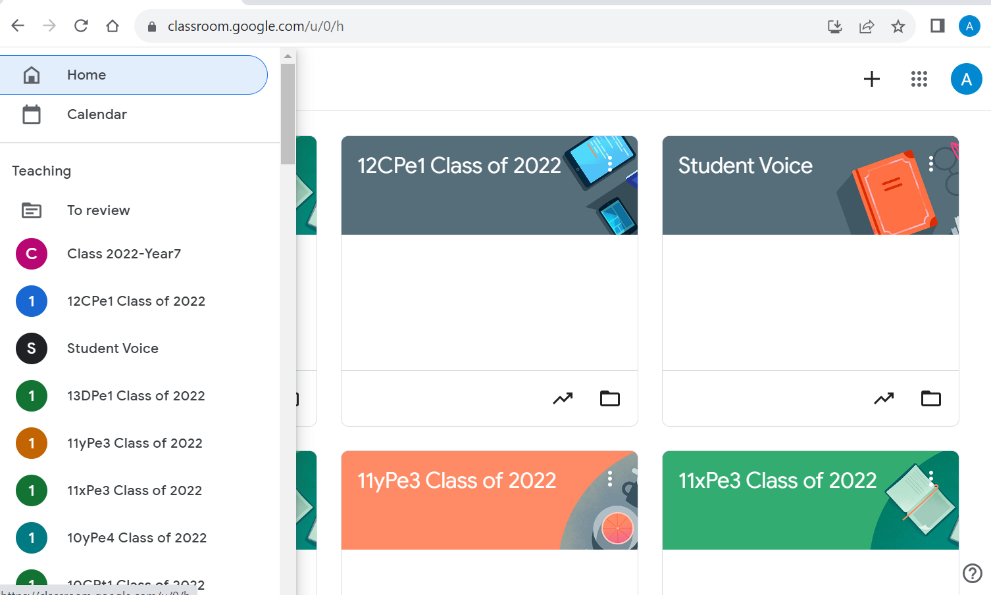
…Classes

Slide 9
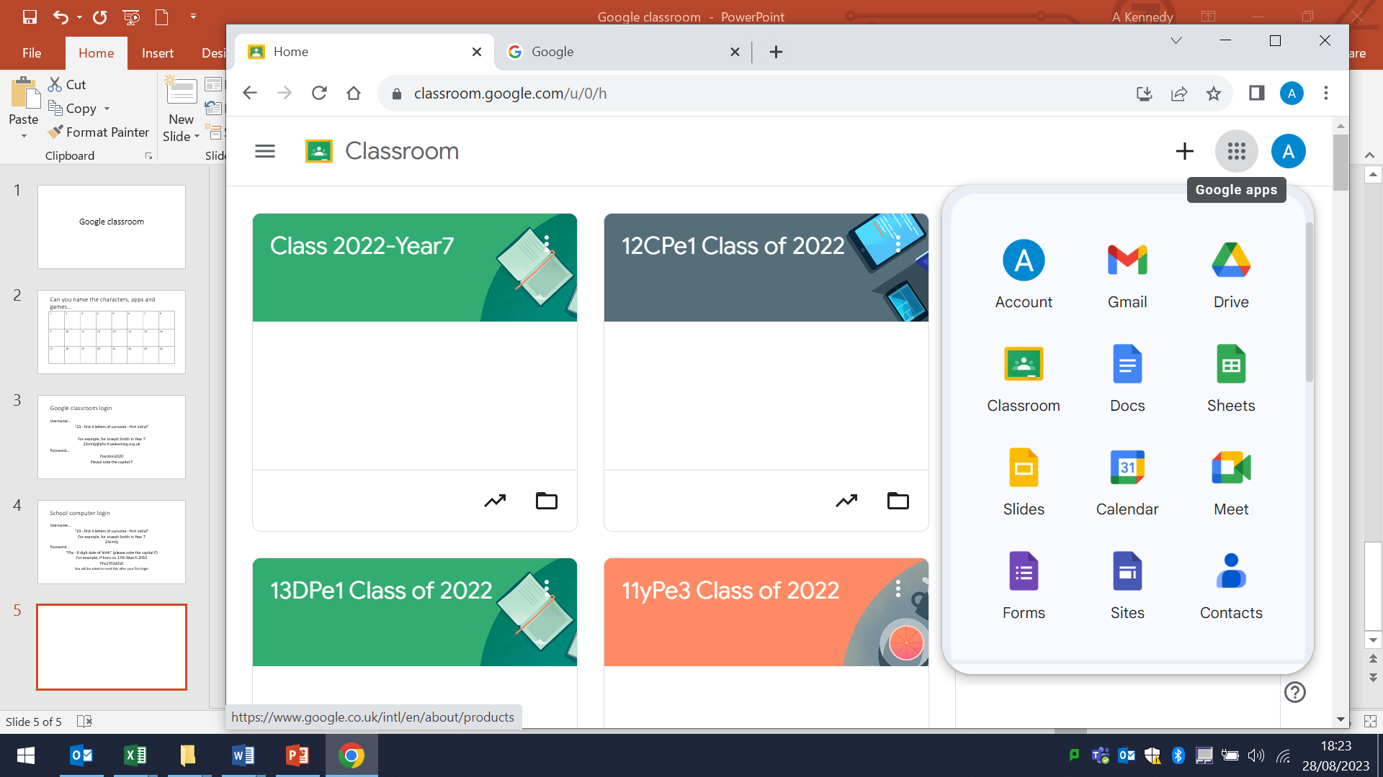
This symbol will take you to…

Slide 10
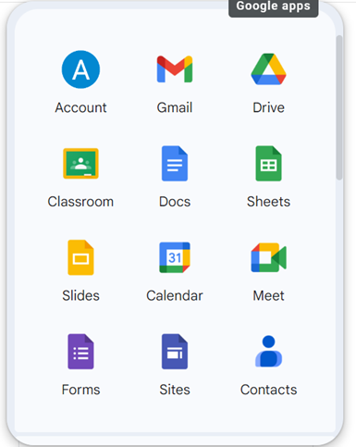
…Google apps

Slide 11
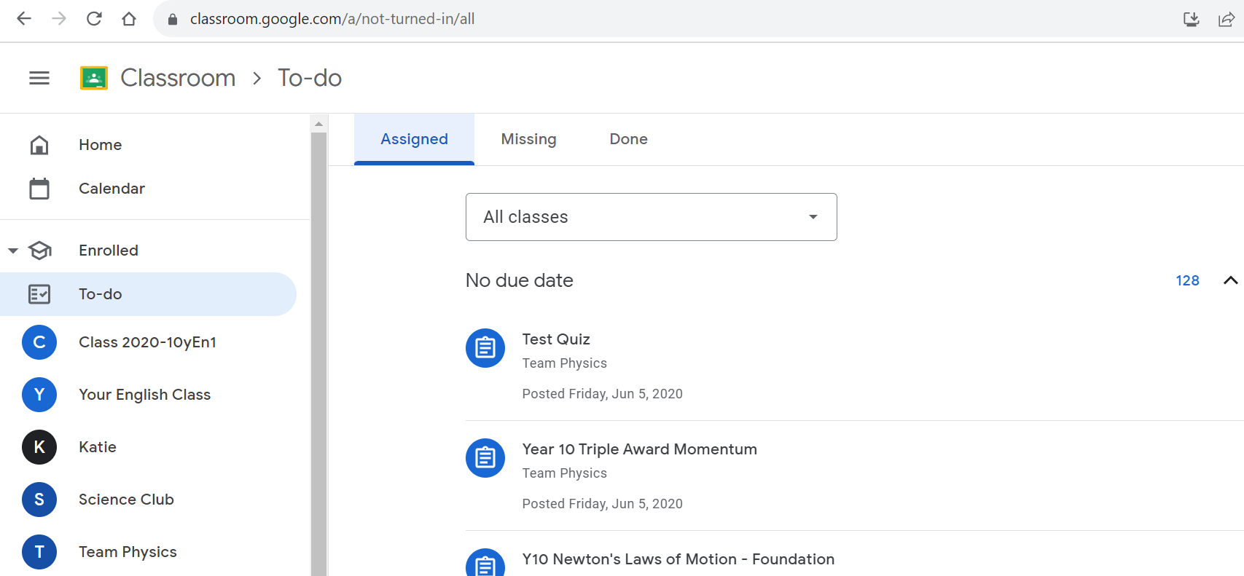
How to find homework?
The best way is to click on your ‘To do’ list…
This will list all homework for all subjects so you don’t need to click individual classes

Slide 12
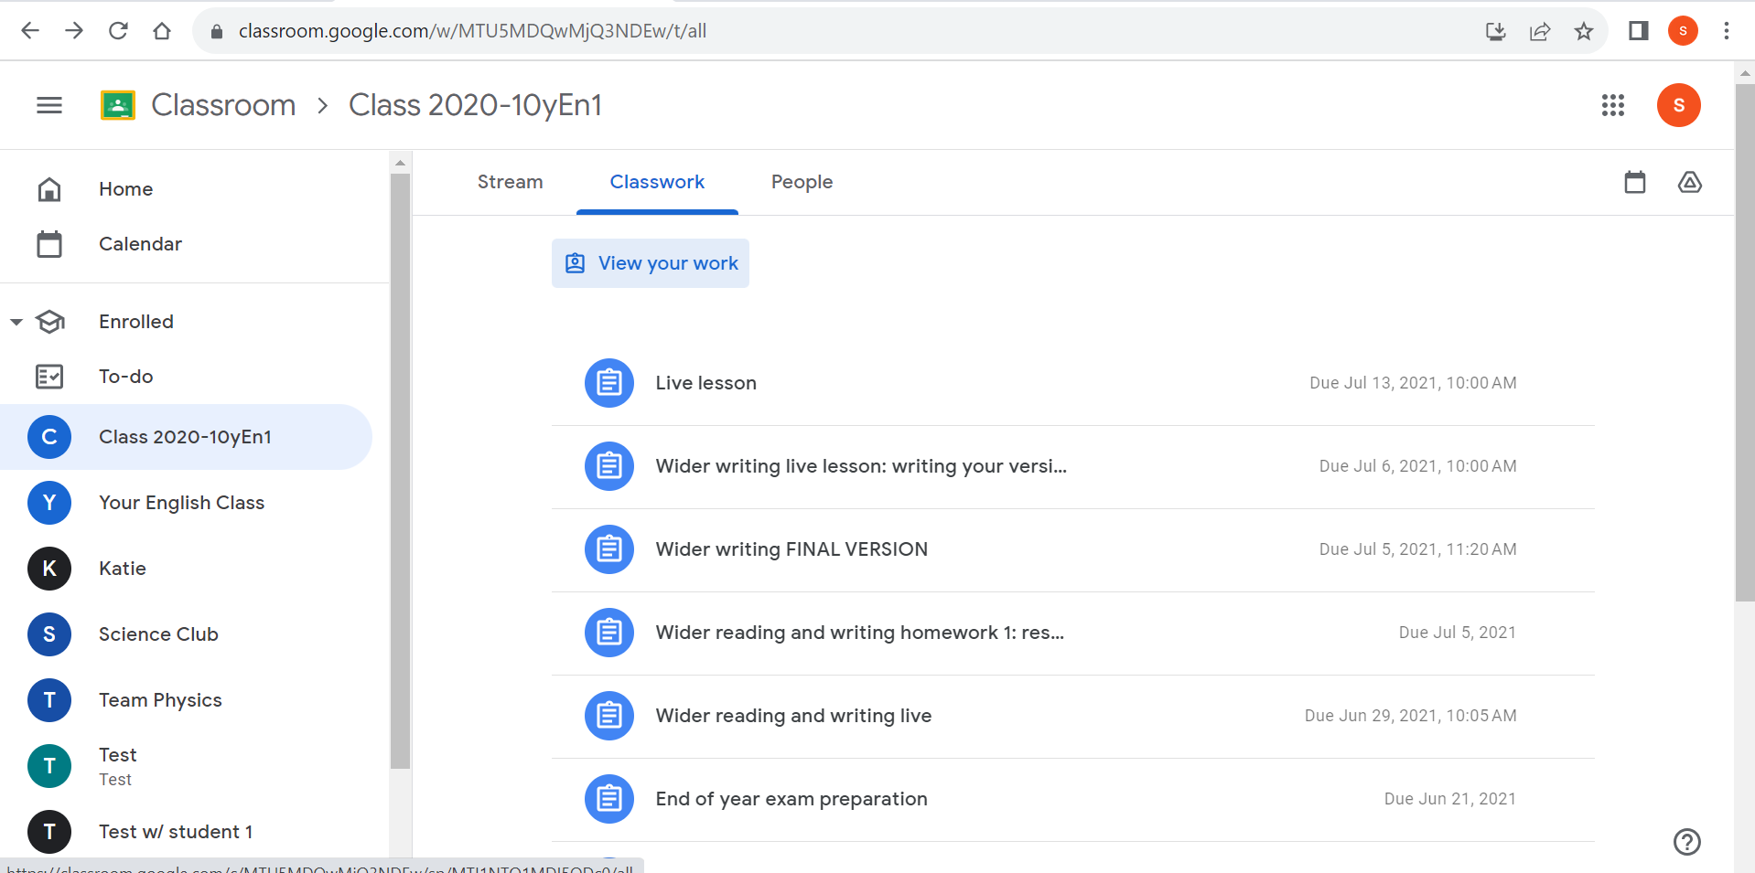
2. Click a class, classwork and then view your work

Slide 13
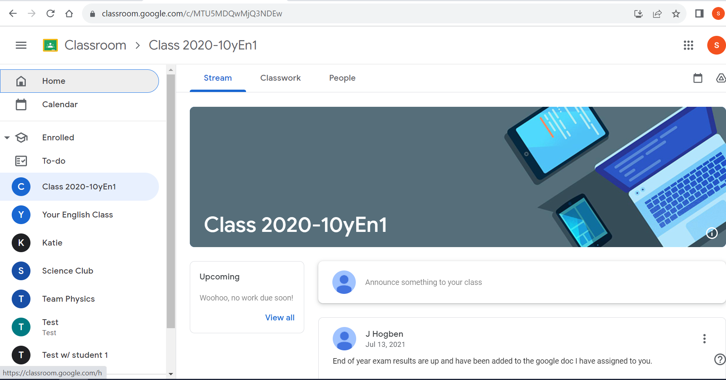
3. Click your class, stream, upcoming tells you if you have homework for that subject

Slide 14
Where do I go if I can’t log in?
Network support which is located in the old sixth form building opposite the year office.
If you forget your password or are having trouble logging on.
No homework is set until Monday 18th September so use this time to familiarise yourselves with google classroom, log on and see your classes.

Slide 15
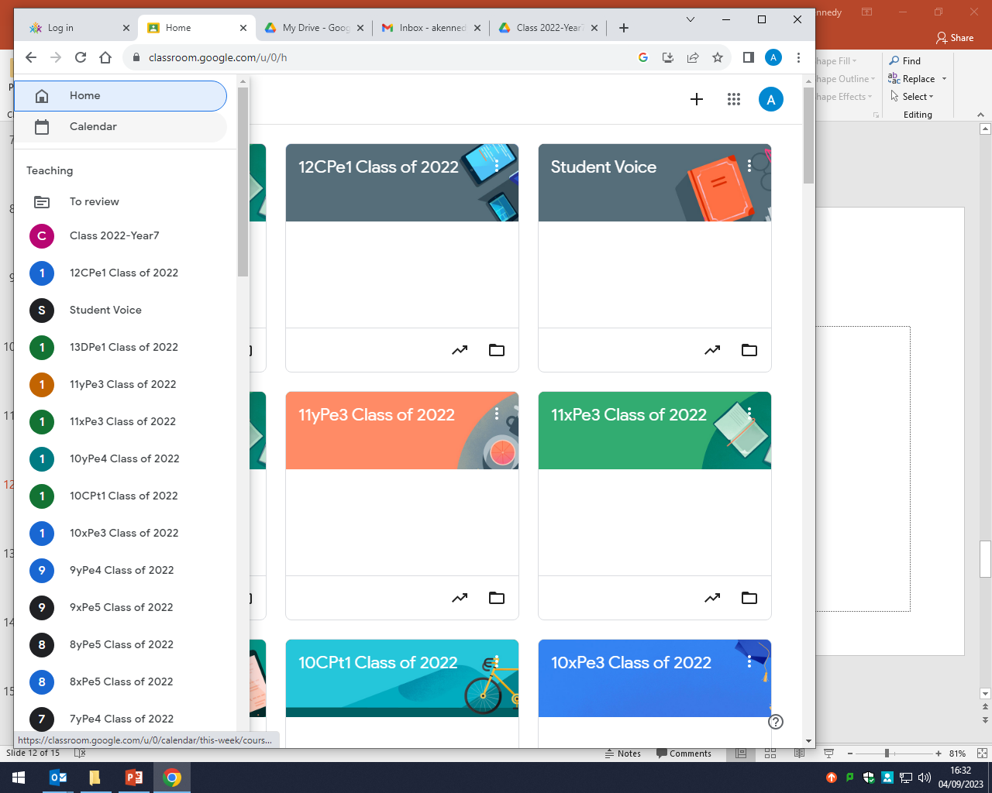
Where can you find the most detailed Calendar?

Slide 16
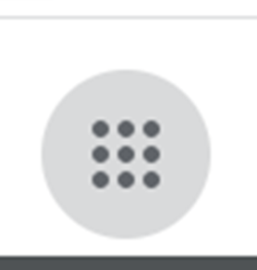
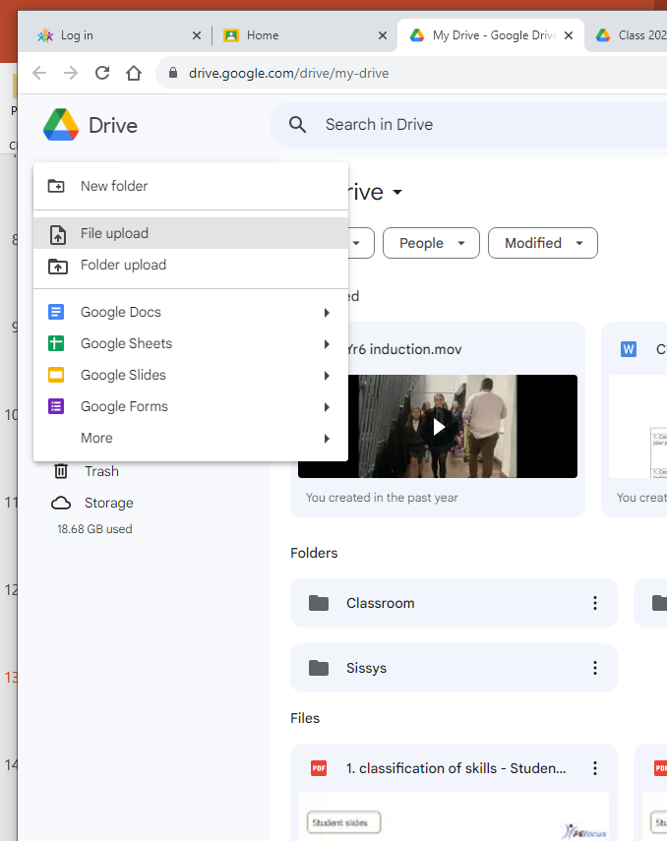
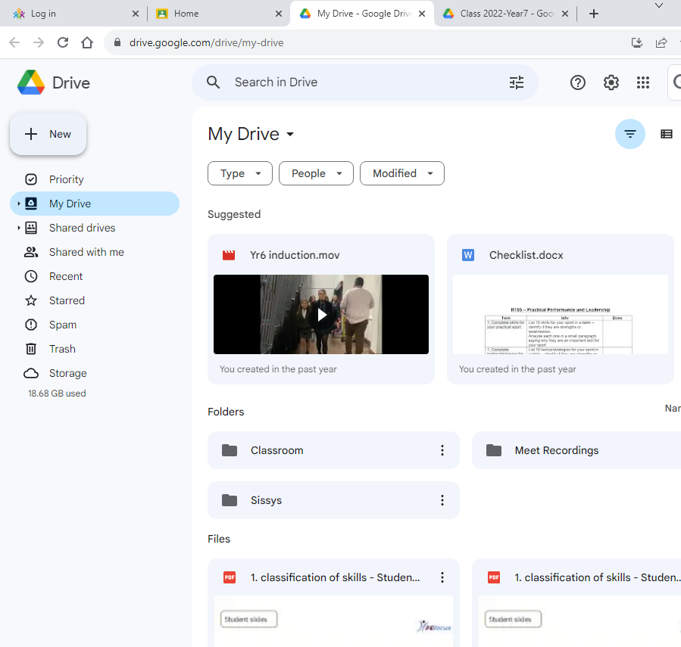
Where can you store work online to upload to GC?

Slide 17

What apps do you need to install to effectively use GC on your phone or tablet?
Google classroom
Google drive
When you download these apps google will ask you for your passcode or face recognition as a way of using the apps.

Slide 18

How do you download a file that your teacher has sent out?
If you are on a computer there will be a download button
If you are using a phone or tablet you will be given the option to download to either your phone/tablet or google drive as it will depend on the size of download.

