Slide 1
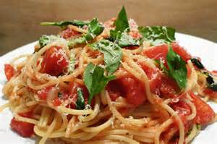
Pasta in Tomato Sauce
Learning objective: Today we are learning… how to cook pasta, so that… we can combine it with tomato sauce to produce an economical dish.
Method
Collect equipment.
Half fill the saucepan with cold water.
Put the pan on full heat and bring to the boil.
While you are waiting, peel and chop the onion.
Add the pasta to the pan once the water is boiling, check the clock and boil for 15 mins.
Heat the oil in the frying pan, add the onion and fry for 5 mins
Drain the pasta in a colander over the sink.
Add the tomatoes and herbs to the onion and simmer for 5 mins.
Mix the pasta into the sauce.
Put it into you container and sprinkle with cheese.
Wash up
Recipe
200g/8oz pasta (any shape)
1 onion
75g/3oz cheddar cheese or a little parmesan
1 tsp mixed herbs/handful of fresh herbs
400g/14oz tin of tomatoes
1 tbs oil
Equipment
Chopping board
Colander
Vegetable knife
Saucepan
Wooden spoon
Large container to take home
Dietary Information
Swap the pasta for gluten free pasta
Swap the cheese for dairy free cheese

