Slide 1
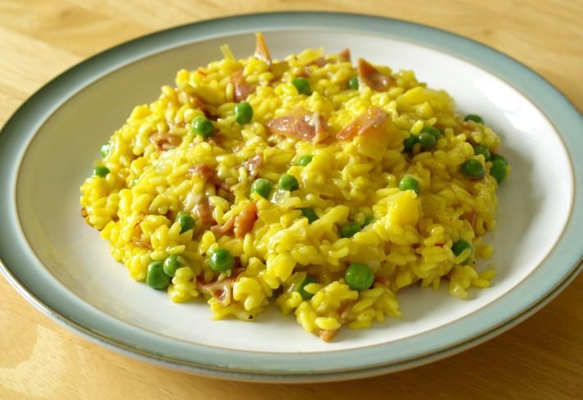
Savoury rice
Making date: ___________
Method
Collect equipment
Rinse the rice under cold water in the sieve
Cover with cold water and add the stock cube
Bring to the boil and cook for 10-12 mins.
Chop vegetables into small pieces
Put oil, and all the vegetables into the 2nd pan and fry for 3 minutes on a medium heat.
Drain the cooked rice in the sieve.
Add the cooked rice to the cooked vegetables.
Put into your container.
Wash up.
Basic Recipe
1 onion (peeled and chopped at home)
1 clove of garlic (peeled and crushed)
225g (8oz) long grain rice
1 stock cube
Containter to take savoury rice home
Possible Additions
1 X 180g can tuna fish drained & brought into school in a Tupperware container
75g (8oz) Cheddar cheese grated at home
2 X 15ml spoons (2tablespoons) chopped parsley
1 courgette / 1 pepper (any colour) / 100g mushrooms
Equipment to get out at school
2 Large saucepans
Wooden spoon
Measuring jug
Container & name label
Sieve
Chopping board
Vegetable knife
Food Facts
Long grain rice is used for savoury dishes such as curry.
Take Home Tips
To reheat: Microwave for 4-5 minutes.
Or:
Cover with foil and reheat for 20 minutes200°C/Gas mark 6.

